Slide 1
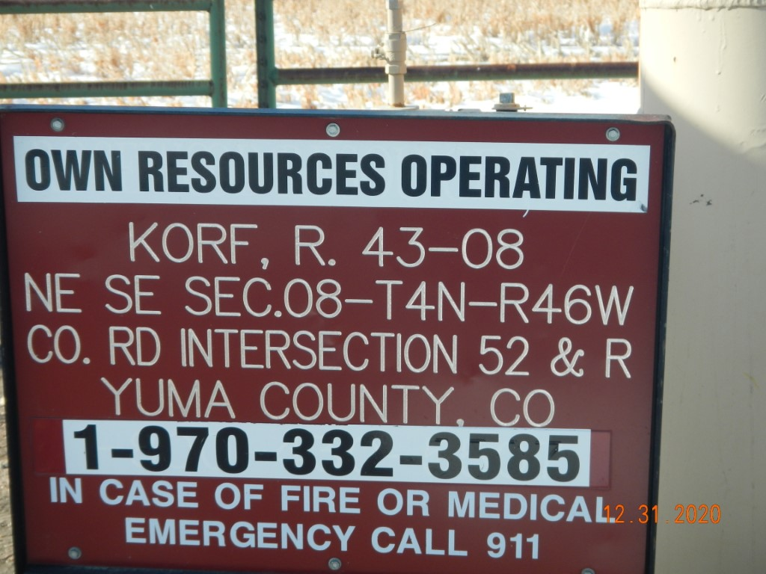
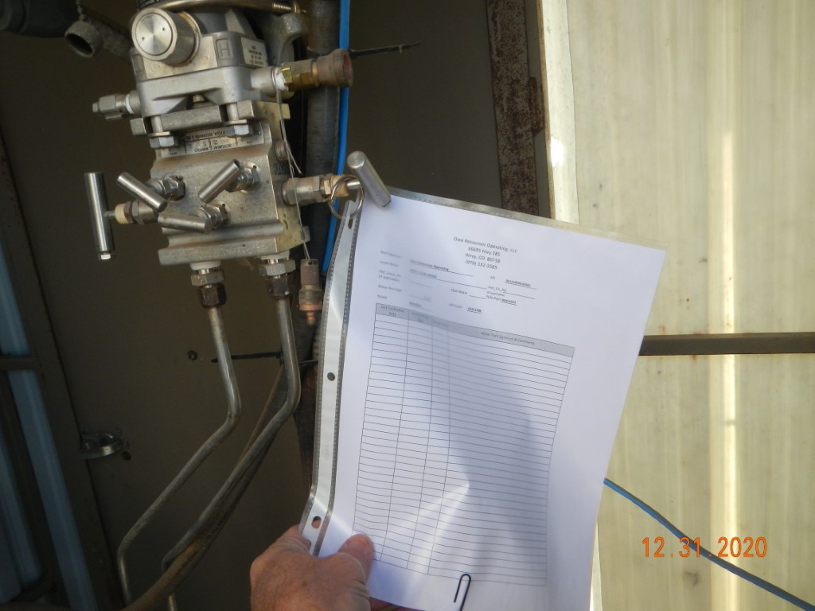
Operator Name: OWN
Facility Name: Korf 43-8 Location ID# 125-09805
Signage @ GMR
Calibration cert @ GMR

