Slide 1
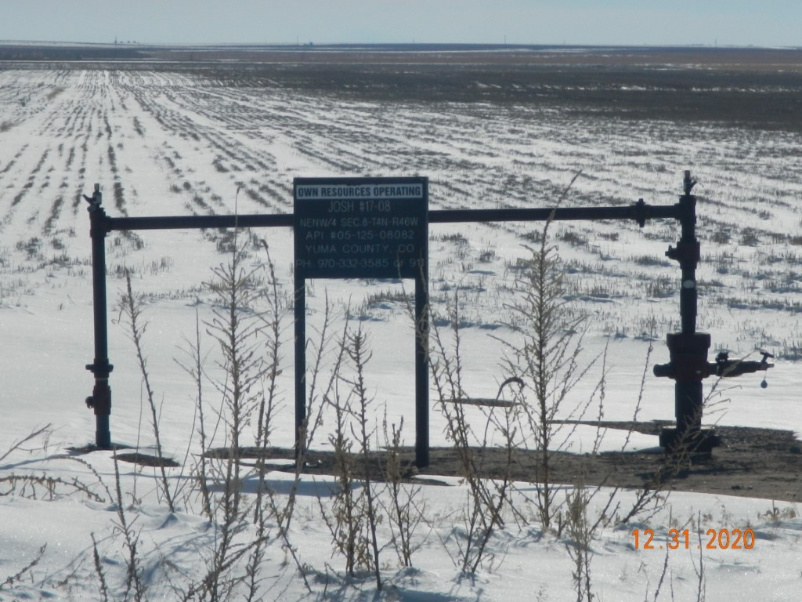
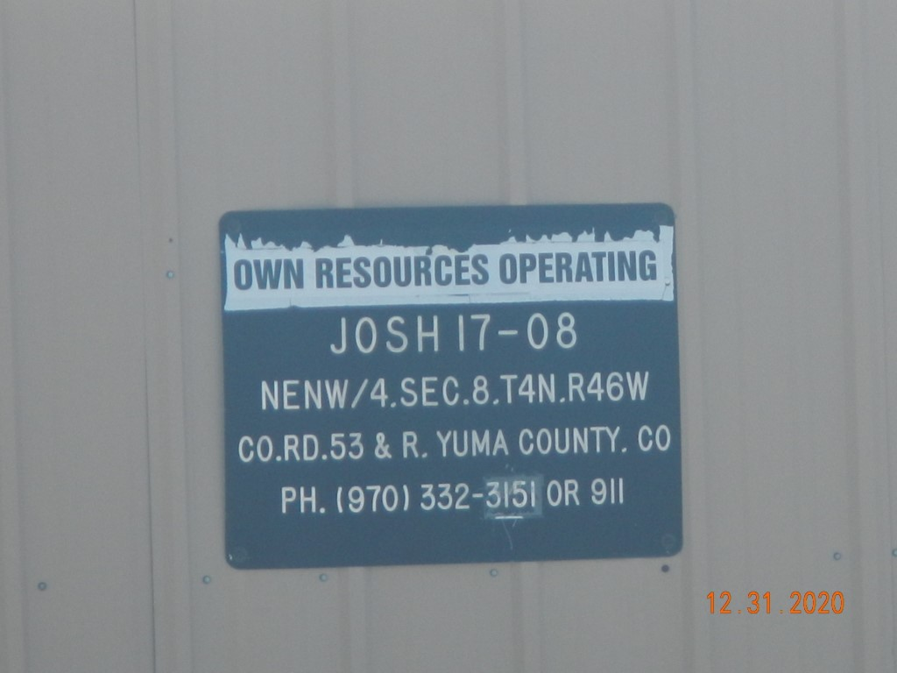
Operator Name: OWN
Facility Name: Josh 17-8 Location ID# 125-08082
Signage @ Wellhead
Signage @ GMR

