Slide 1
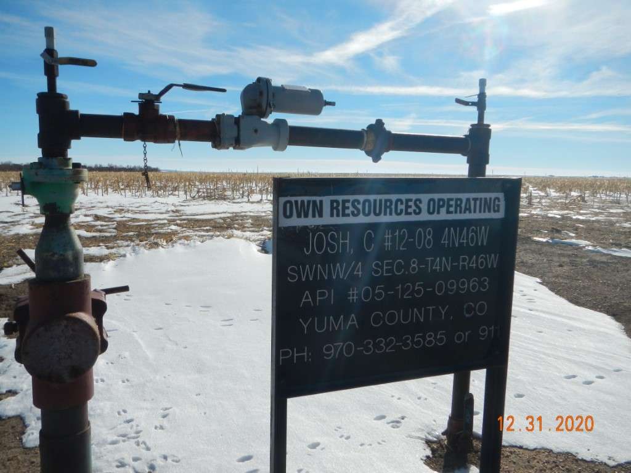
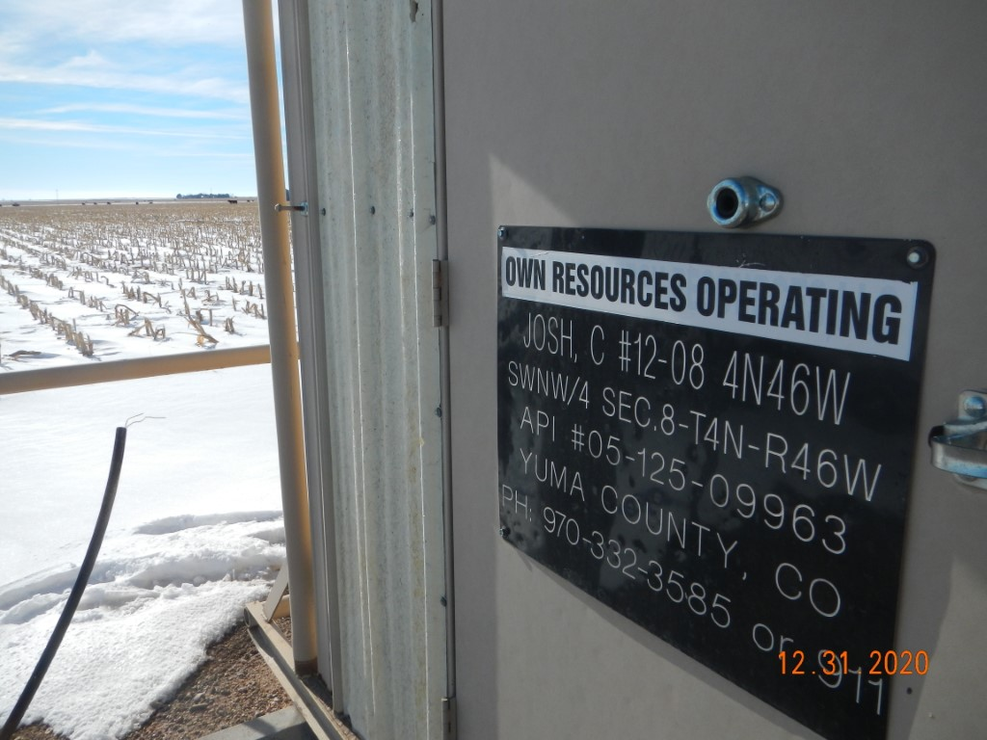
Operator Name: OWN
Facility Name: Josh 12-8 Location ID# 125-09963
Signage @ Wellhead - Fence
Signage @ GMR

Slide 2
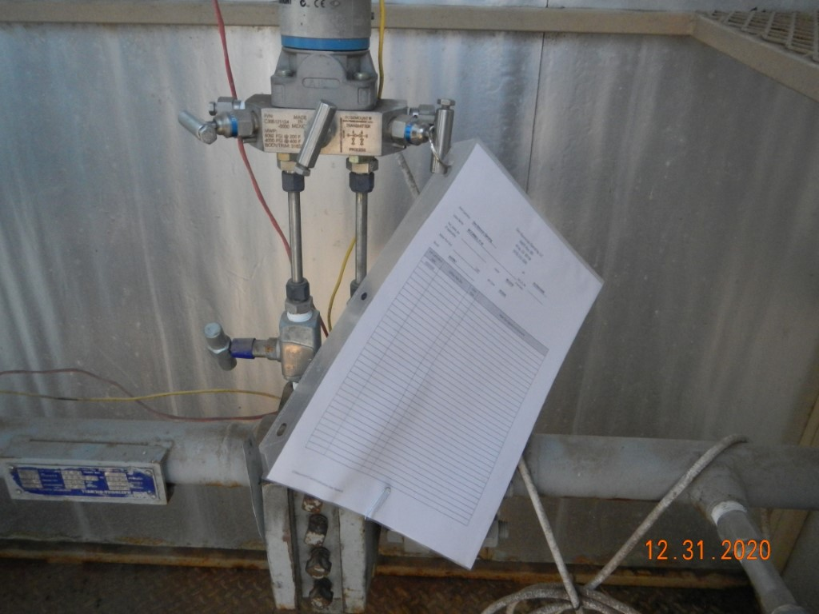
Operator Name: OWN
Facility Name: Josh 12-8 Location ID# 125-09963
Signage @ Wellhead - Fence
Calibration cert

