Slide 1
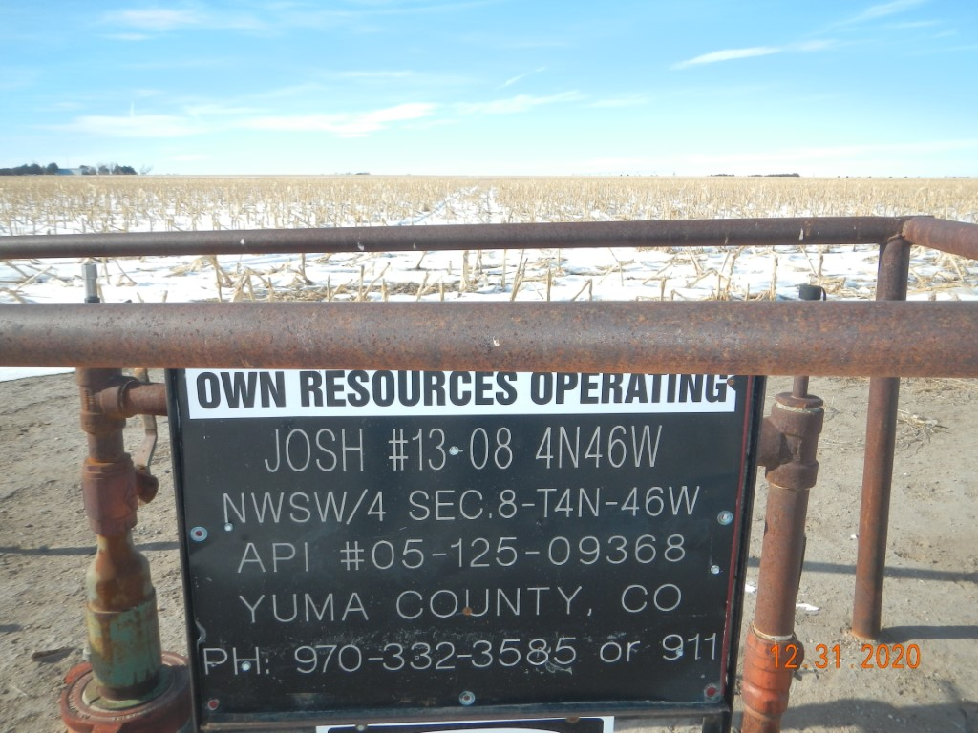
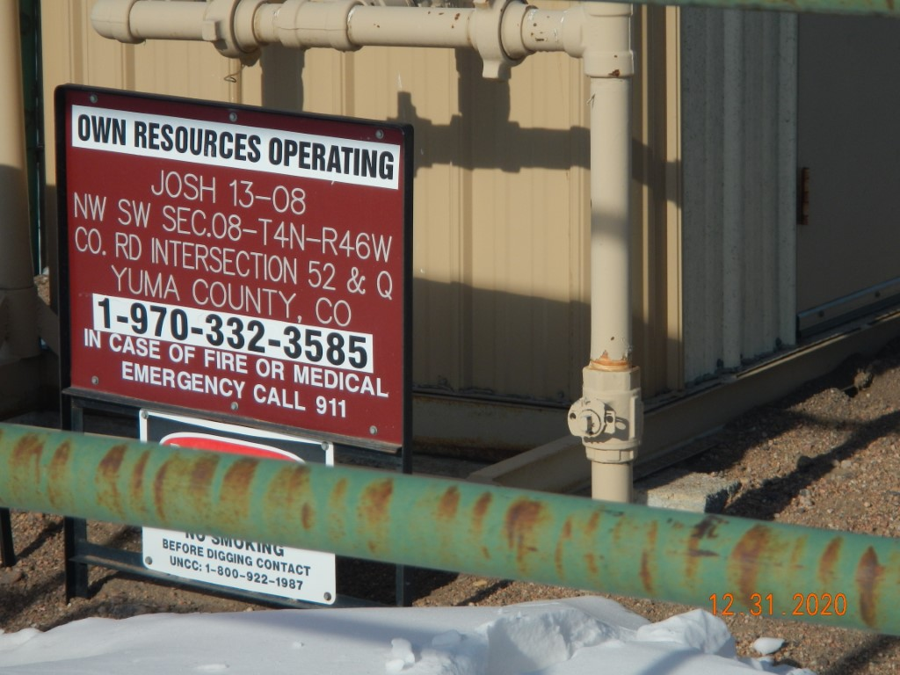
Operator Name: OWN
Facility Name: Josh 13-8 Location ID# 125-09368
Signage @ Wellhead
Signage @ GMR

