Slide 1
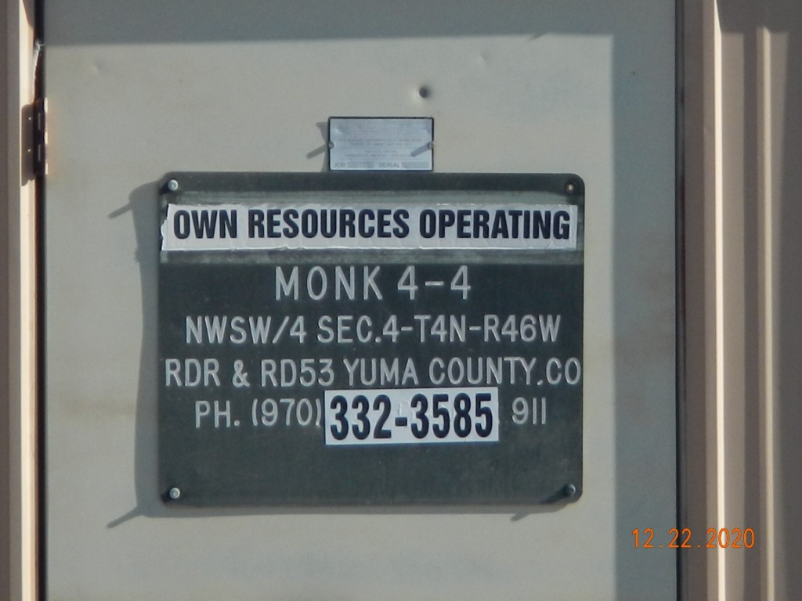
Operator Name: OWN
Facility Name: Monk 4-4 Location ID# 125-08183
Wellhead-PJ-PM-Fence-Signage
Signage @ GMR

