Slide 1
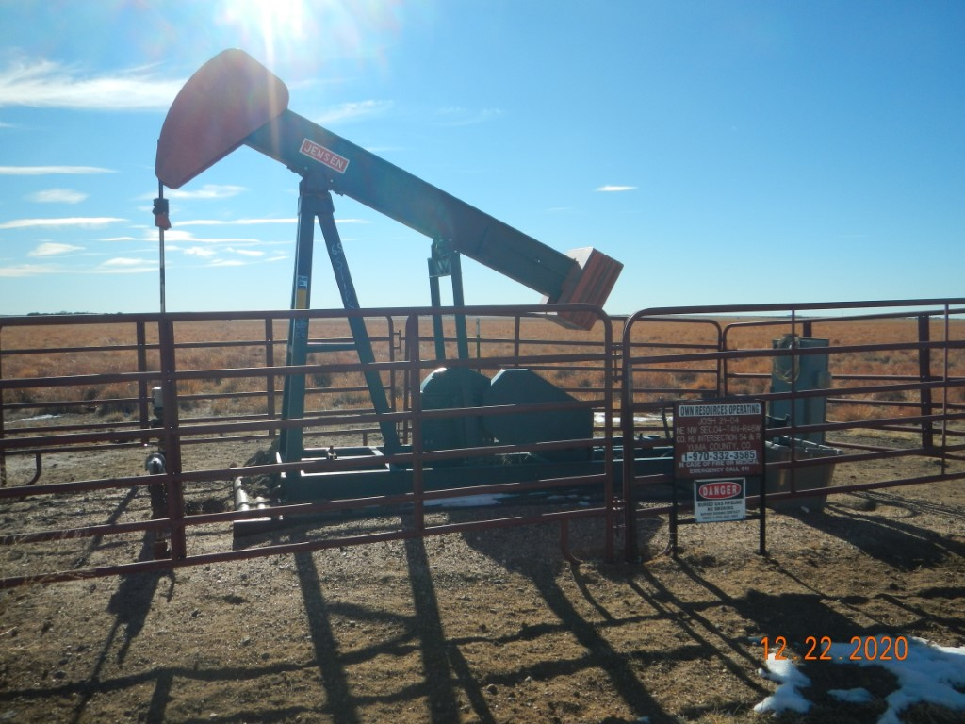
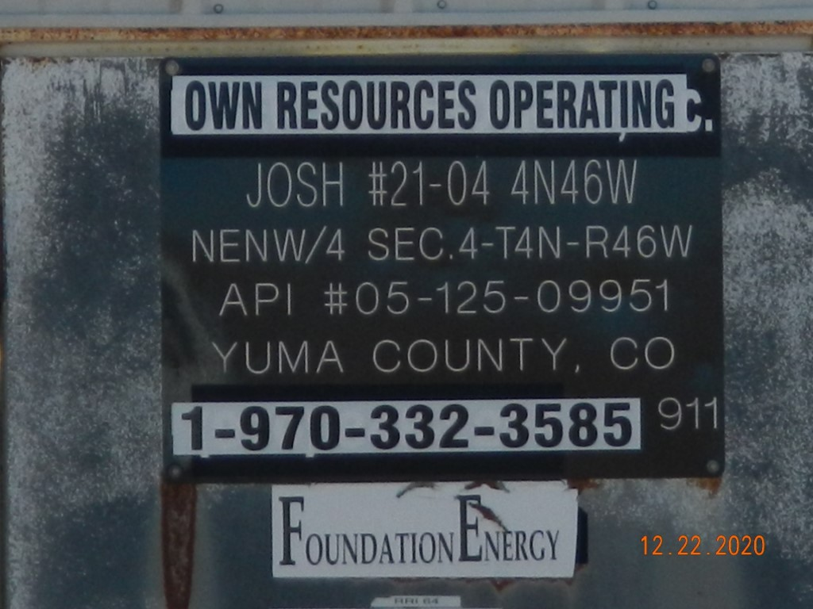
Operator Name: OWN
Facility Name: Josh 21-04 Location ID# 125-09951
Wellhead-Signage-PJ-PM-Fence
Signage @ GMR

