Slide 1
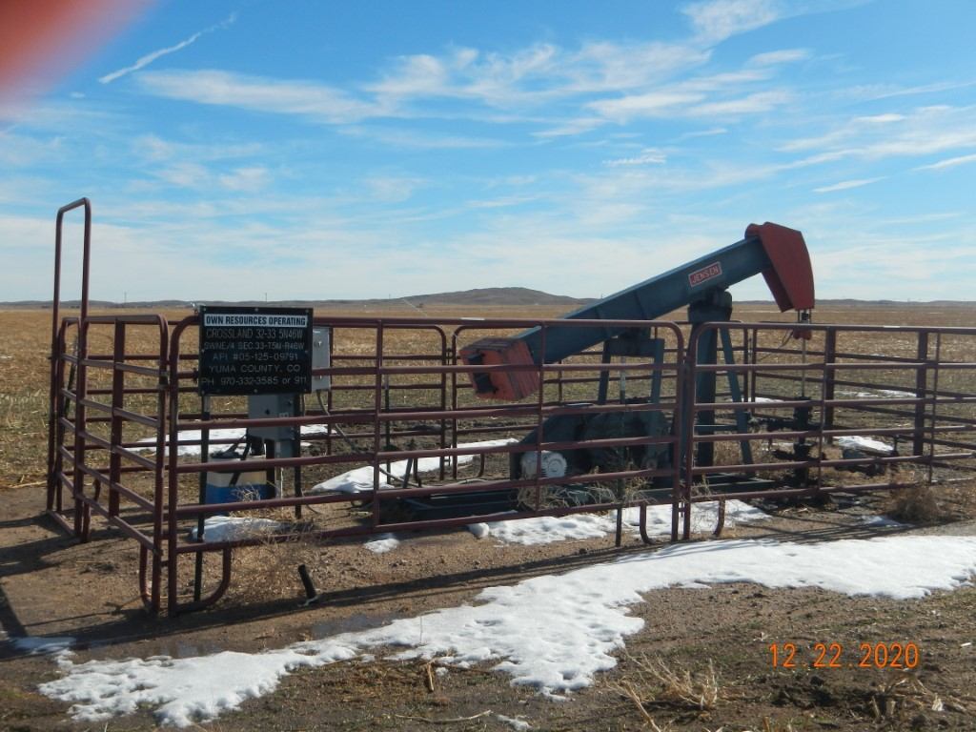
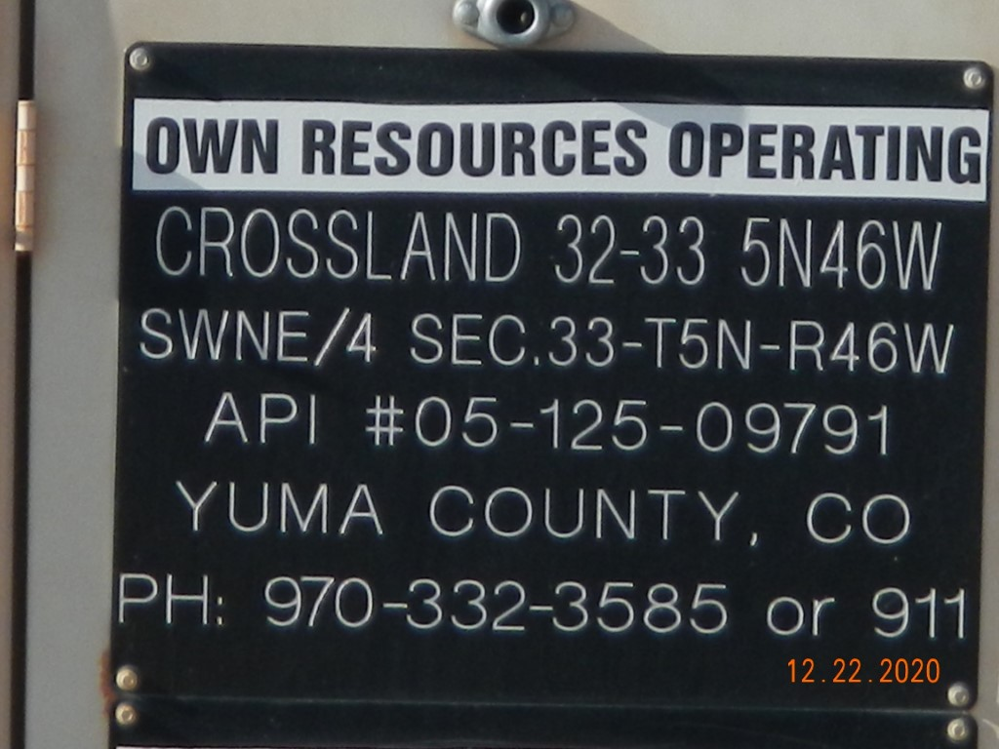
Operator Name: OWN
Facility Name: Crossland 32-33 Location ID# 125-09791
Wellhead-PM-Signage-PJ
Signage @ GMR

