Slide 1
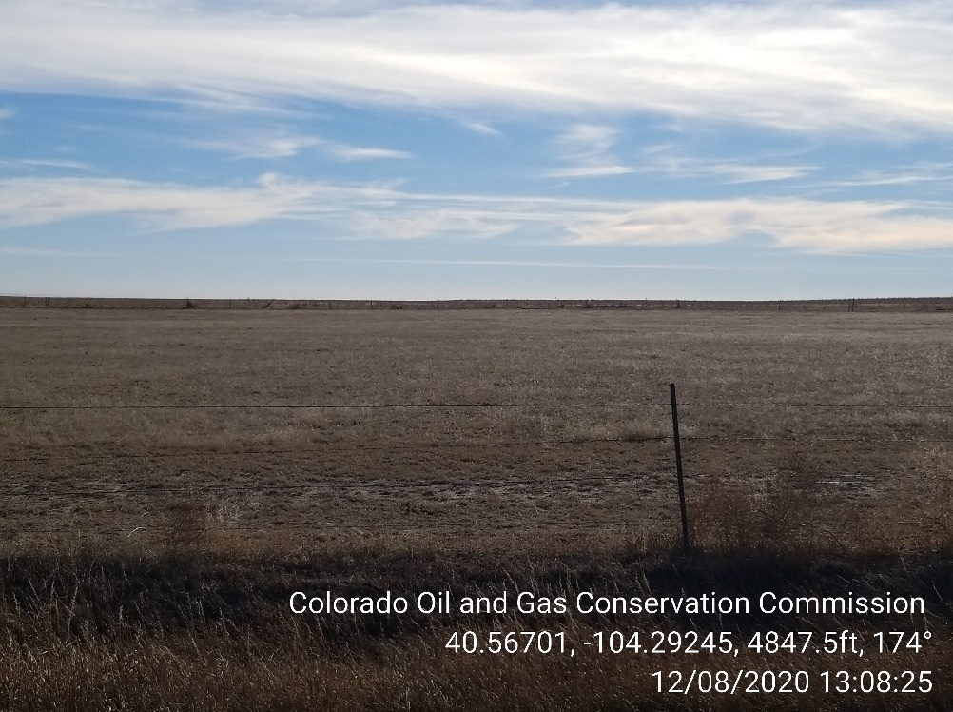
Inspection Photos
Location Name: Crow Valley 7-62-23-2H
Location ID: 428138
Photo 1 – Location where wells were set to be Drilled

