Slide 1
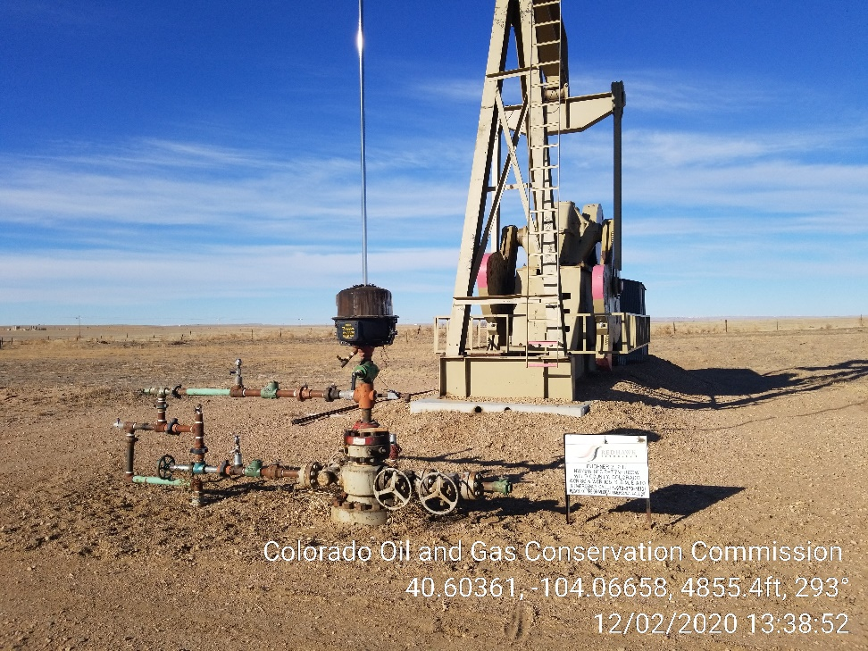
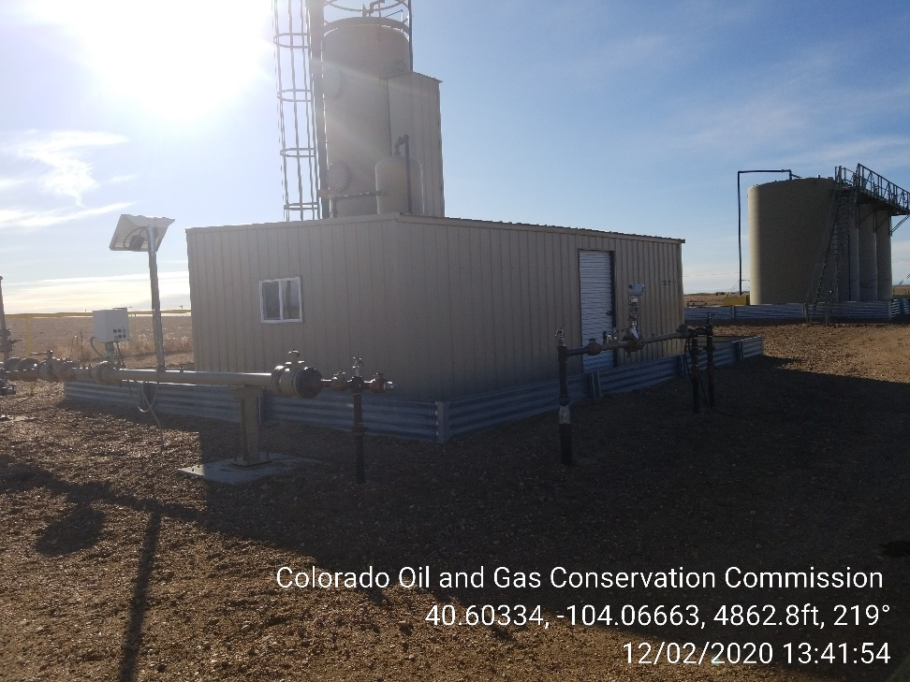
Inspection Photos
Location Name: Buchner 2-2H
Location ID: 431634
Photo 1 – Pumping Unit
Photo 2 – Heater Treater

Slide 2
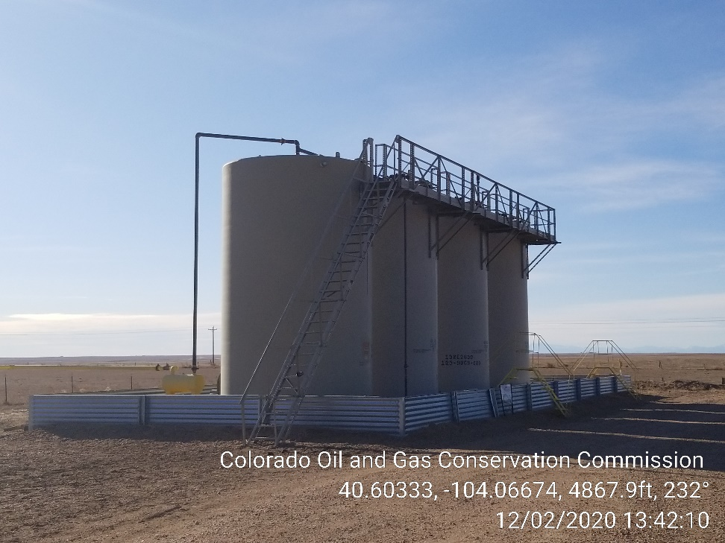
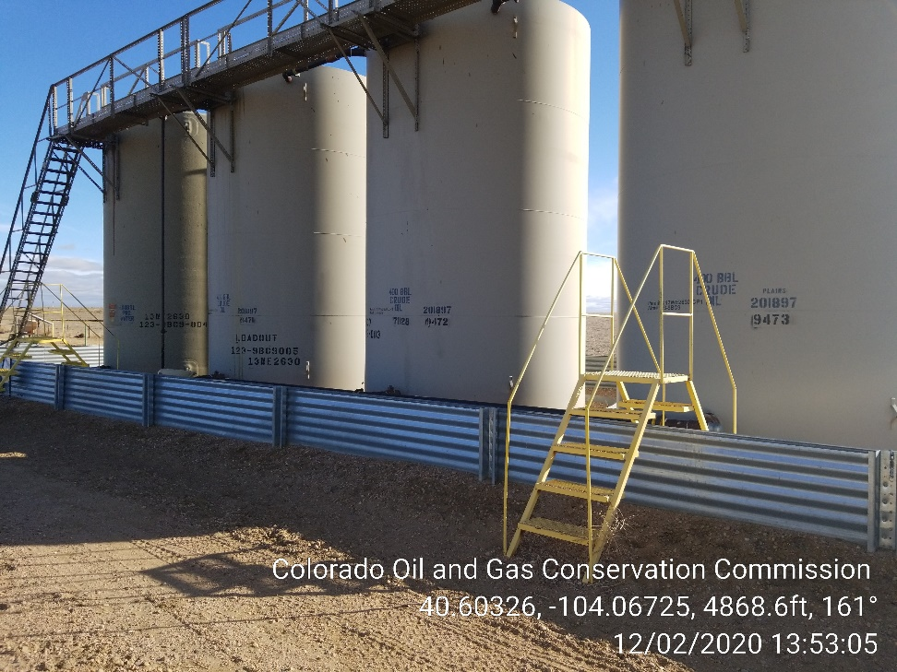
Inspection Photos
Location Name: Buchner 2-2H
Location ID: 431634
Photo 3 – Tank Battery – NFPA Labels missing
Photo 4 – Tank Battery – NFPA Labels missing

Slide 3
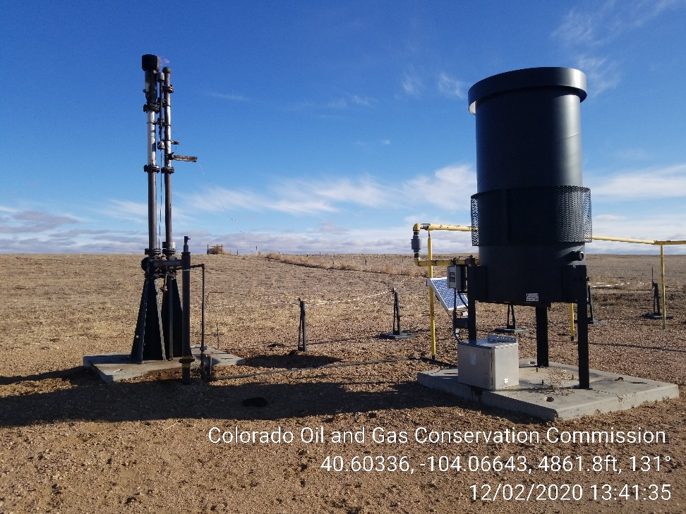
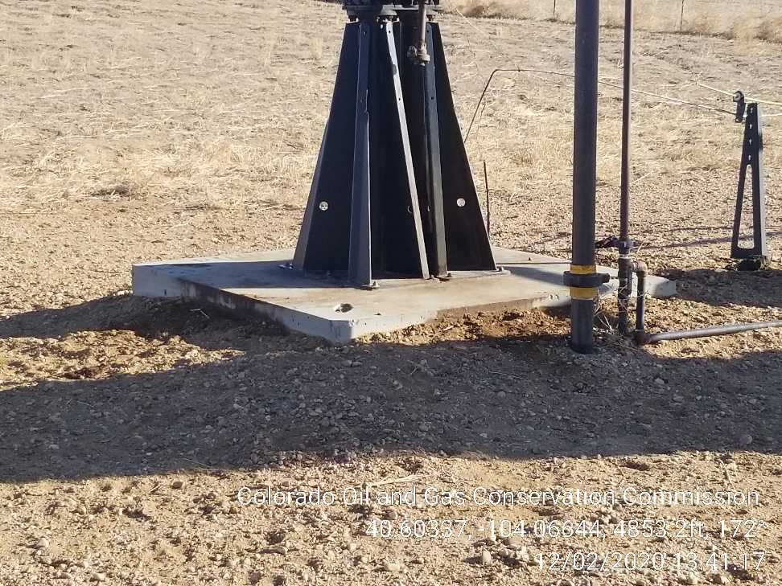
Inspection Photos
Location Name: Buchner 2-2H
Location ID: 431634
Photo 5 – ECD and Flare
Photo 6 – Flare – Stained Soil

Slide 4
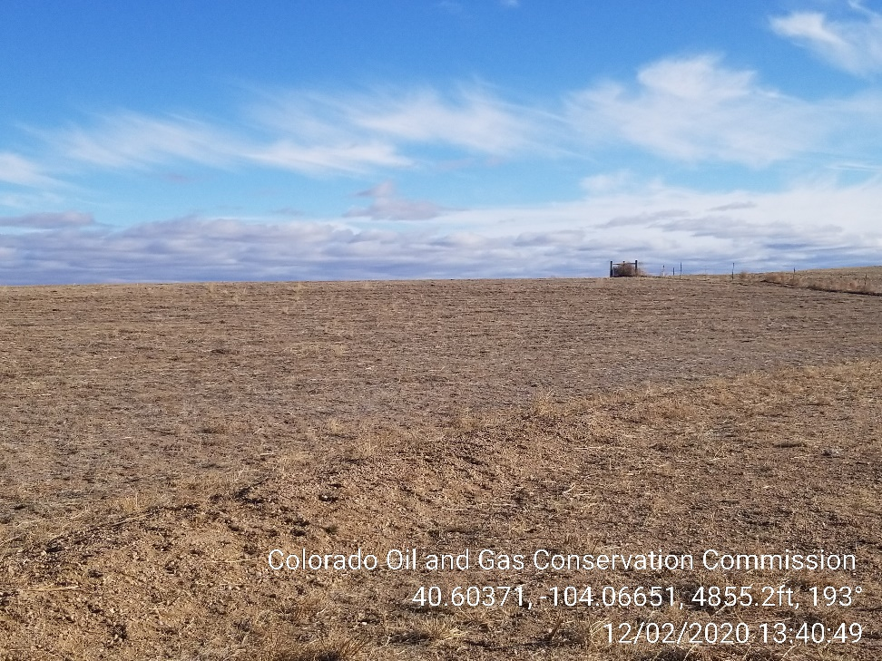
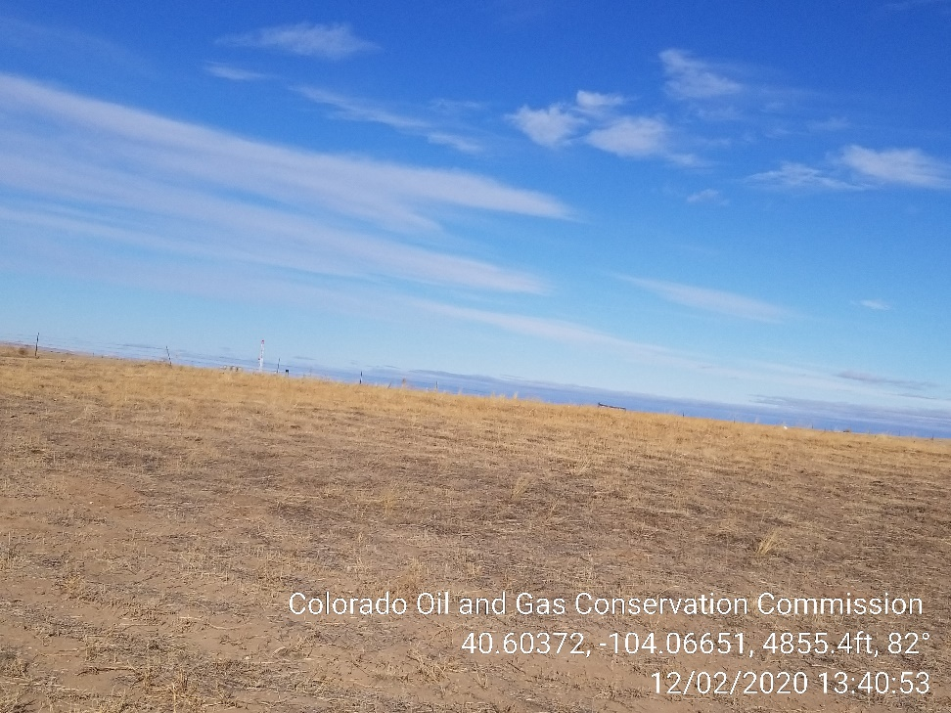
Inspection Photos
Location Name: Buchner 2-2H
Location ID: 431634
Photo 7 – Weeds mowed in Interim Reclamation Area
Photo 8 – Weeds mowed in Interim Reclamation Area

Slide 5
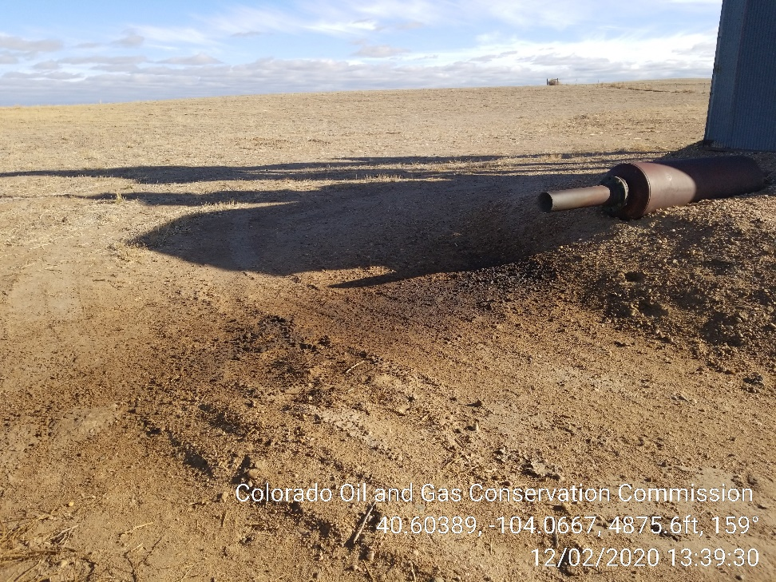
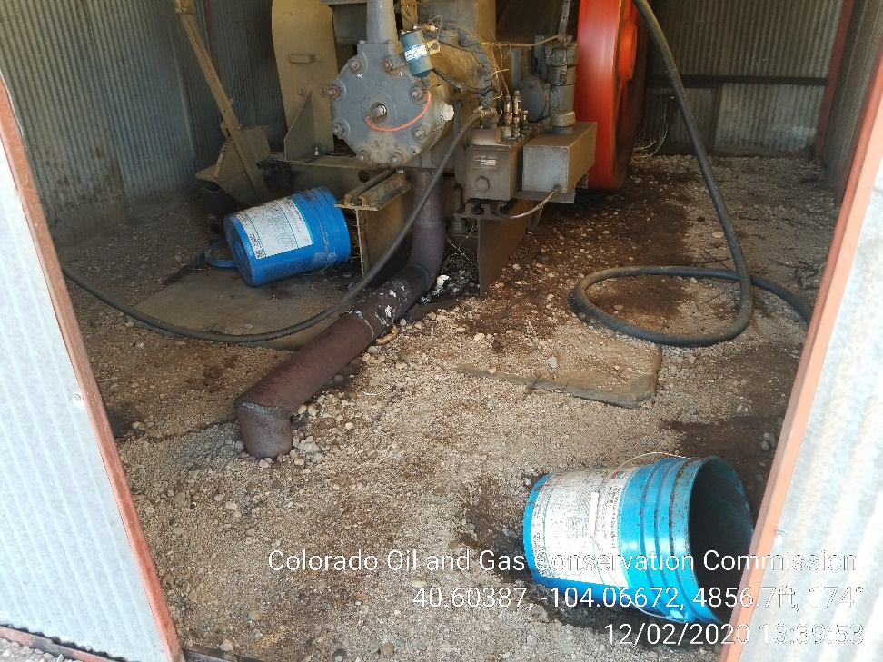
Inspection Photos
Location Name: Buchner 2-2H
Location ID: 431634
Photo 7 – Stained Soil at Exhaust
Photo 8 – Stained Soil at Gas Engine

Slide 6
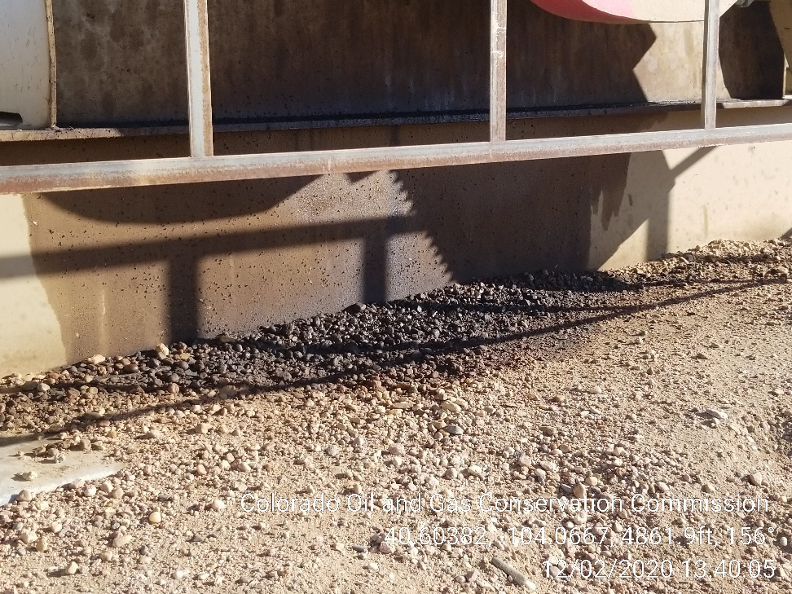
Inspection Photos
Location Name: Buchner 2-2H
Location ID: 431634
Photo 9 – Stained Soil at Pumping Unit

