Slide 1
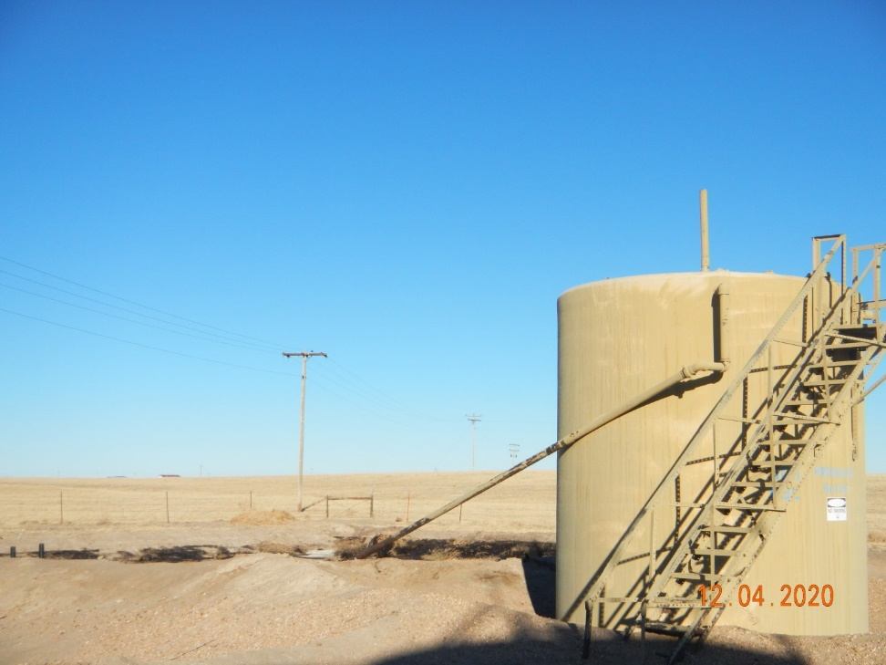
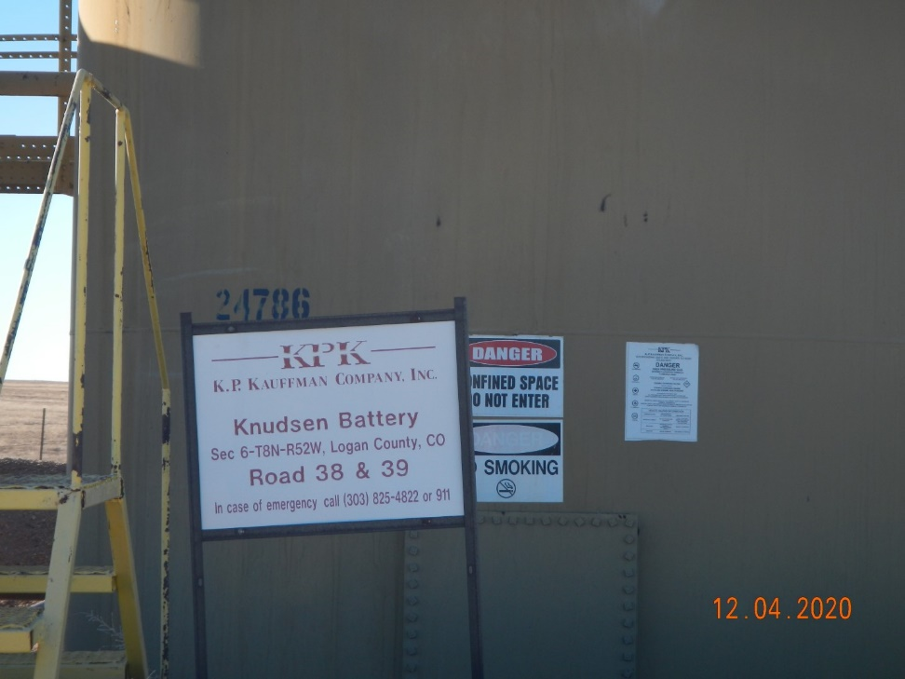
Operator Name: KP Kauffman
Facility Name: Knudsen #7 Location ID# 075-07533
CO ring on inside berm @ PW pit. PW tank in foreground.
Signage @ battery (CO tanks)

