Slide 1
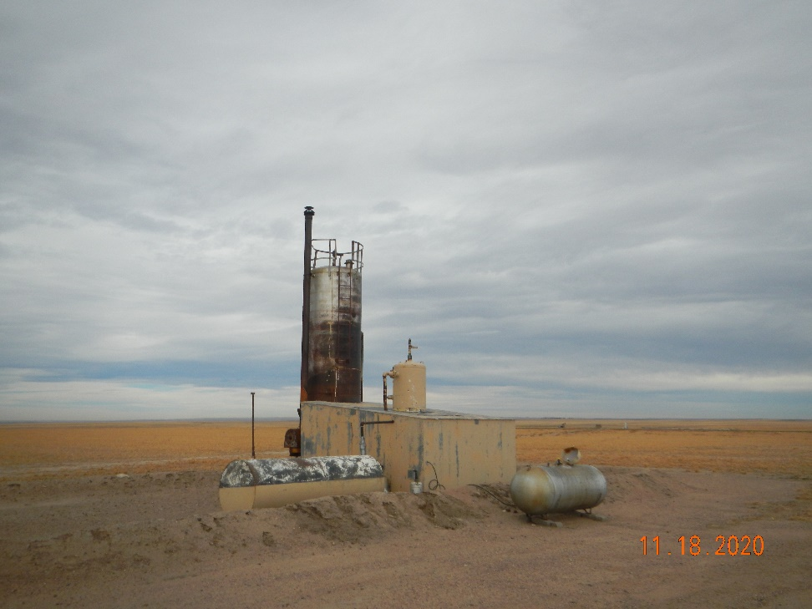
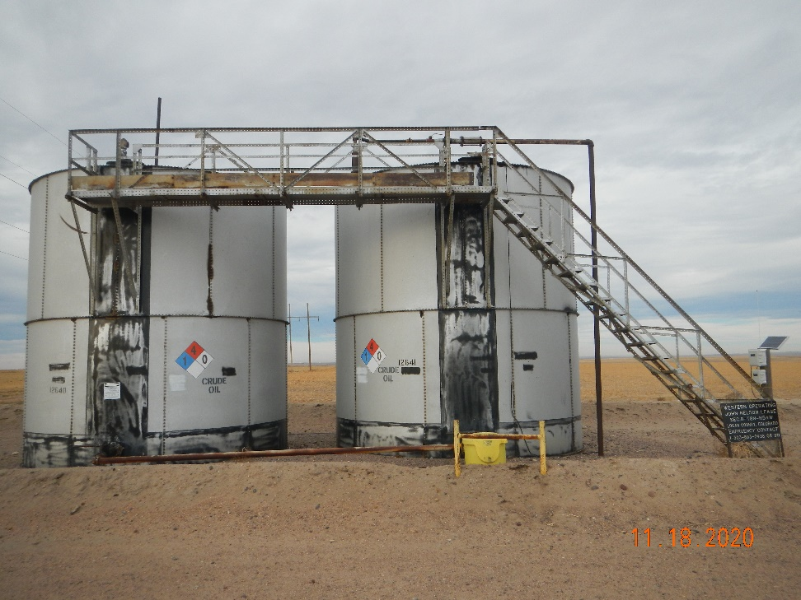
Operator Name: Western Oper.
Facility Name: Nelson A-6 Location ID# 075-05841
Heated vertical sep. - ancillary
Production crude tanks

