Slide 1
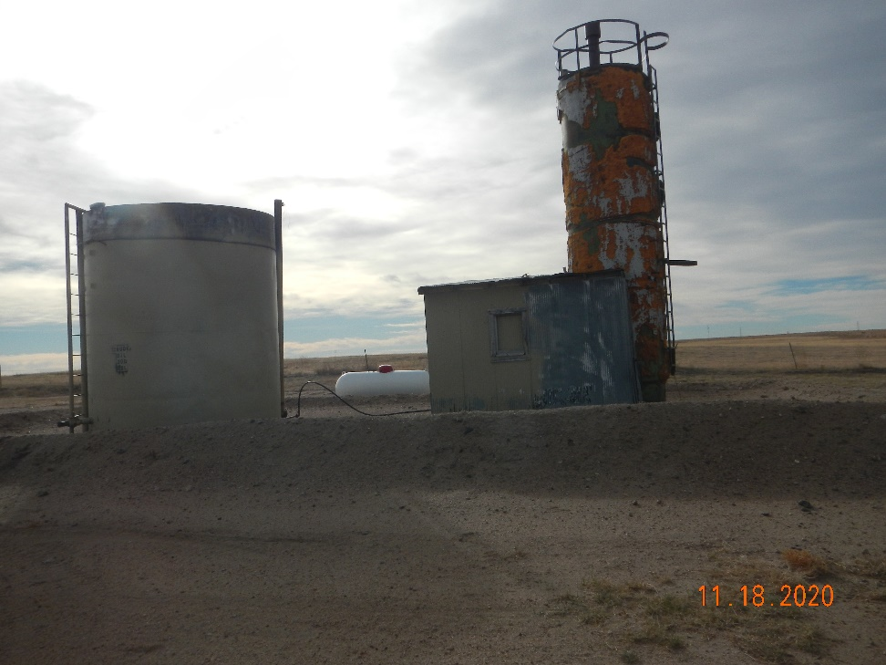
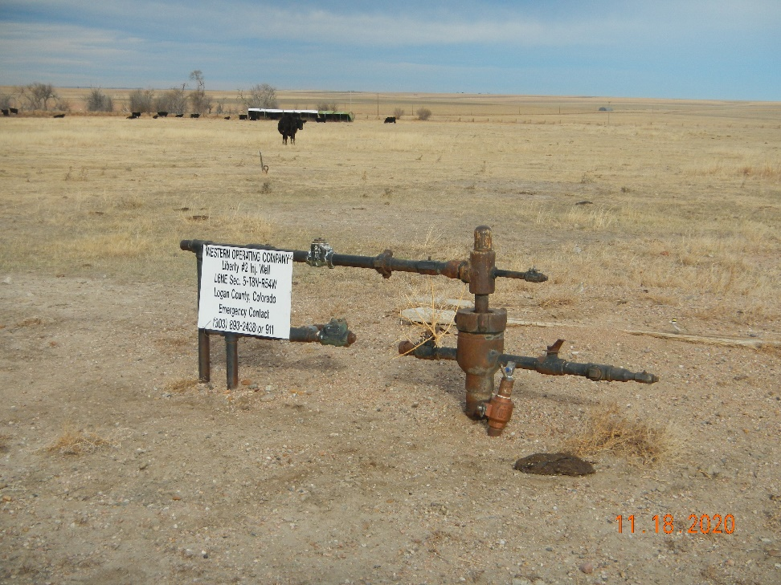
Operator Name: Western Oper.
Facility Name: Liberty 2 Location ID# 075-06172
Liberty PW tank and Sep.
Signage - Wellhead

