Slide 1
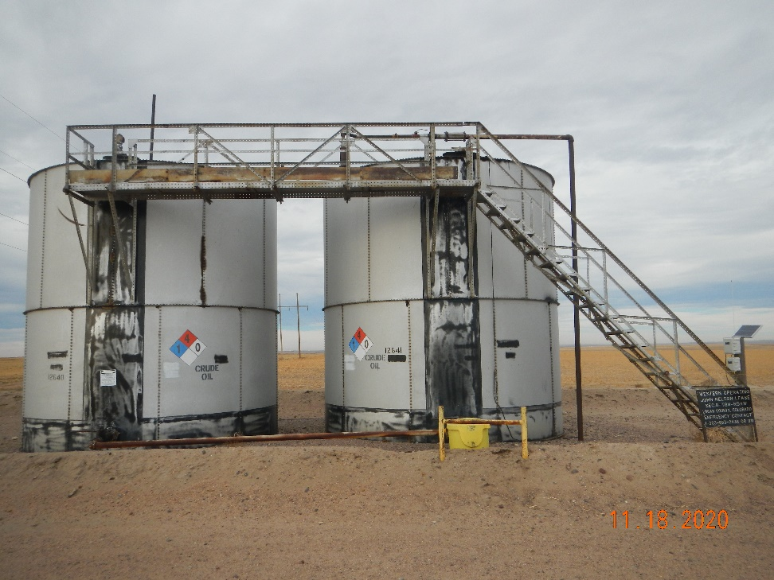
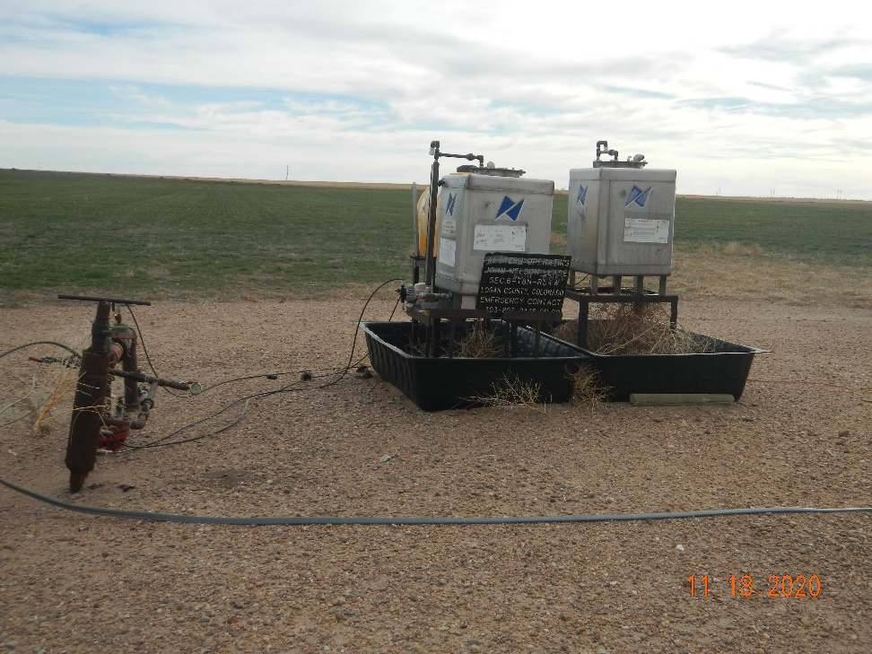
Operator Name: Western Oper.
Facility Name: Nelson Jarrett 1 Location ID#075-05957
Liberty Battery tanks (crude)
Ancillary

