Slide 1
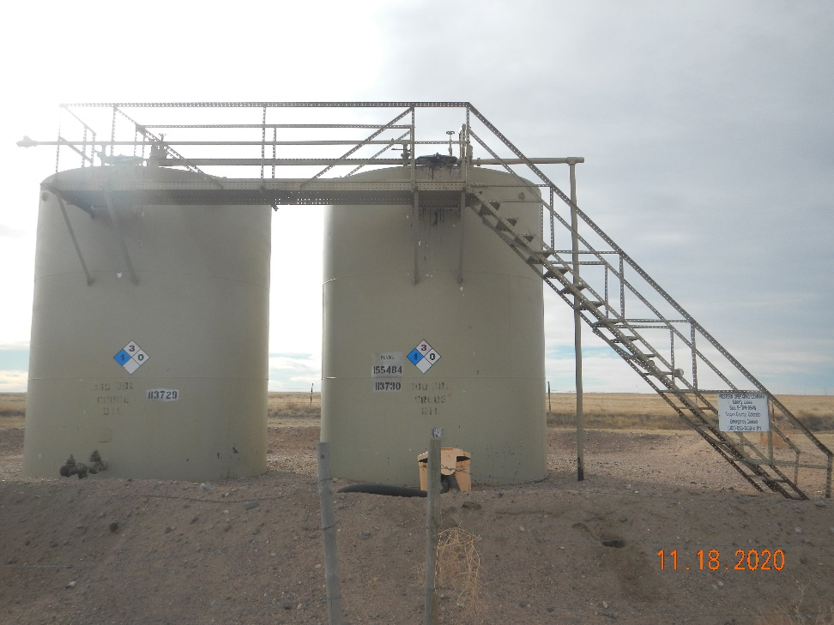
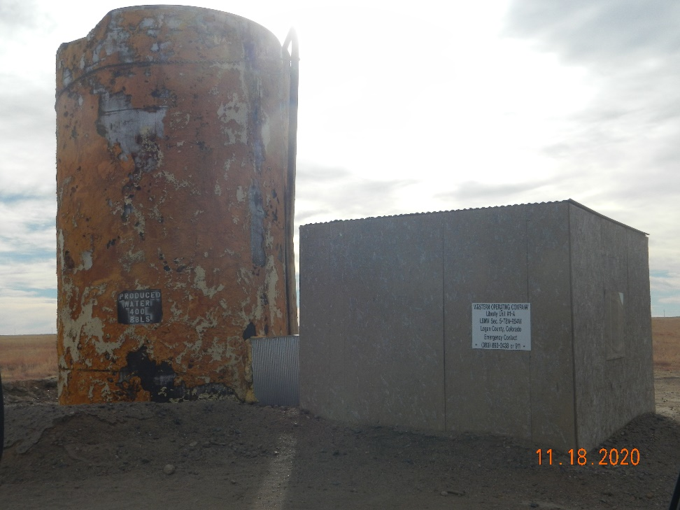
Operator Name: Western Oper.
Facility Name: Liberty #1 -A Location ID#075-06123
Liberty Battery tanks (crude)
Wellhead - Ancillary

