Slide 1
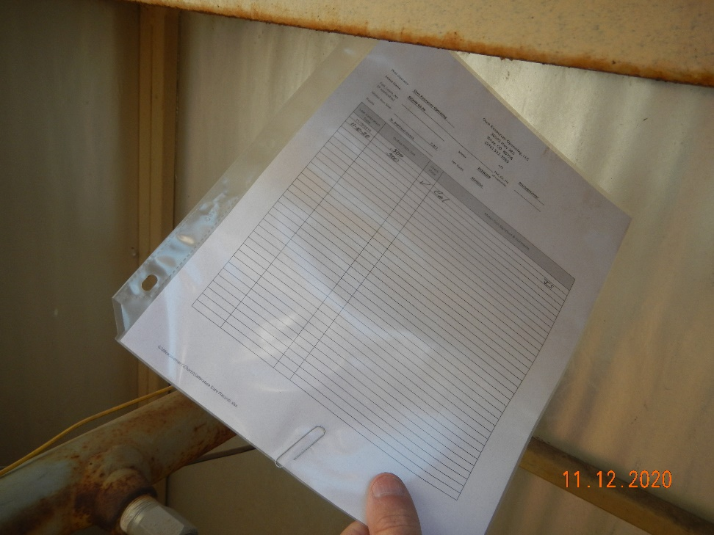
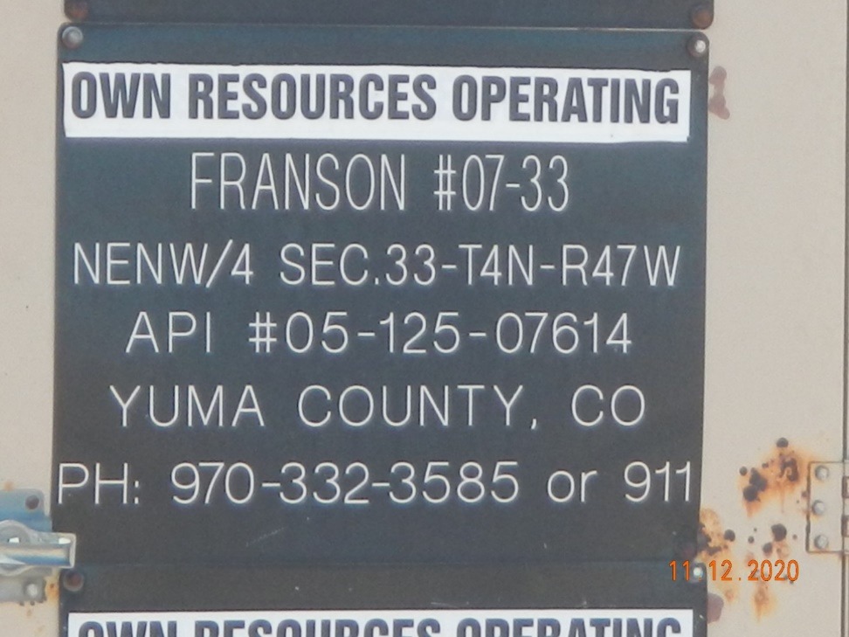
Operator Name: OWN
Facility Name: Franson 7-33
Location ID# 125-07614
Calibration certificate
Signage – GMR – Sep.

