Slide 1
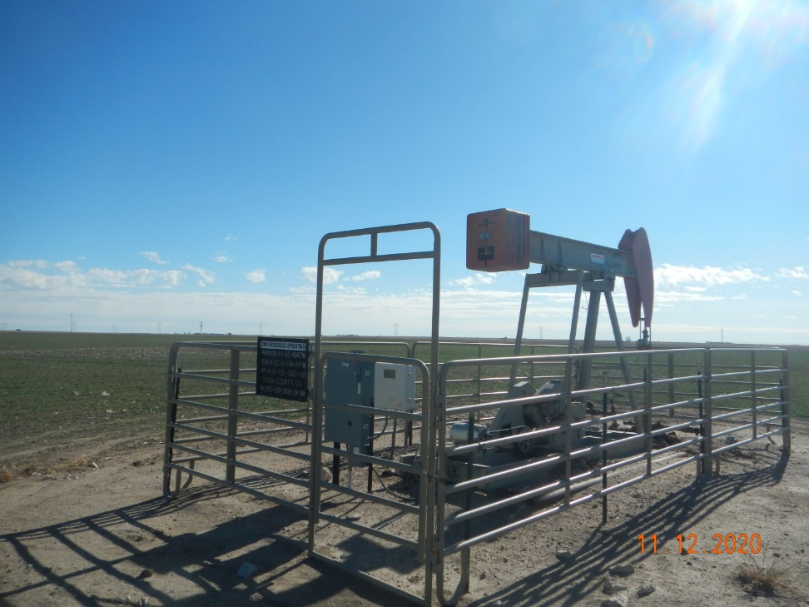
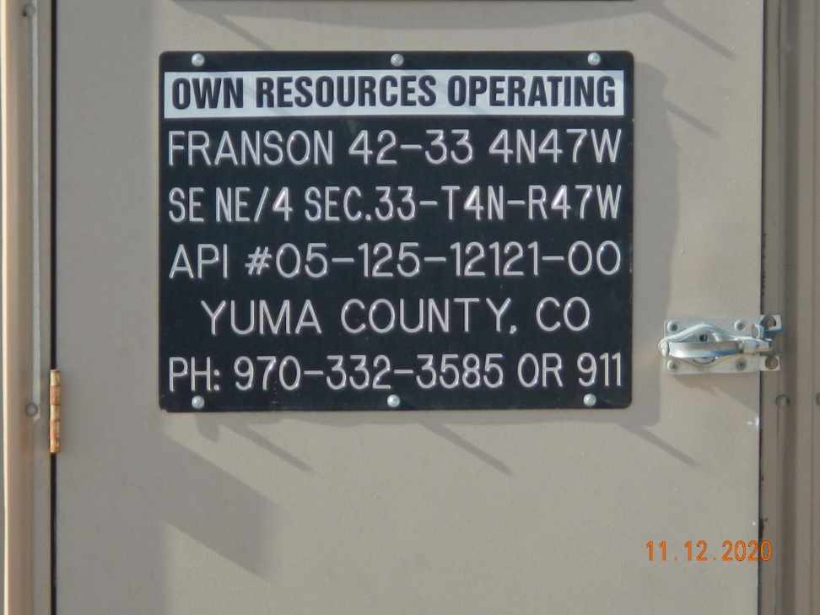
Operator Name: OWN
Facility Name: Franson 42-33
Location ID# 125-12121
Wellhead – PJ – PM – Fence - Signage
Signage – GMR – Sep.

