Slide 1
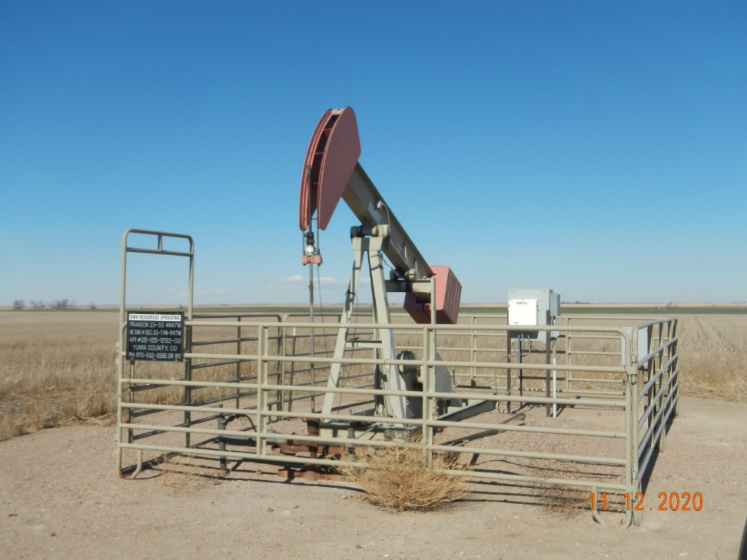
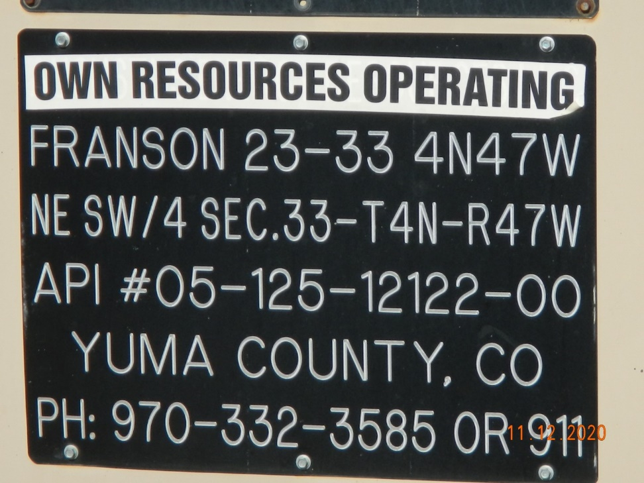
Operator Name: OWN
Facility Name: Franson 23-33
Location ID# 125-12122
Wellhead – PJ – Elec. motor
Signage – GMR – Sep.

