Slide 1
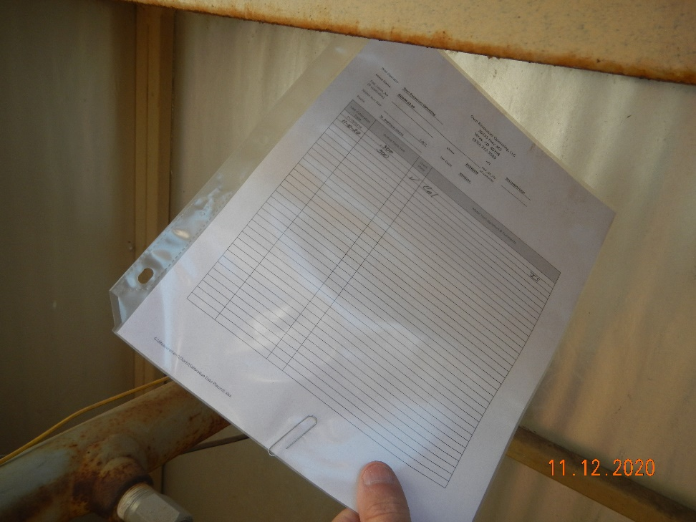
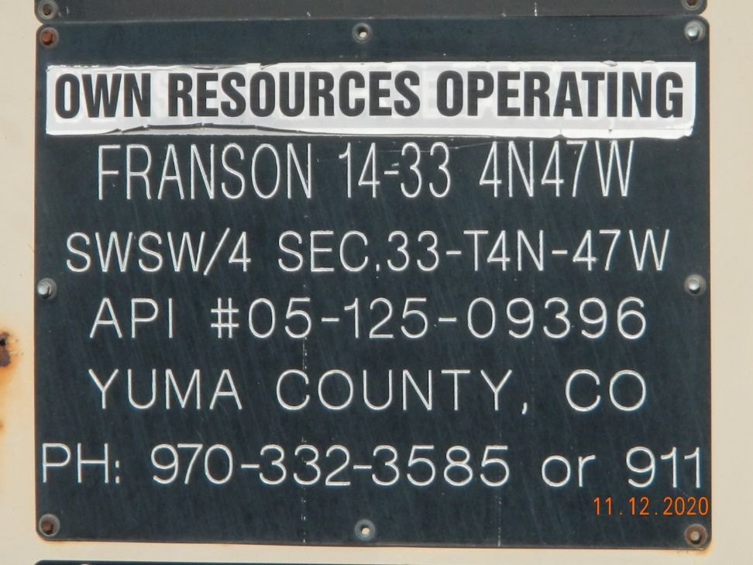
Operator Name: OWN
Facility Name: Franson 14-33
Location ID# 125-09396
Calibration cert
Signage – GMR – Sep.

