Slide 1
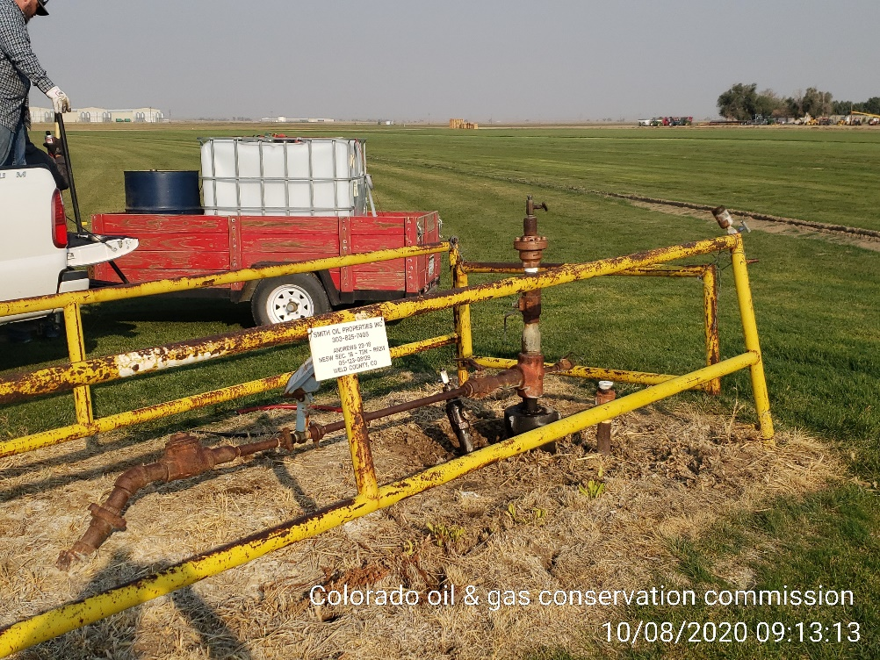
Inspection Photos
Location Name: Andrews 23-18
Location ID: 05-123-08129
MIT test

