Slide 1
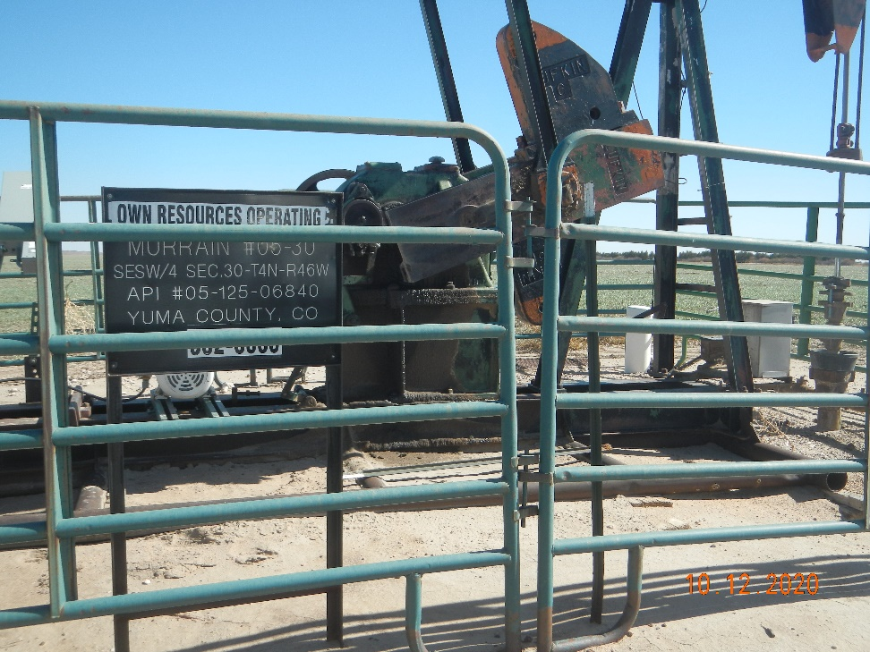
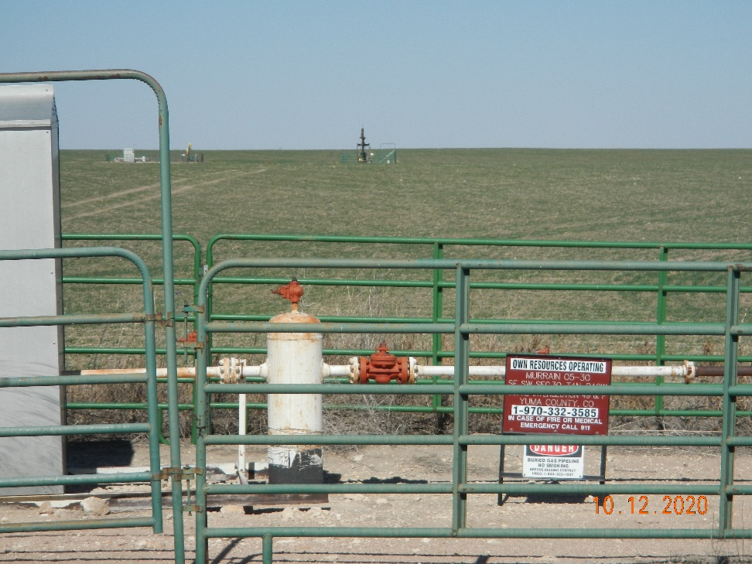
Operator Name: OWN
Facility Name: Murrain, M. 5-30
Location ID# 125-06840
Wellhead - Signage
Signage – GMR – Sep.

