Slide 1
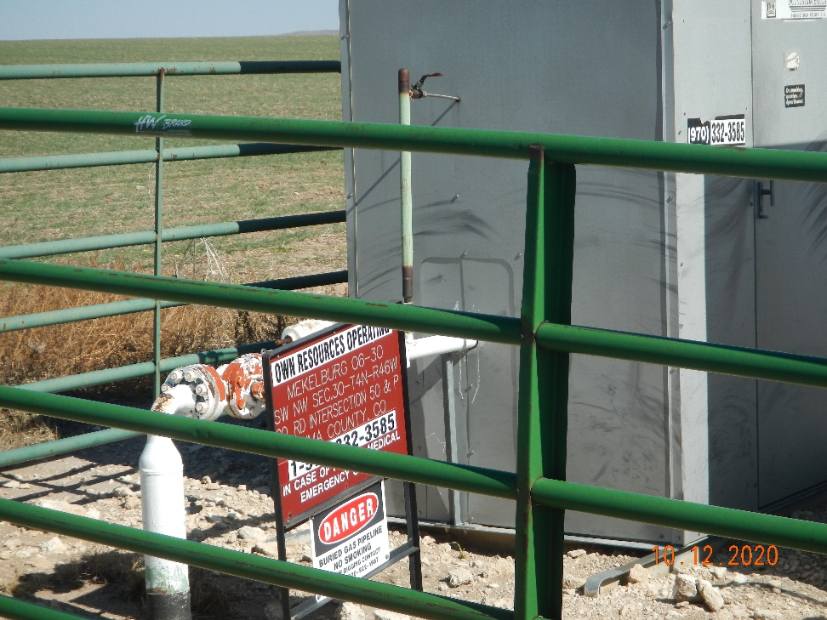
Operator Name: OWN
Facility Name: Meckelburg 6-30
Location ID# 125-07459
Wellhead (background)
Signage – GMR – Sep.

