Slide 1
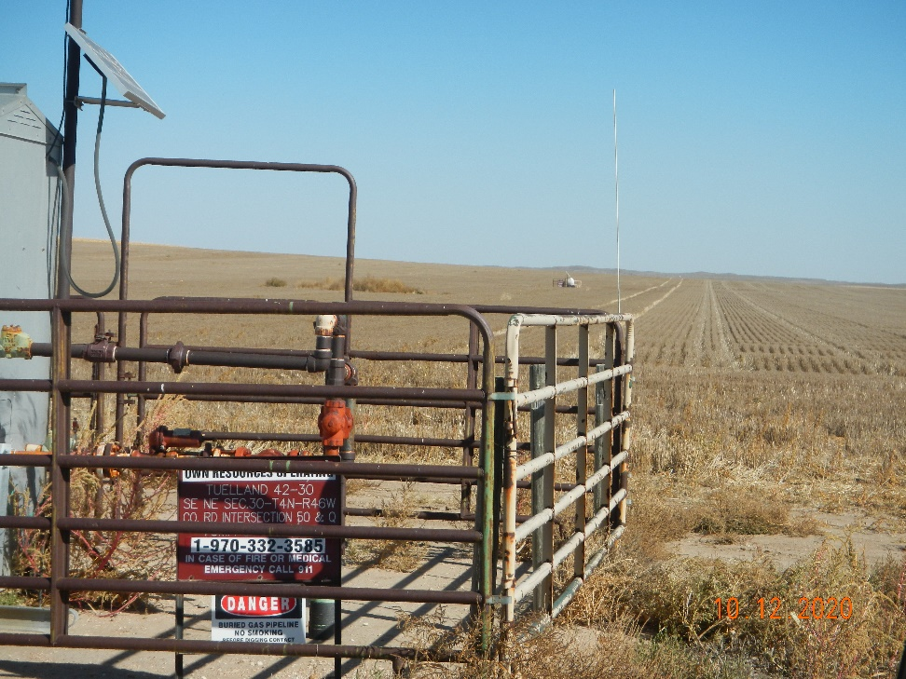
Operator Name: OWN
Facility Name: Tuelland 42-30
Location ID# 125-10111
Wellhead (background)
Signage – GMR – Sep.

