Slide 1
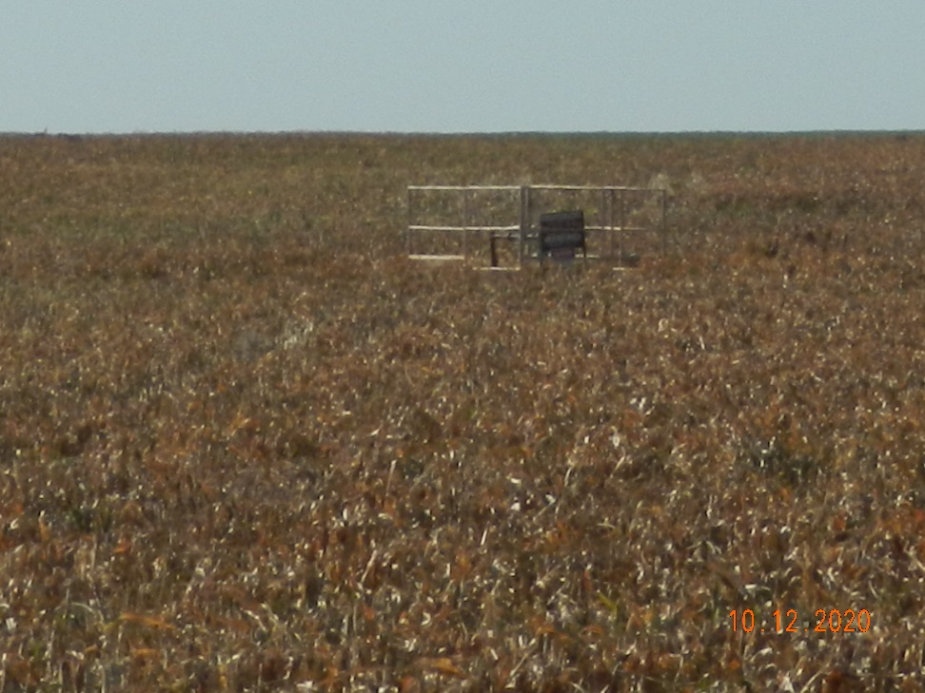
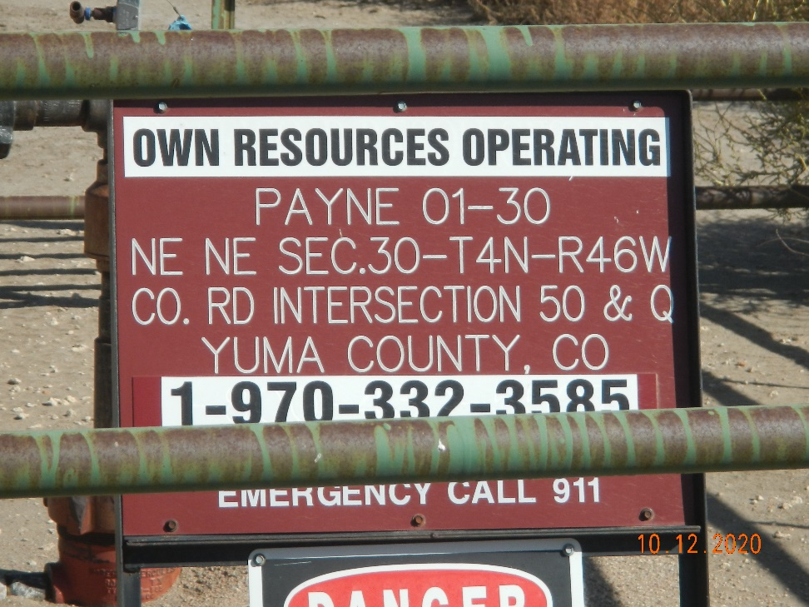
Operator Name: OWN
Facility Name: Payne 1-30
Location ID# 125-07406
Wellhead
Signage – GMR – Sep.

