Slide 1
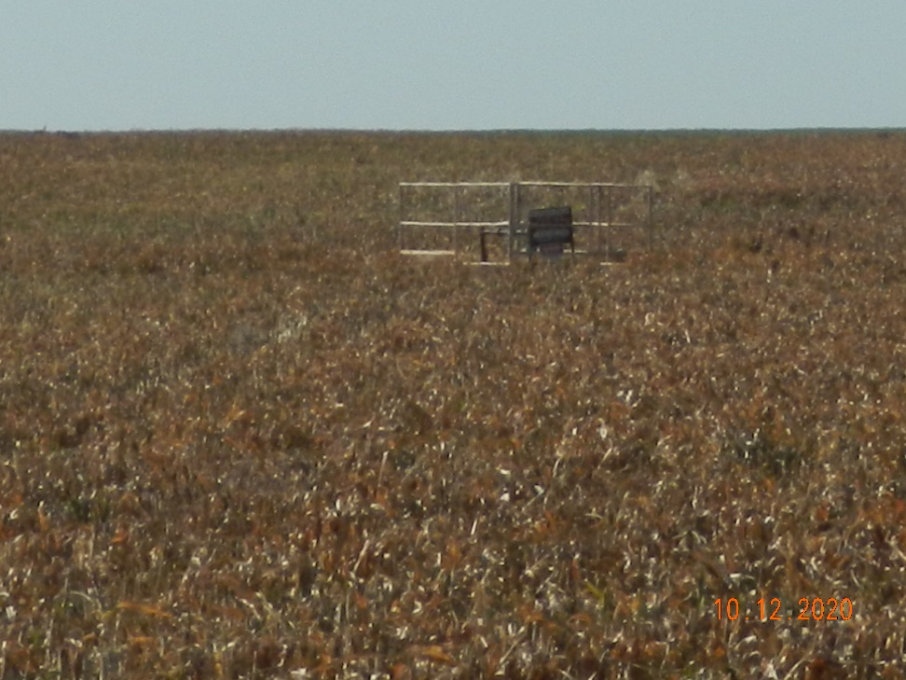
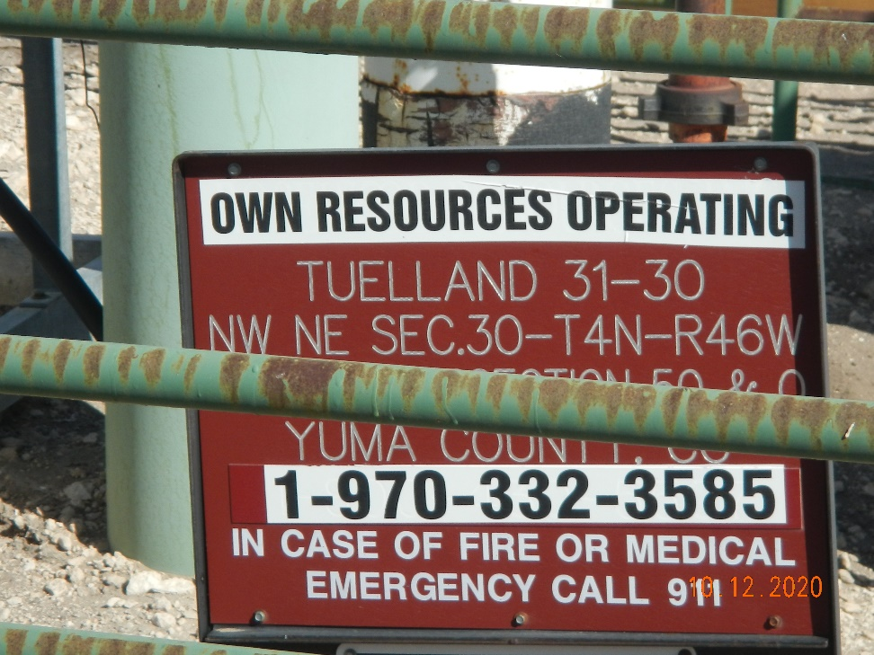
Operator Name: OWN
Facility Name: Tuelland 31-30
Location ID# 125-10112
Wellhead
Signage – GMR – Sep.

