Slide 1
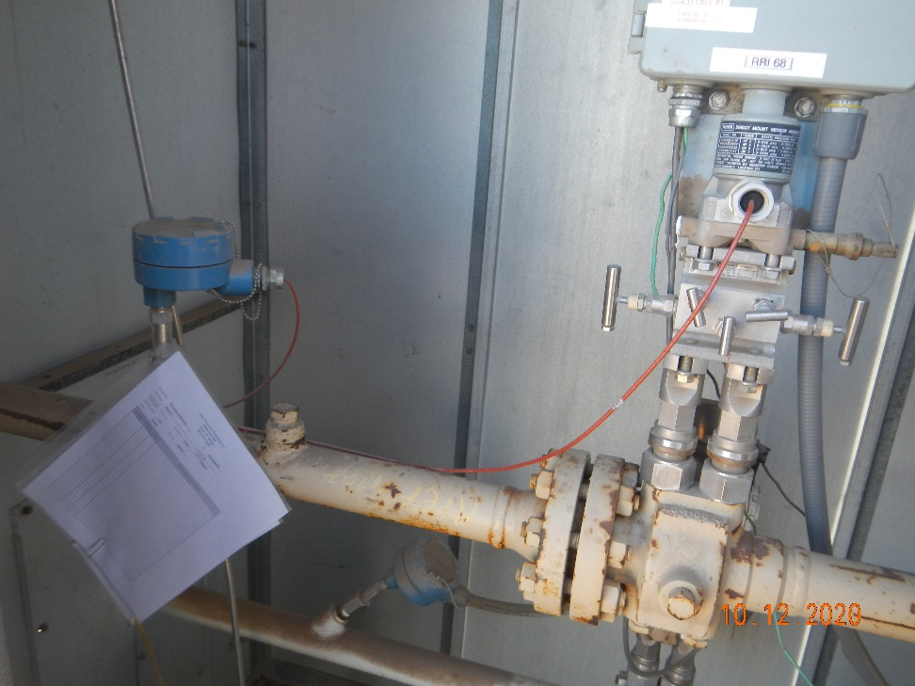
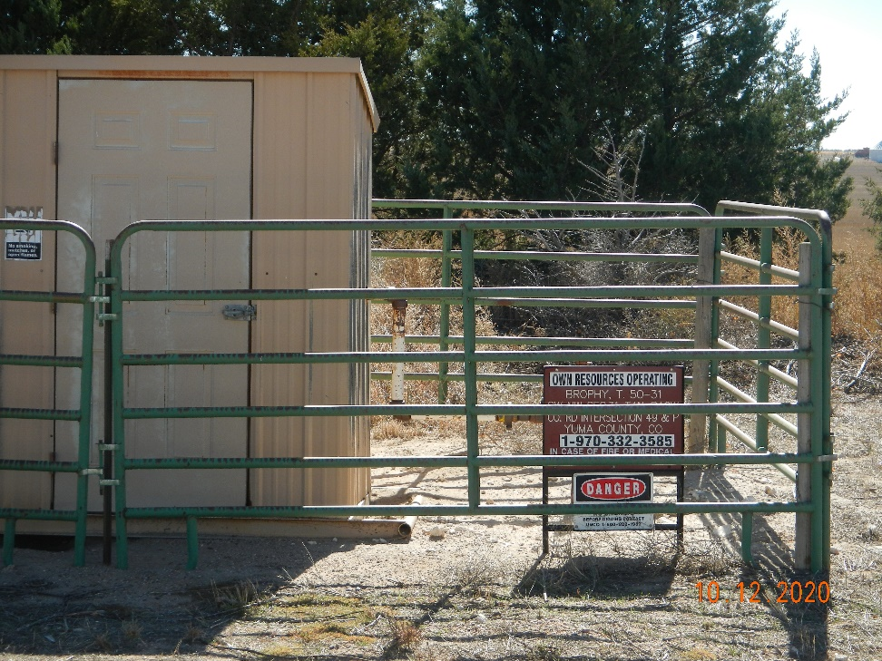
Operator Name: OWN
Facility Name: Brophy, T 50-31
Location ID# 125-07145
Calibration cert
Signage – GMR – Sep.

