Slide 1
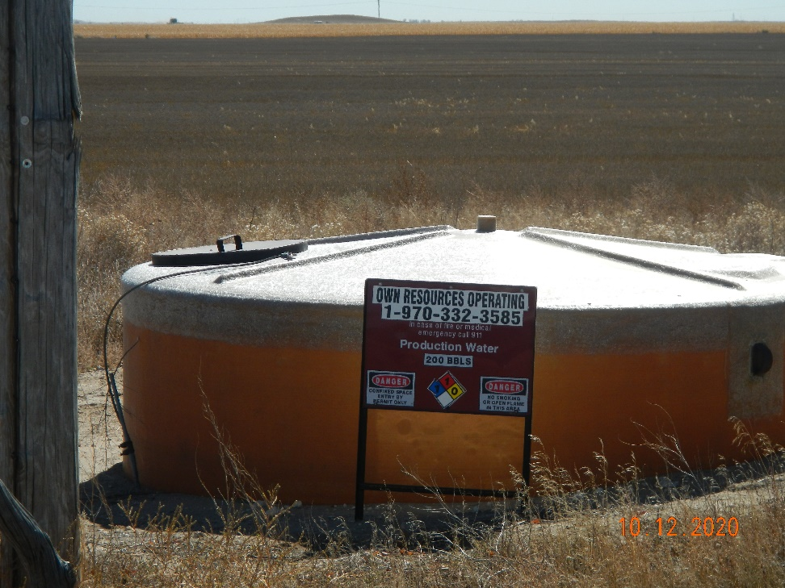
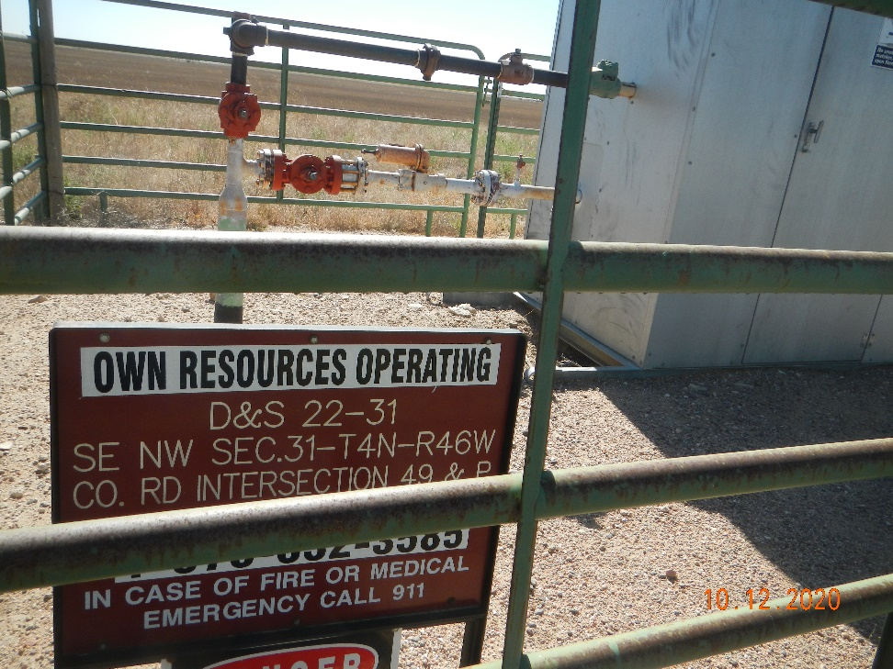
Operator Name: OWN
Facility Name: D&S 22-31
Location ID# 125-10095
PW Tank
Signage – GMR – Sep.

