Slide 1
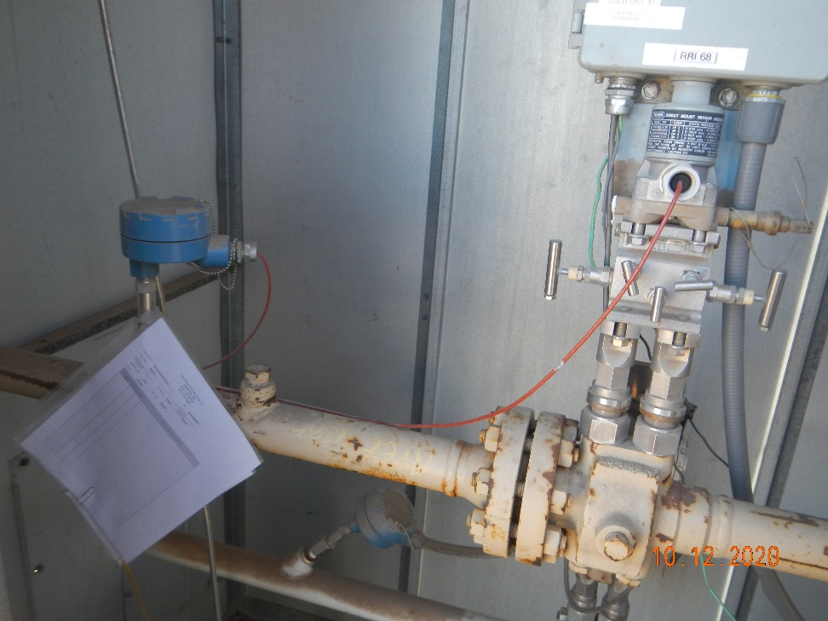
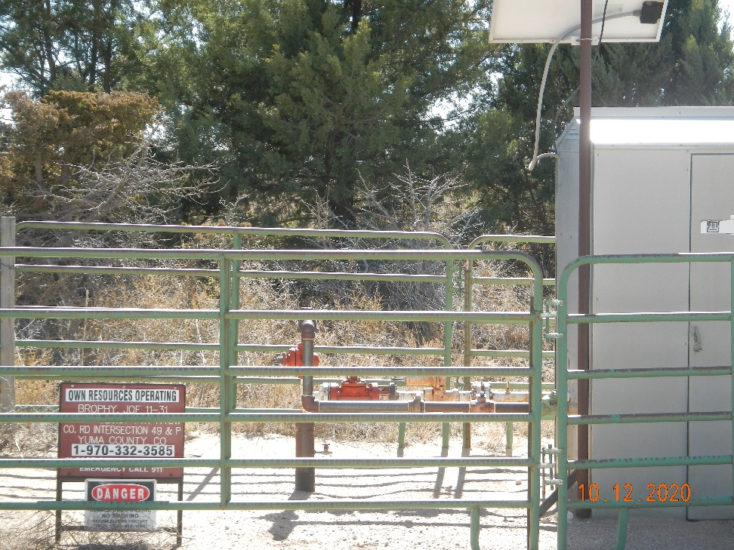
Operator Name: OWN
Facility Name: - Joe Brophy 11-31
Location ID# 125-10212
Calibration cert
Signage – GMR – Sep.

