Slide 1
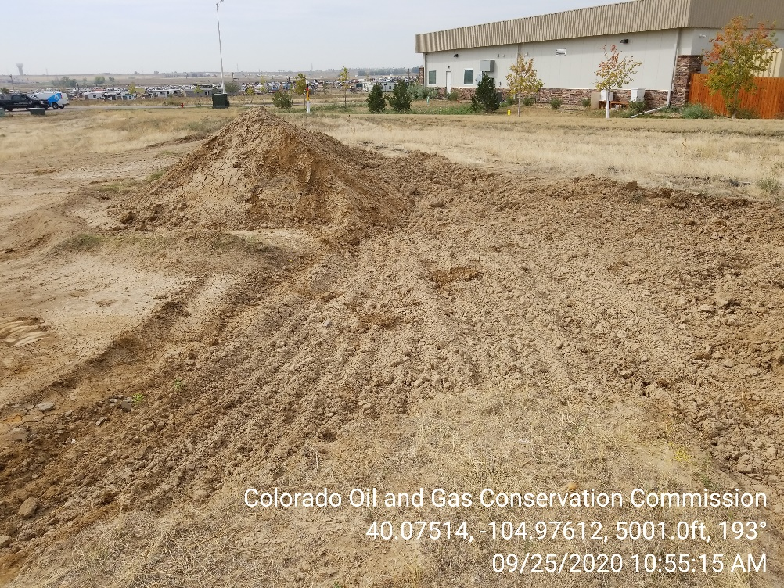
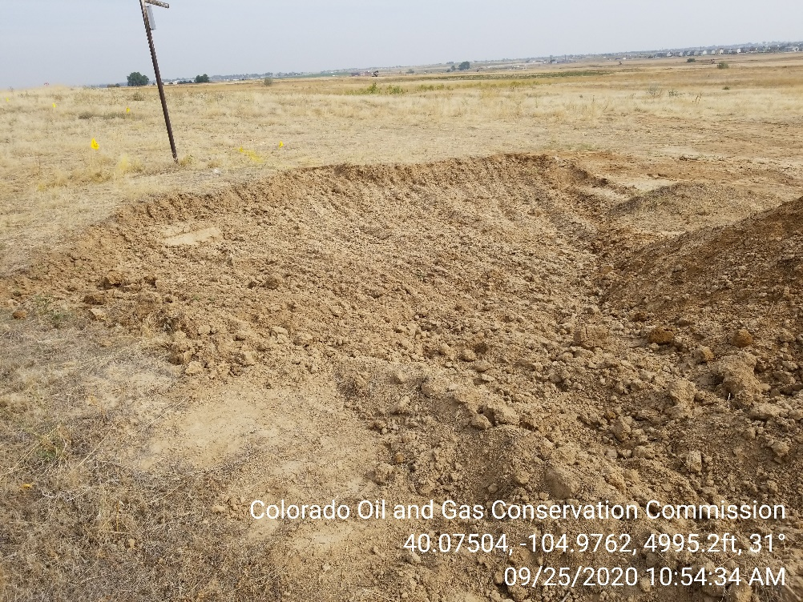

Inspection Photos
Location Name: James S Haley Trustee B #2 Flowline Release
Spill ID: 478014
Photo 1 –Spill area. Surface area of the spill has been scraped. Soils piled on site.
Photo 2 – Surface area of the spill has been scraped.

Slide 2
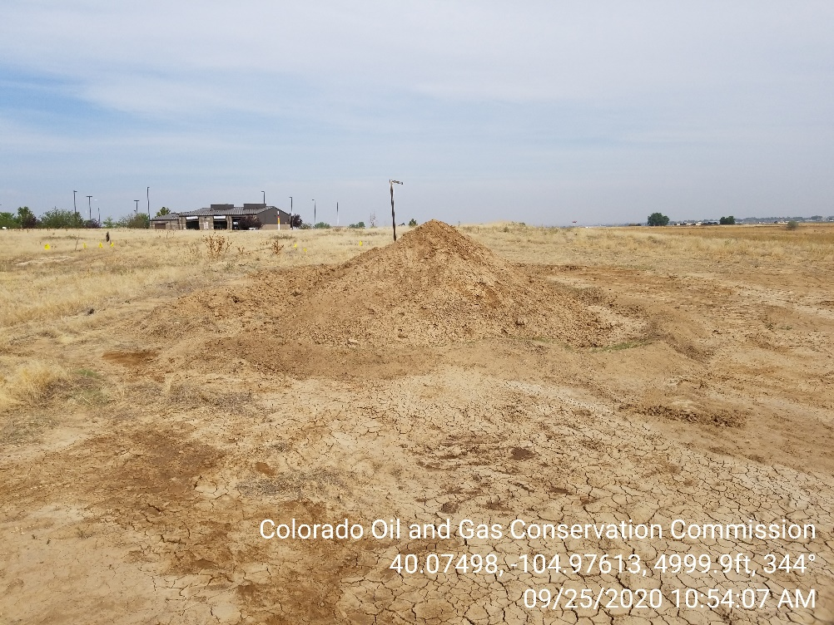
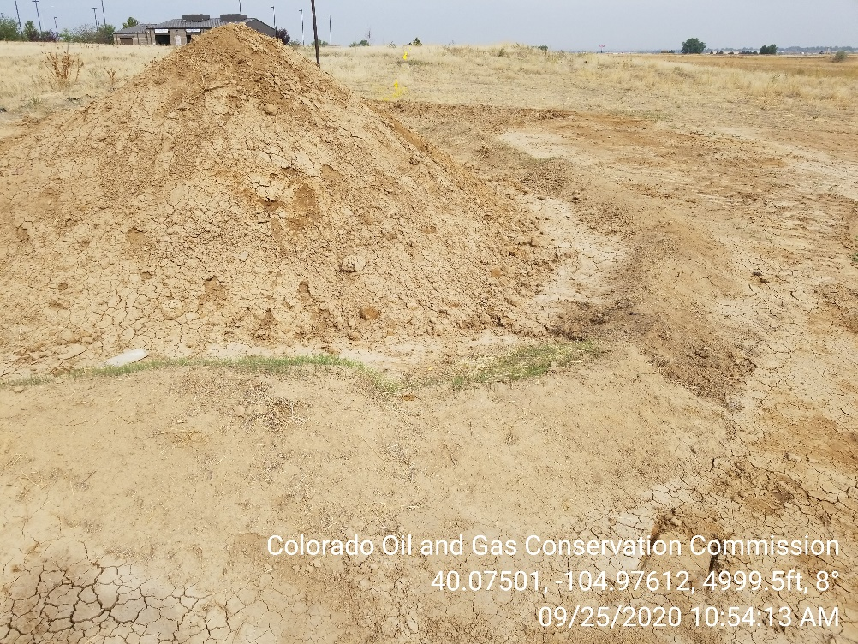
Inspection Photos
Location Name: James S Haley Trustee B #2 Flowline Release
Spill ID: 478014
Photo 3 –Soils pile. BMPs inadequate to contain runoff.
Photo 4 – Soils pile. BMPs inadequate to contain runoff.

