Slide 1
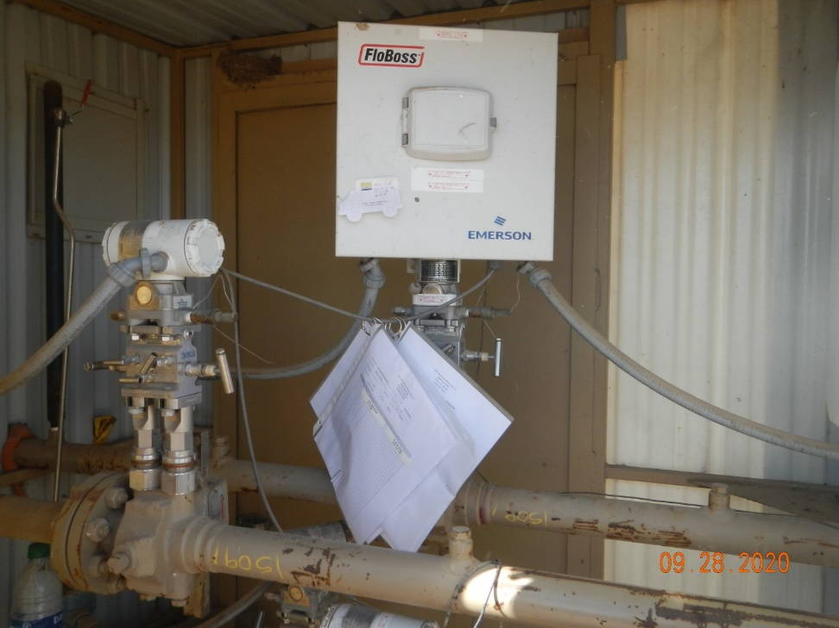
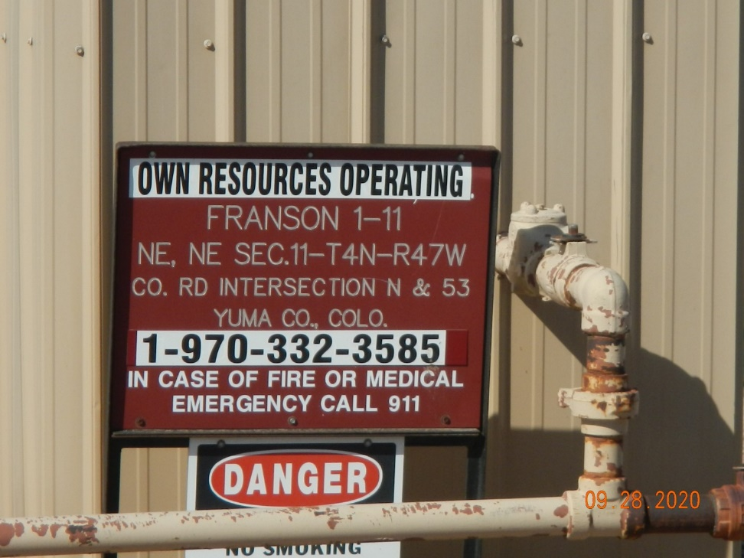
Operator Name: OWN
Facility Name: Franson 1-11
Location ID# 125-02355
GM – Calibration cert.
Signage – GMR – Sep.

