Slide 1
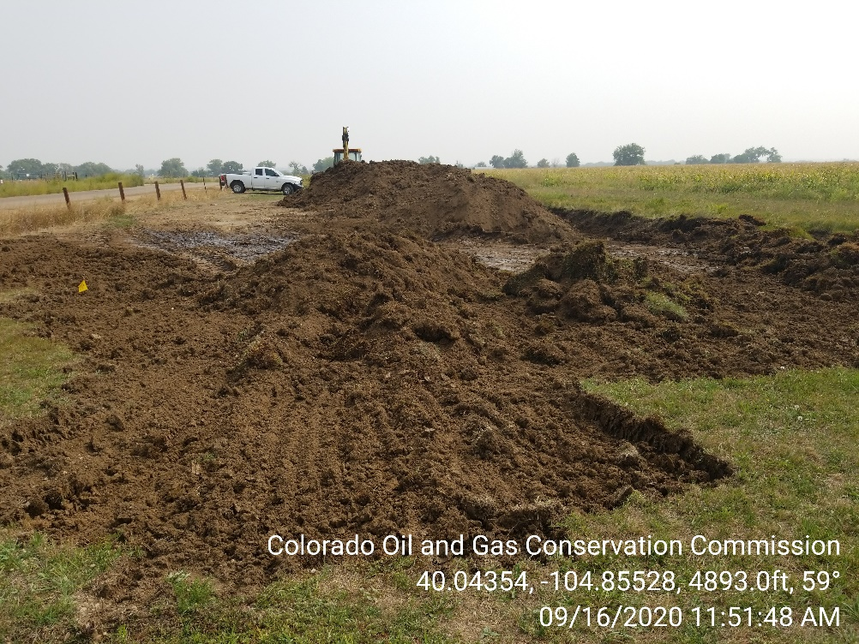
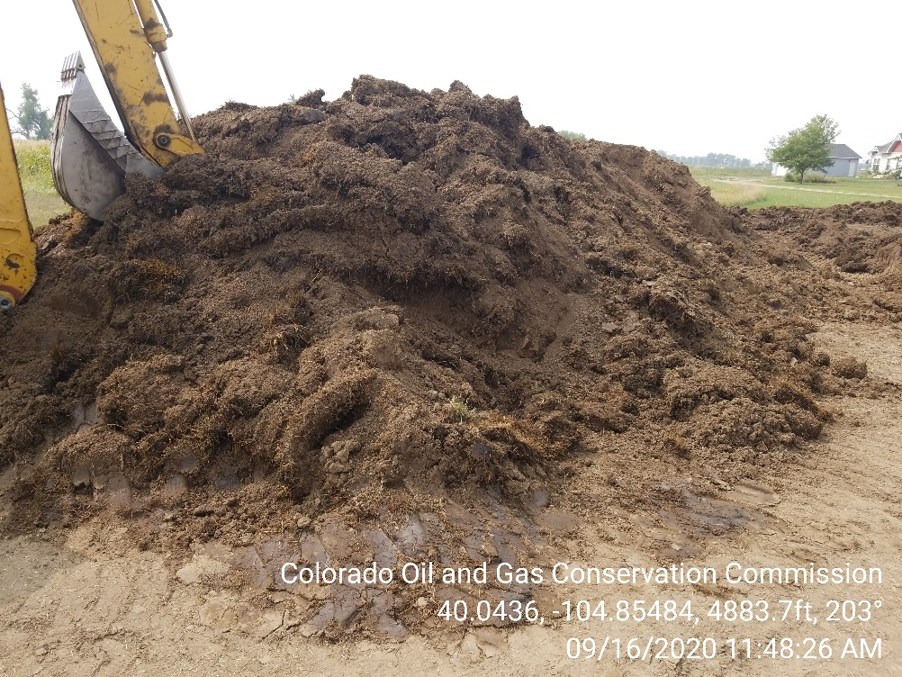

Inspection Photos
Location Name: H. Huett Consolidation Release
Spill ID: 478005
Photo 1 – Spill area. Oily wasted stockpiled on location with partial excavation. Hydrocarbon fluids pooling on soil surface.
Photo 2 – Oily waste stockpiled on location

Slide 2
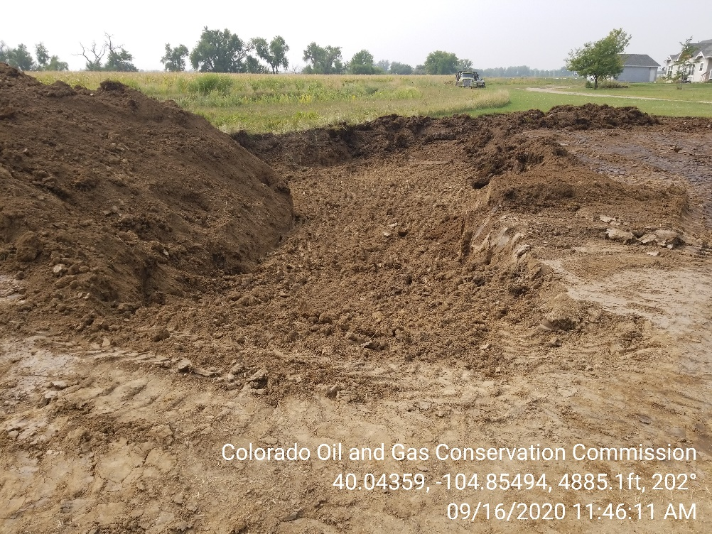
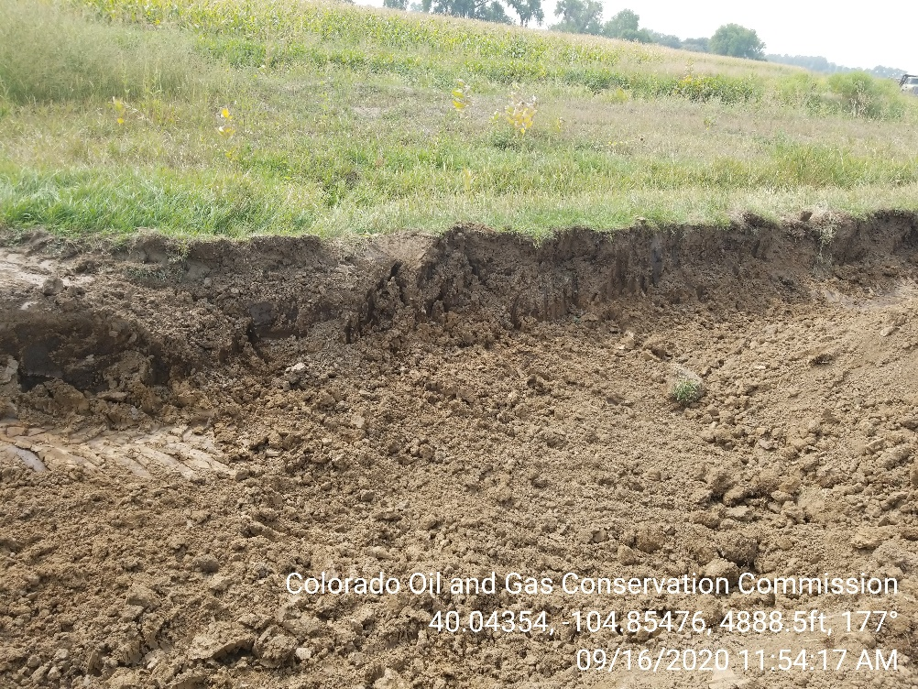
Inspection Photos
Location Name: H. Huett Consolidation Release
Spill ID: 478005
Photo 3 – Area of spill excavation
Photo 4 – Area of spill excavation

Slide 3
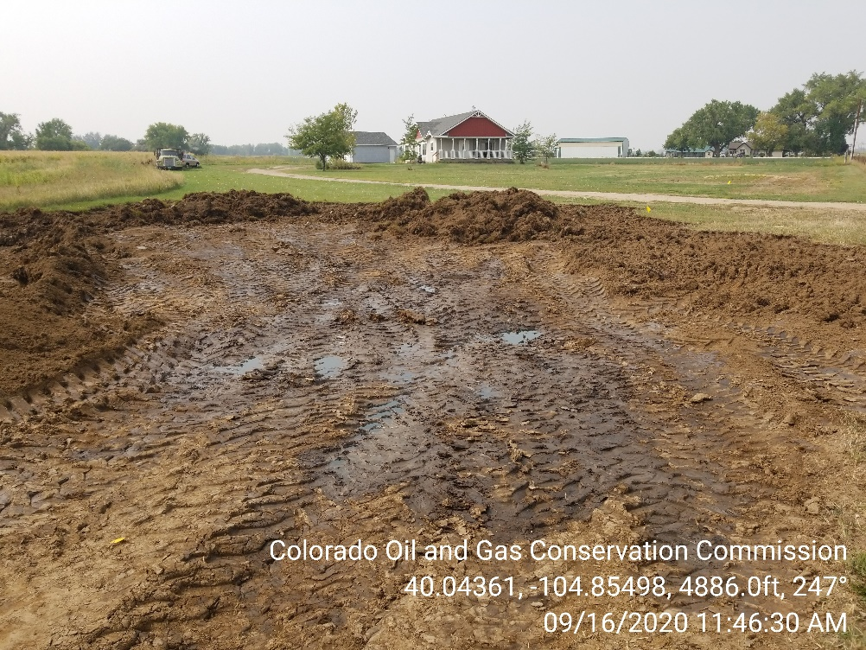
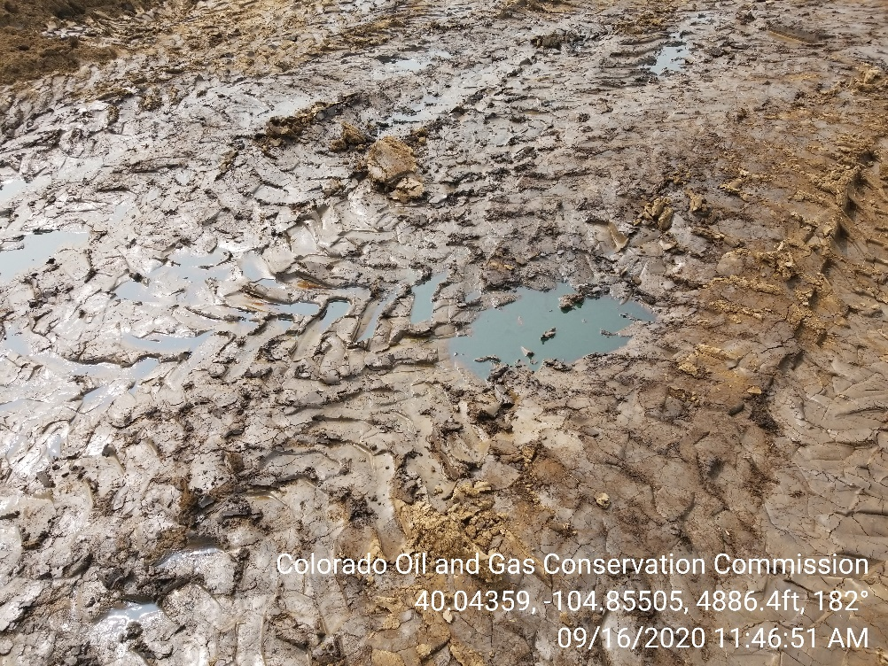
Inspection Photos
Location Name: H. Huett Consolidation Release
Spill ID: 478005
Photo 5 – Pooled fluids on location. Private residence approximately 300’ from spill location.
Photo 6 – Pooled fluids on location.

Slide 4
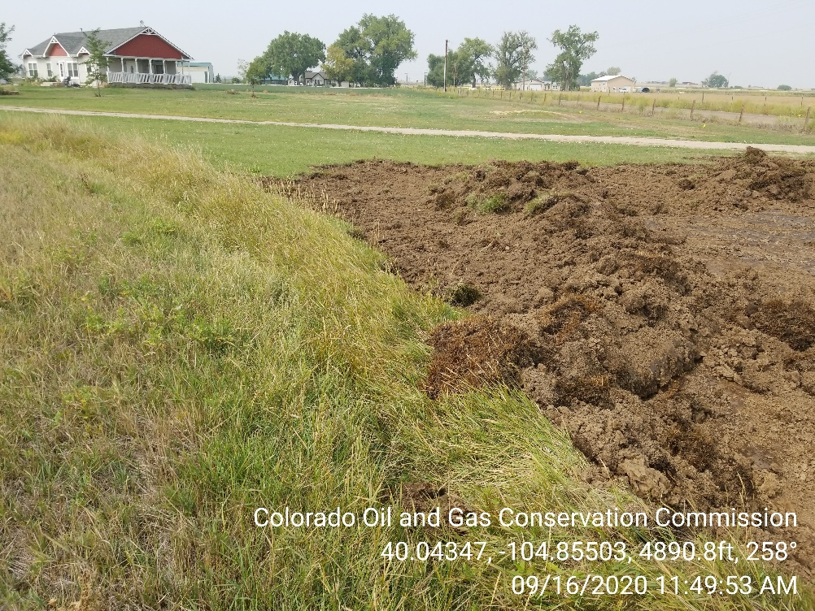
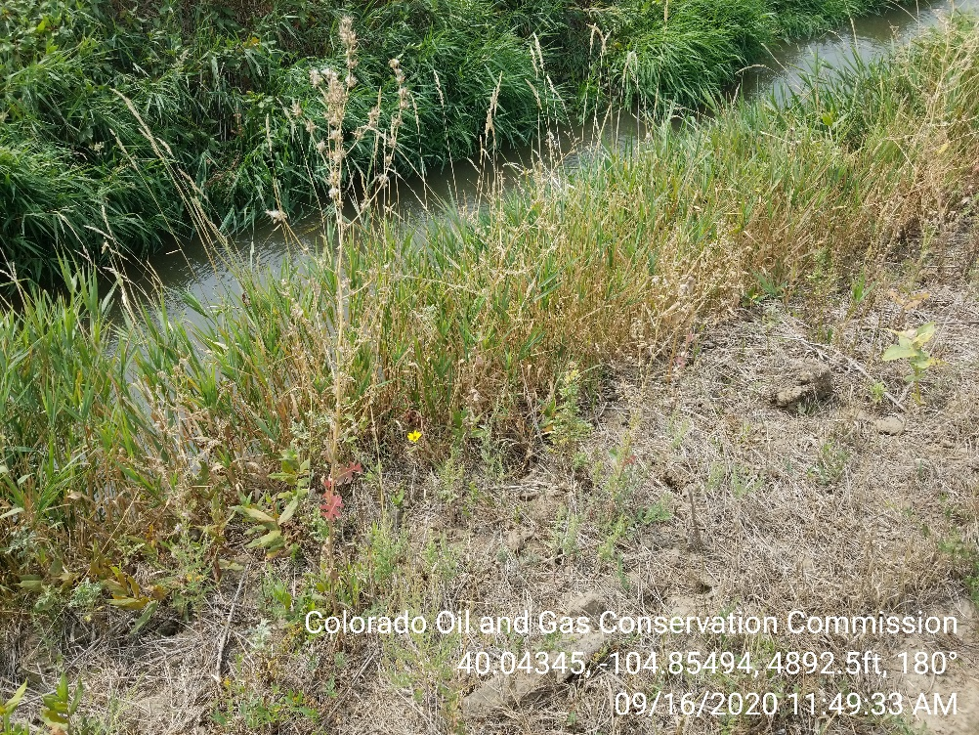
Inspection Photos
Location Name: H. Huett Consolidation Release
Spill ID: 478005
Photo 7 – Oily soil/vegetation piled on location.
Photo 8 – Flowing Brighton Ditch; approximately 15’ from spill location.

