Slide 1
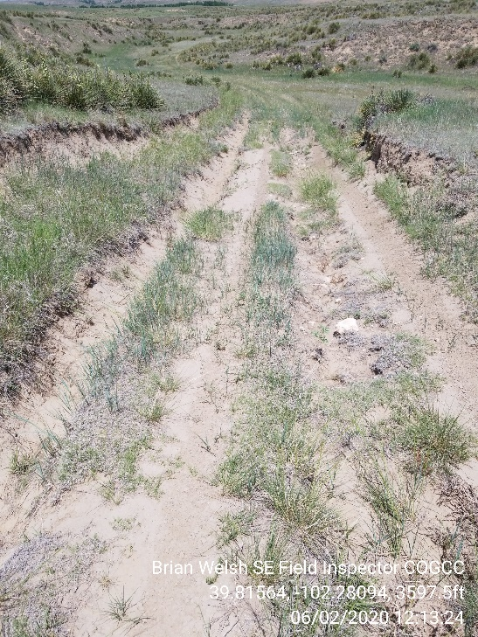
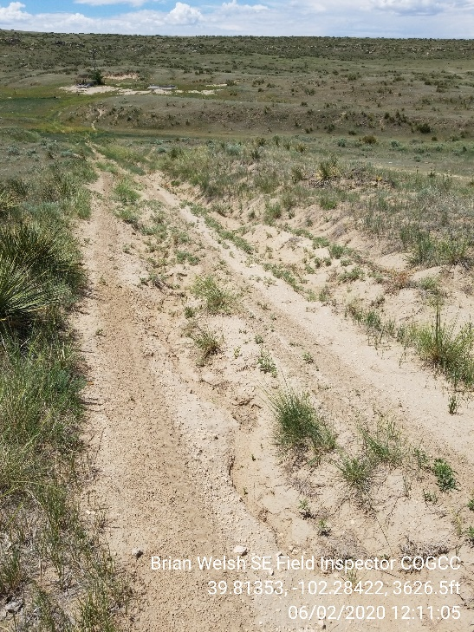
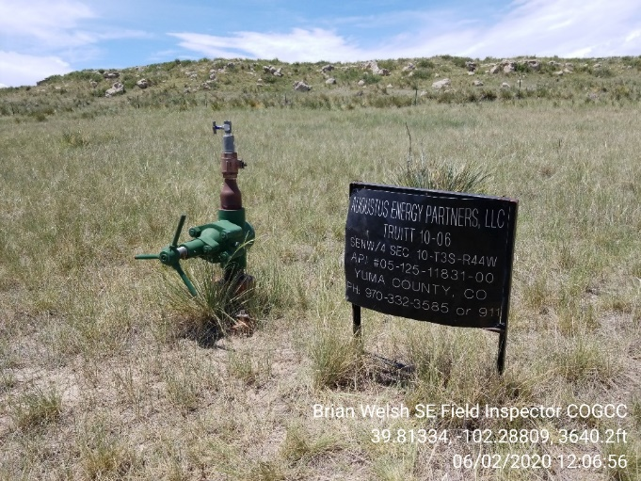
Inspection Photos
Location Name: Truitt 10-06
API: 05-125-11831
1. Access to wellhead is impassable and needs maintenance
2. Wellhead. Update lease sign to current operator
3. Access near windmill is eroded and needs repaired

