Slide 1
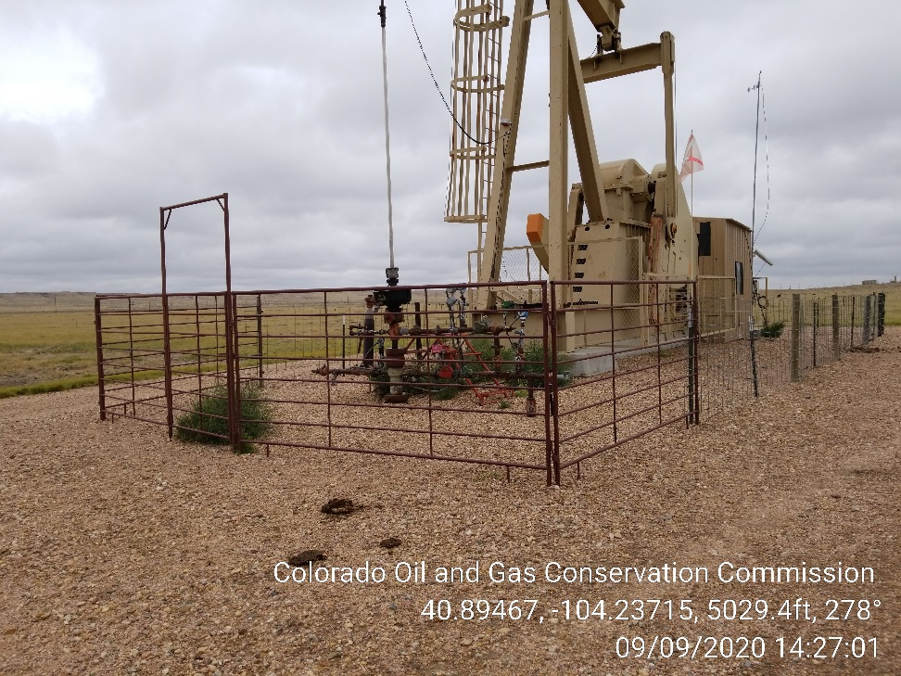
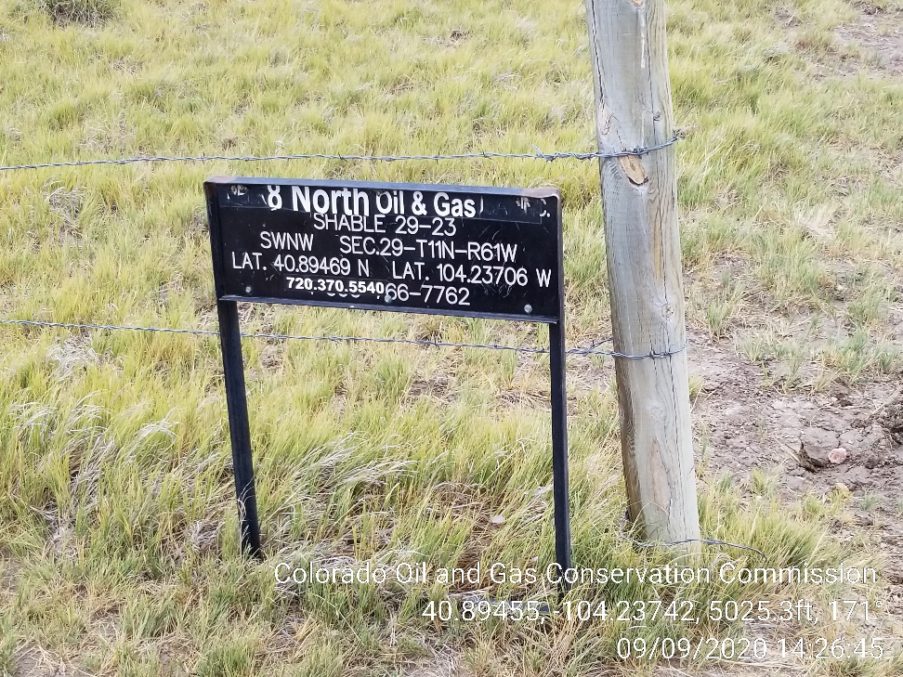
Inspection Photos
Location Name: Shable 29-23
Location ID: 410182
Photo 1 – Pumping Unit, Weeds
Photo 2 – Wellhead Sign

