Slide 1
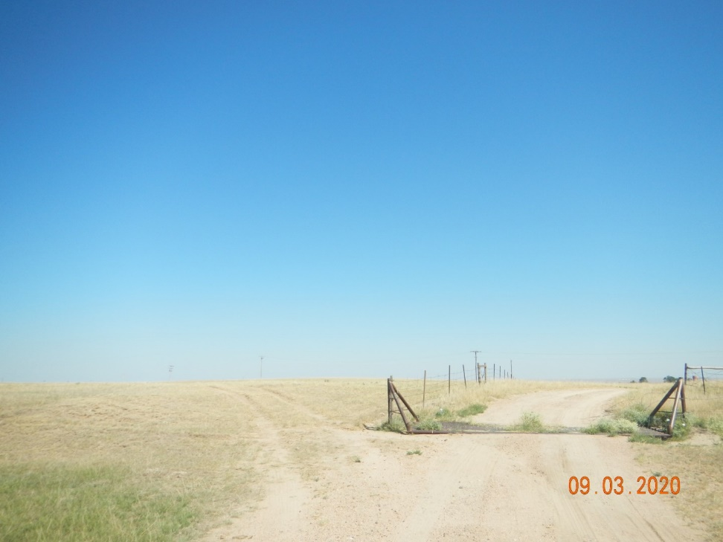
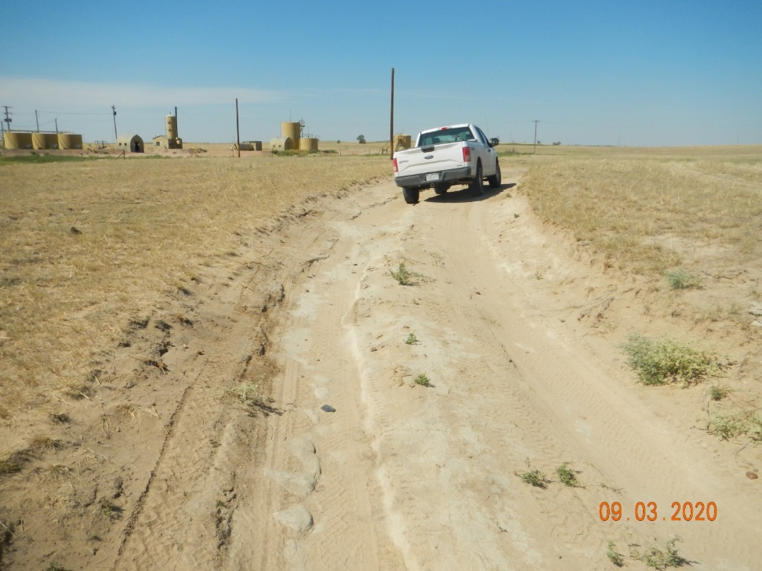
Operator Name: KP Kauffman
Facility Name: Knudson 7
Location ID# 075-07533
Unapproved bypass lease road
Lease road erosion-damage

Slide 2
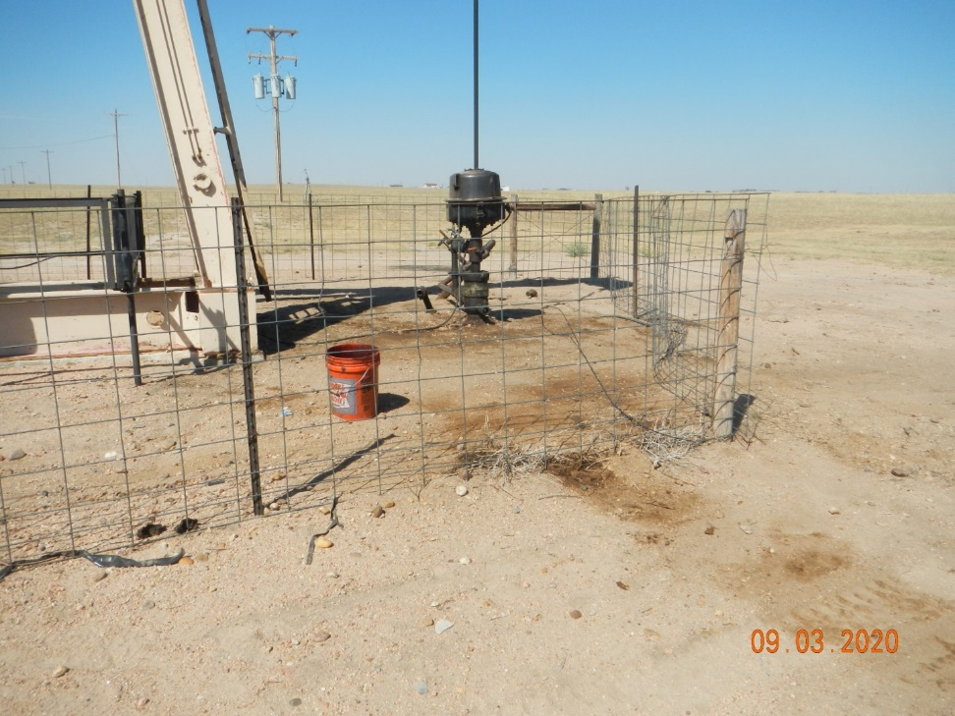
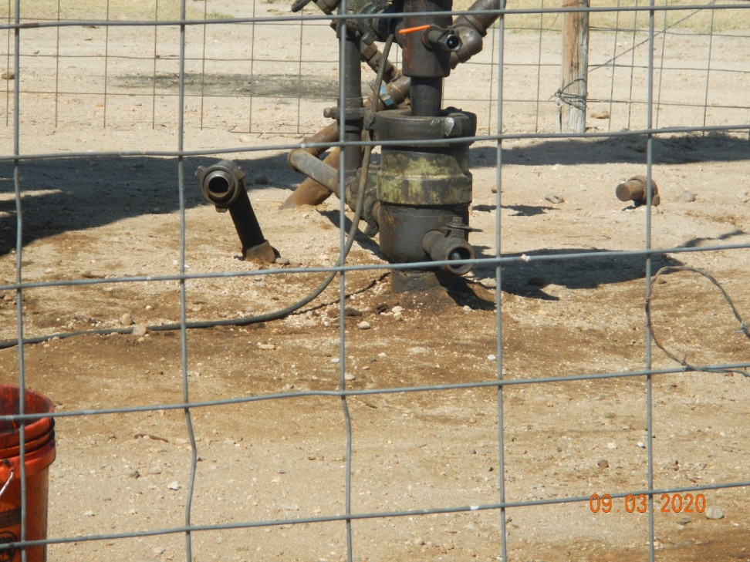
Operator Name: KP Kauffman
Facility Name: Knudson 7
Location ID# 075-07533
Stain @ wellhead
Stain @ wellhead

Slide 3
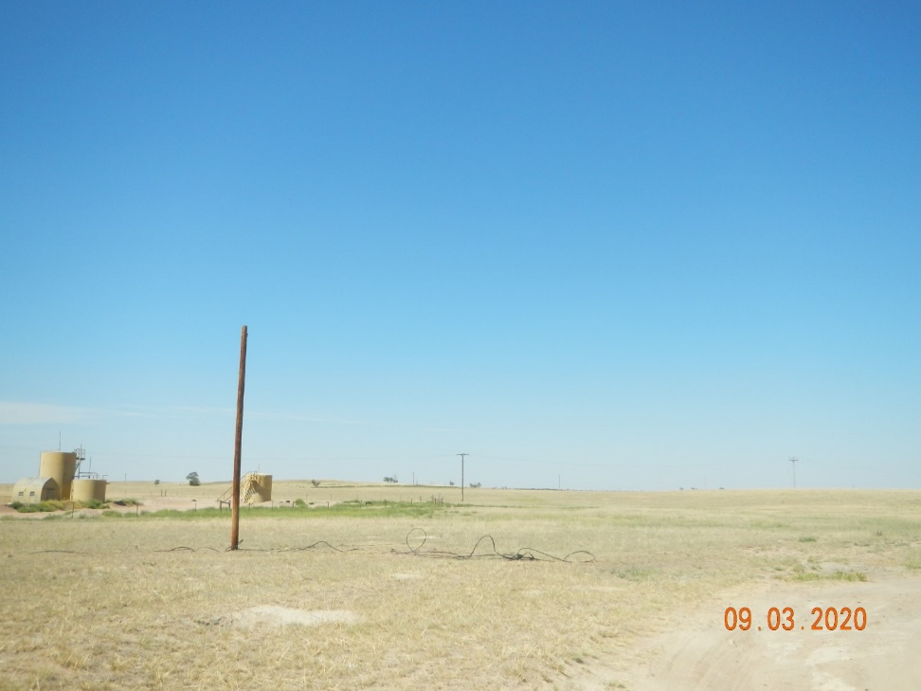
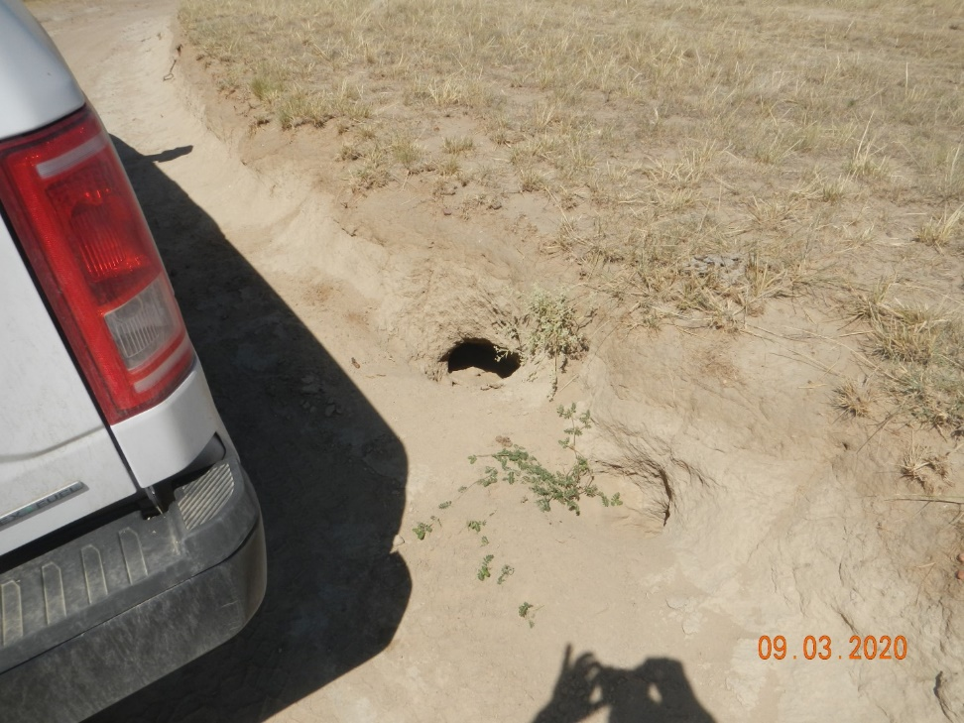
Operator Name: KP Kauffman
Facility Name: Knudson 7
Location ID# 075-07533
Abandoned elec. service to well
Badger hole on lease road

Slide 4
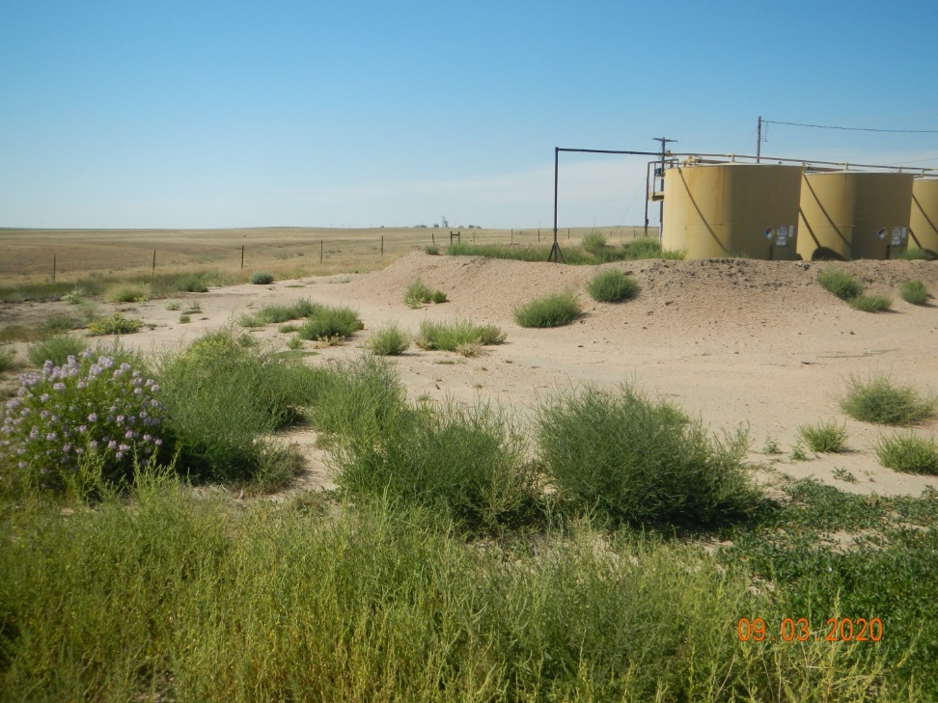
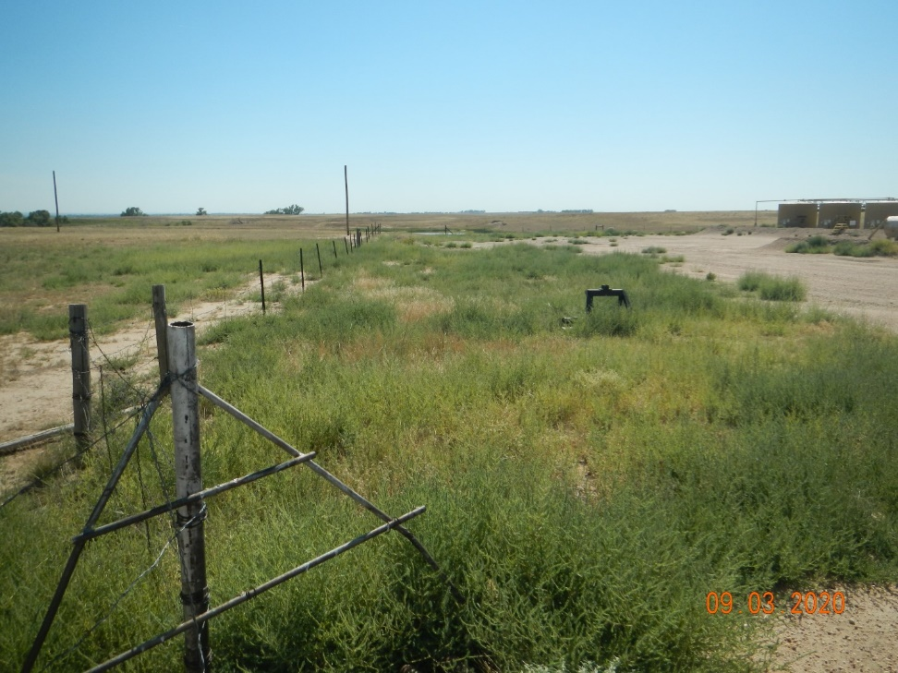
Operator Name: KP Kauffman
Facility Name: Knudson 7
Location ID# 075-07533
Weeds @ tank battery – inside and outside berms
Weeds @ battery

Slide 5
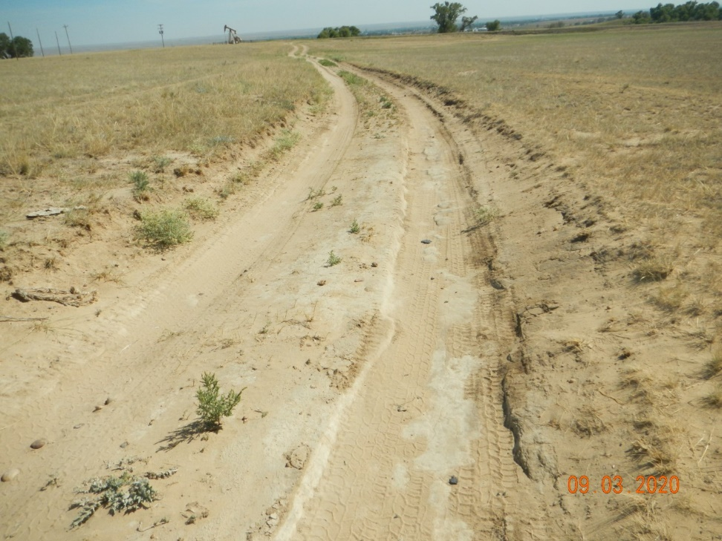
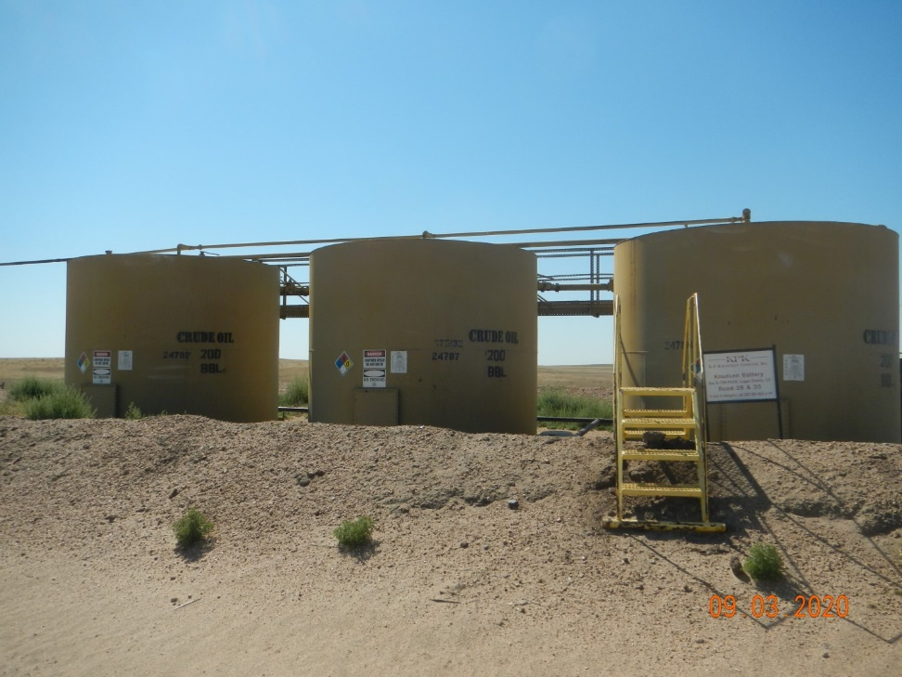
Operator Name: KP Kauffman
Facility Name: Knudson 7
Location ID# 075-07533
Lease road erosion
Placarding @ battery

