Slide 1
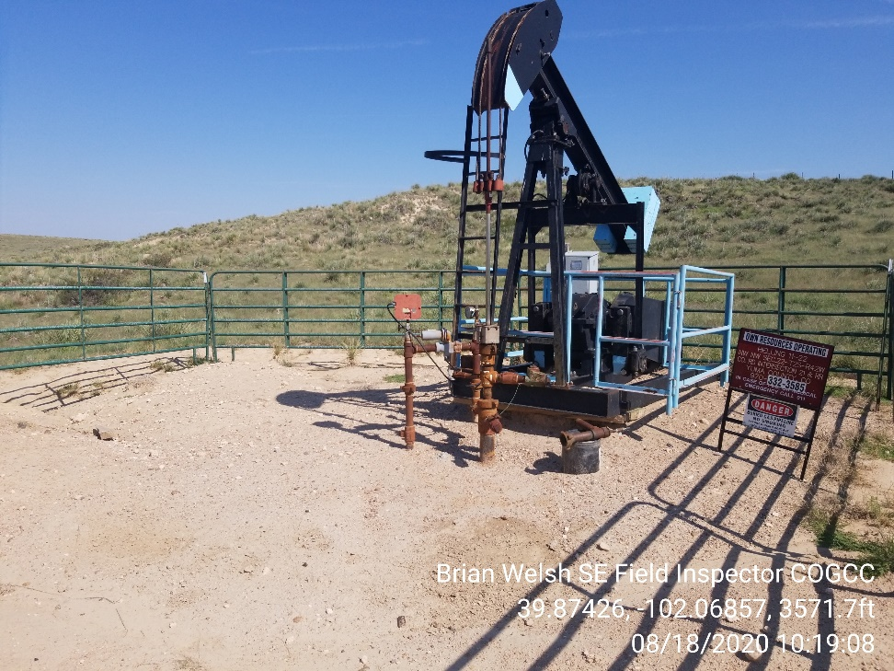
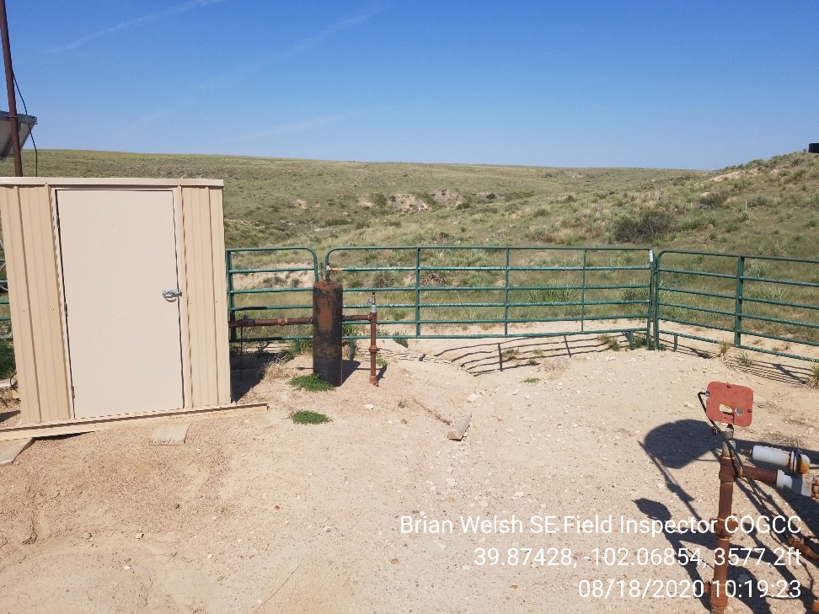
Inspection Photos
Location Name: Helling 11-22
API: 05-125-10203
1. Wellhead
2. Erosion leading off of location

Slide 2
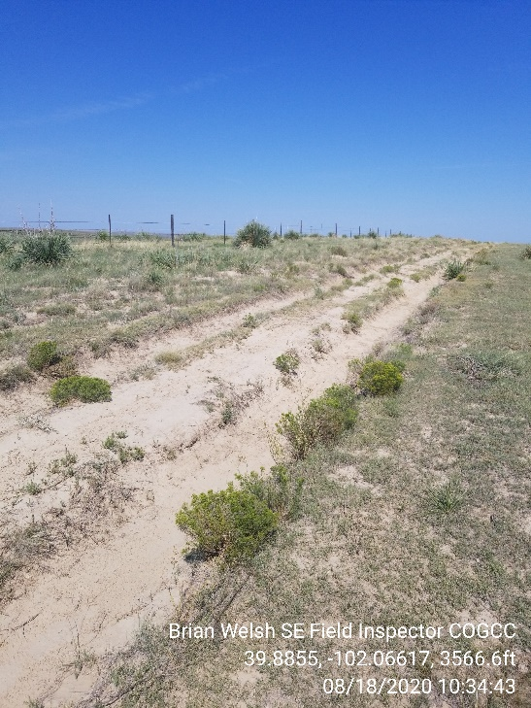
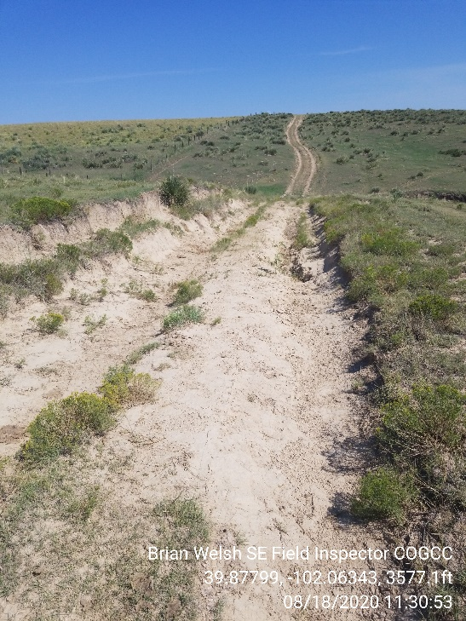
Inspection Photos
Location Name: Helling 11-22
API: 05-125-10203
3. Deep tire tracks on access
4. Access needs maintenance

