Slide 1
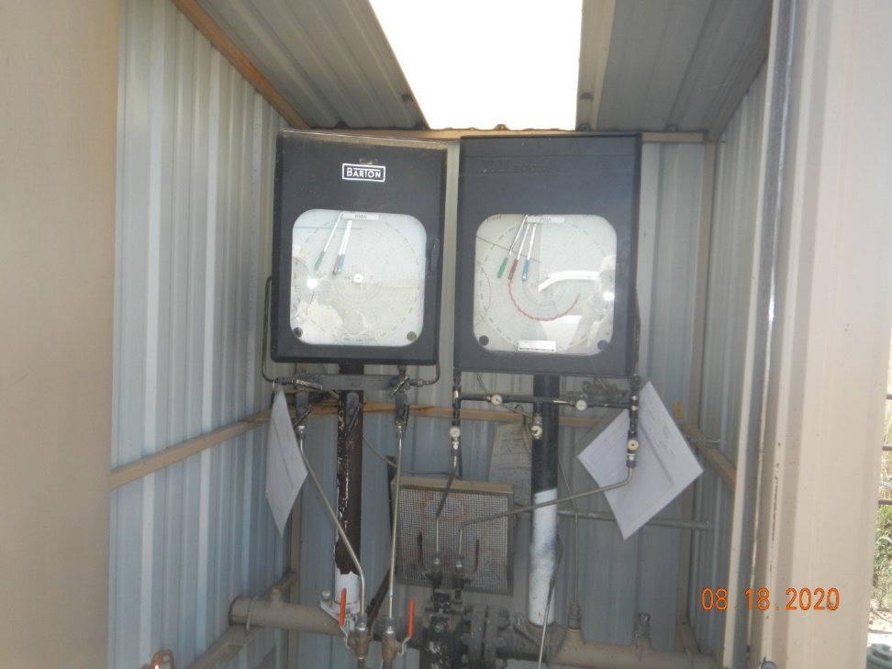
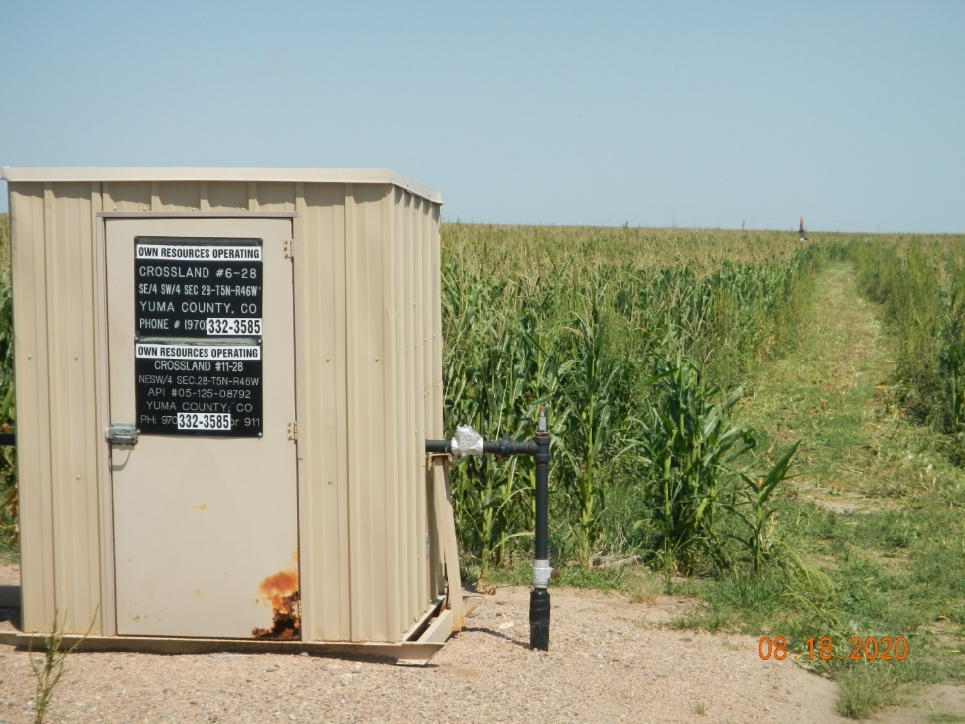
Operator Name: OWN
Facility Name: Salvador 14-28
Location ID# 125-10554
Calibration Cert.
Signage – GMR- Wellhead/PJ

