Slide 1
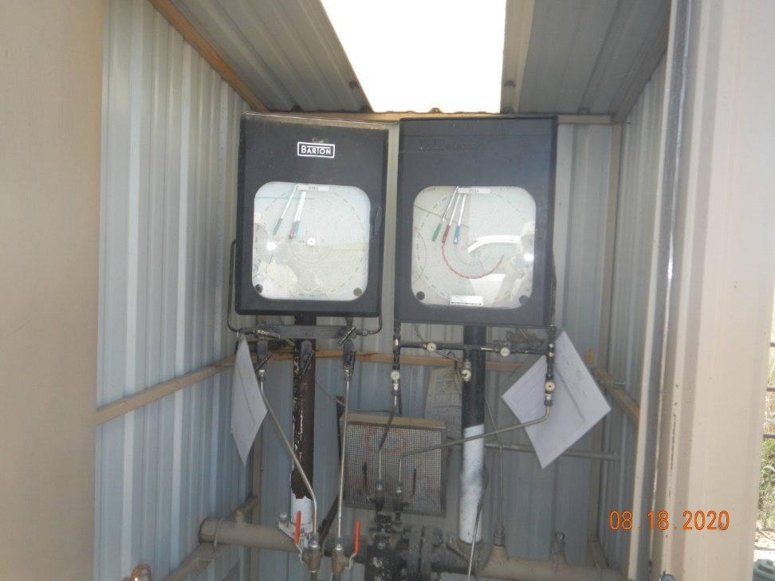
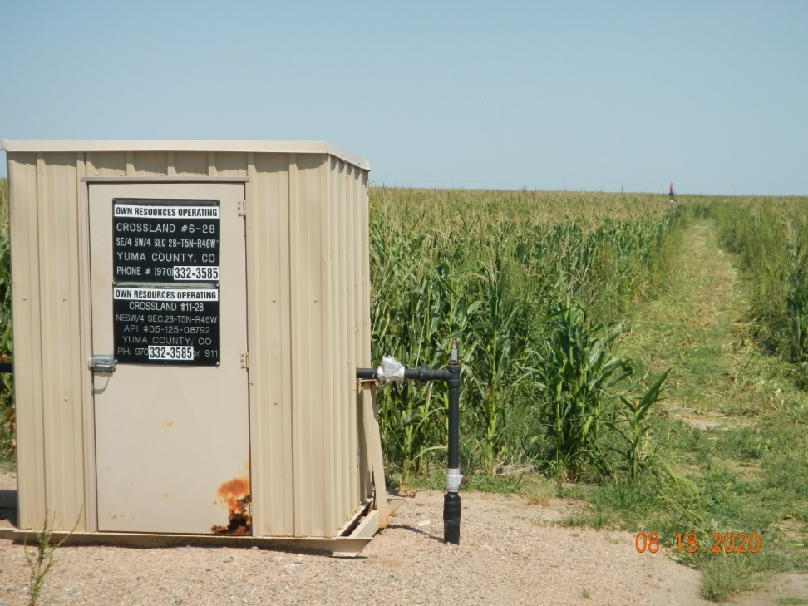
Operator Name: OWN
Facility Name: Salvador 9-28
Location ID# 125-08110
Calibration Cert.
Signage – GMR- Wellhead/PJ

