Slide 1
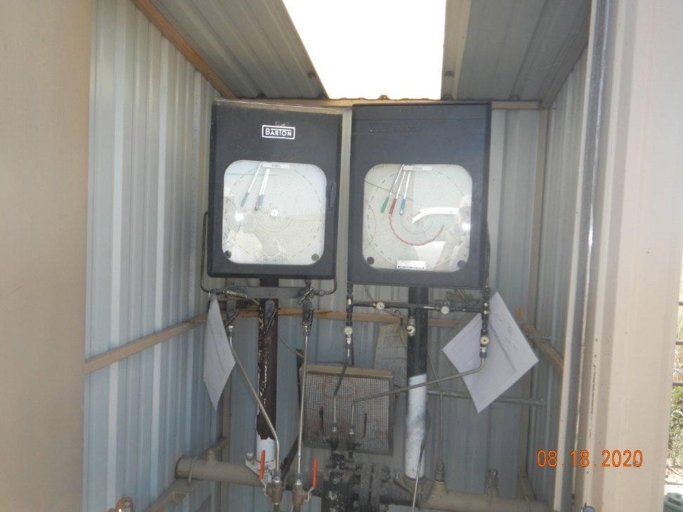
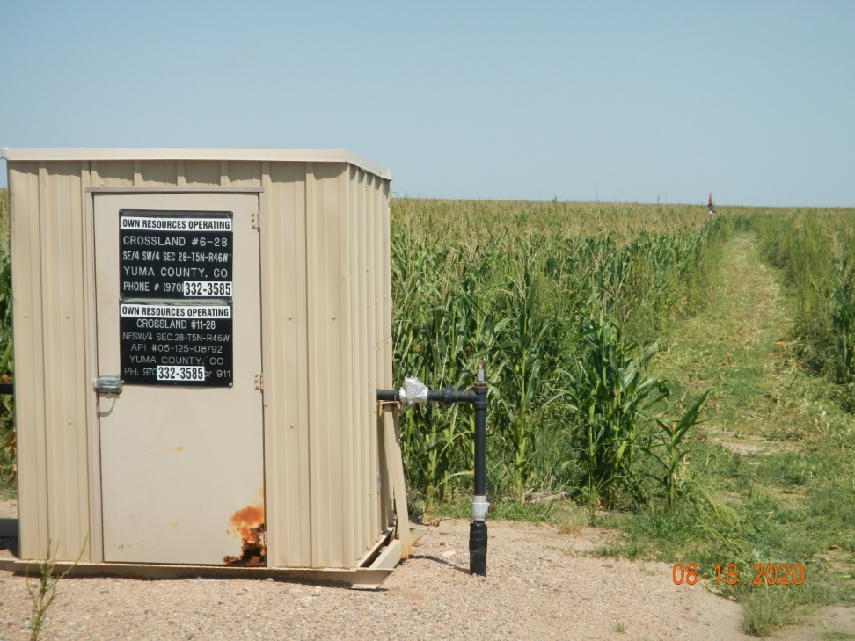
Operator Name: OWN
Facility Name: Crossland11-28
Location ID# 125-08792
Calibration Cert.
Signage - GMR

