Slide 1
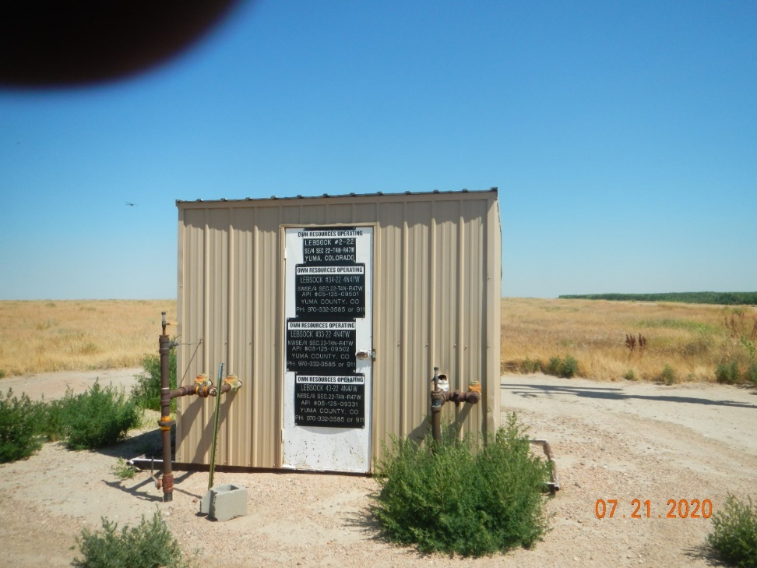
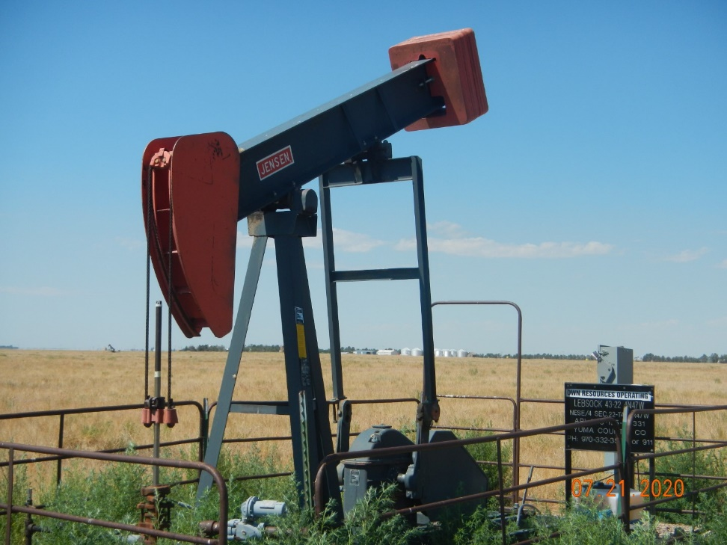
Operator Name: OWN
Facility Name: Lebsock 43-22
Location ID# 125-09331
GMR - Weeds
Wellhead-PJ-Signage-Weeds

