Slide 1
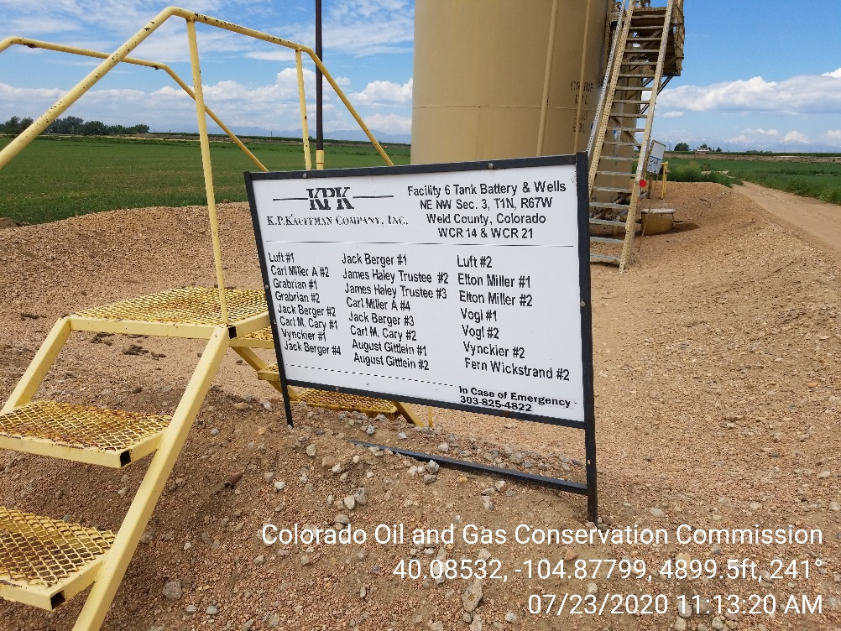
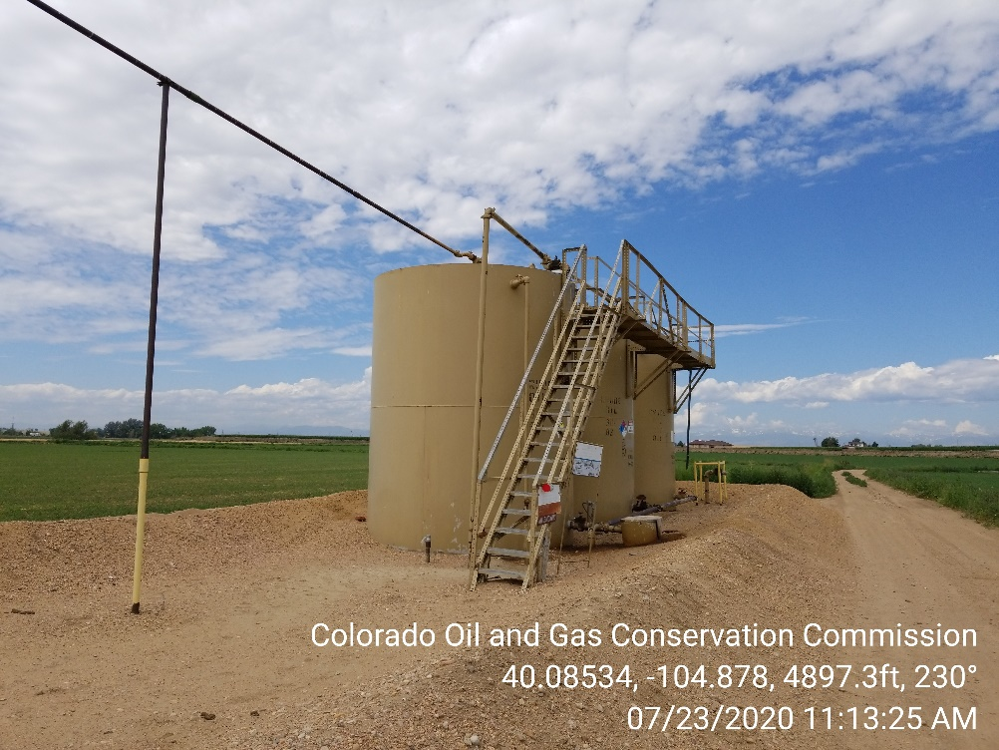
Inspection Photos
Location Name: AUGUST GITTLEIN 1 Pit
Location ID 317646; Pit ID 118161
Photo 1 – Battery location sign
Photo 2 – Location photo

Slide 2
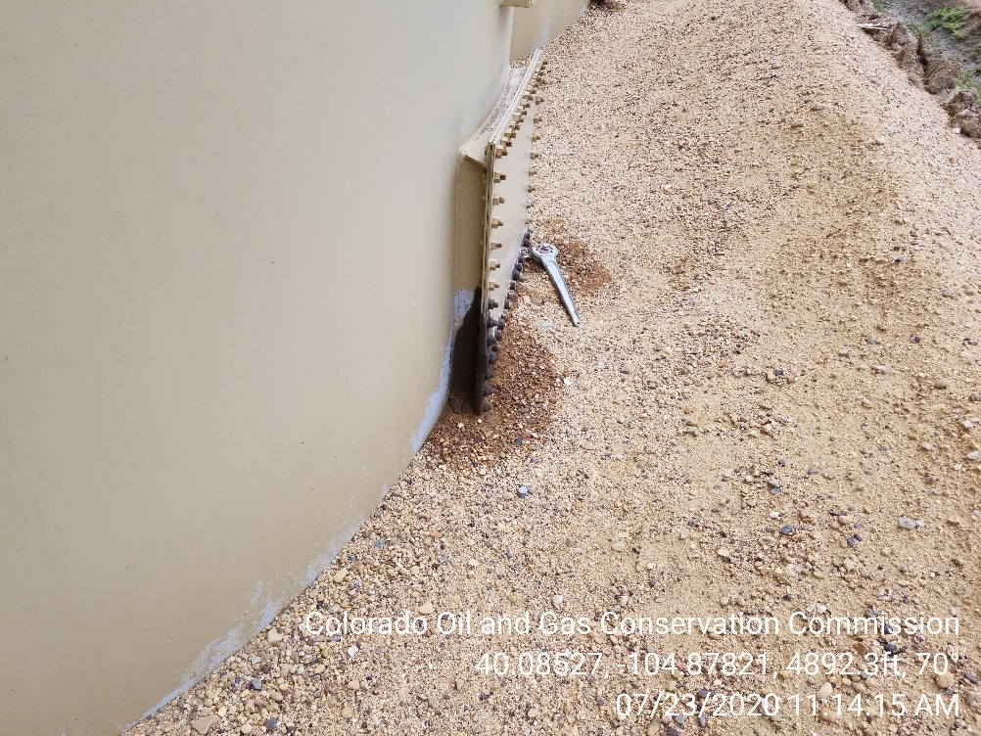
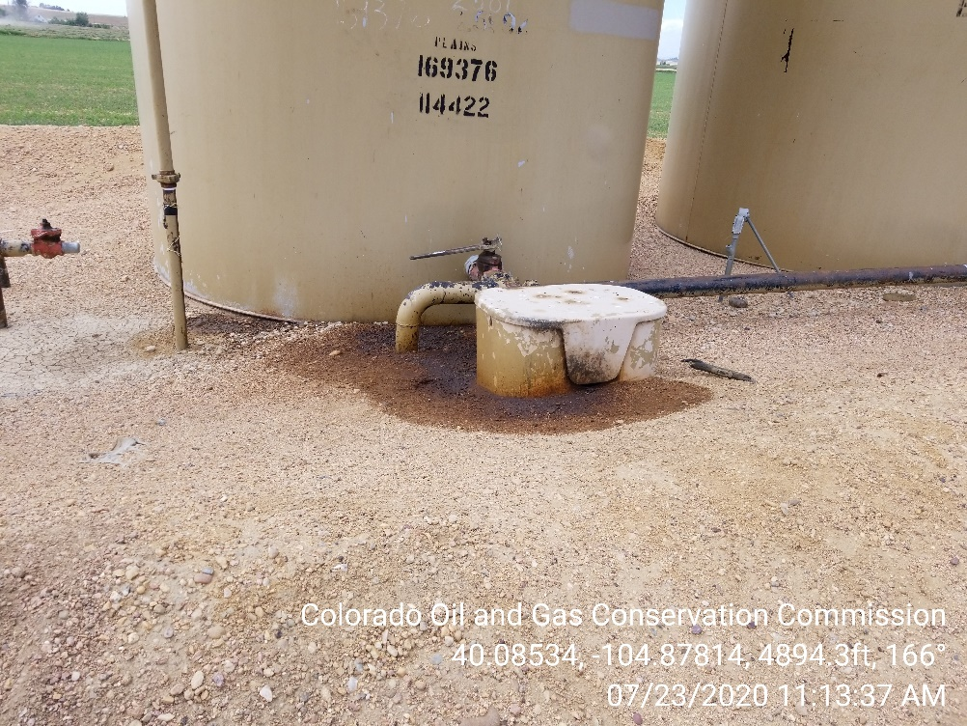
Inspection Photos
Location Name: AUGUST GITTLEIN 1 Pit
Location ID 317646; Pit ID 118161
Photo 3 – Stained soil
Photo 4 – Stained soil

Slide 3
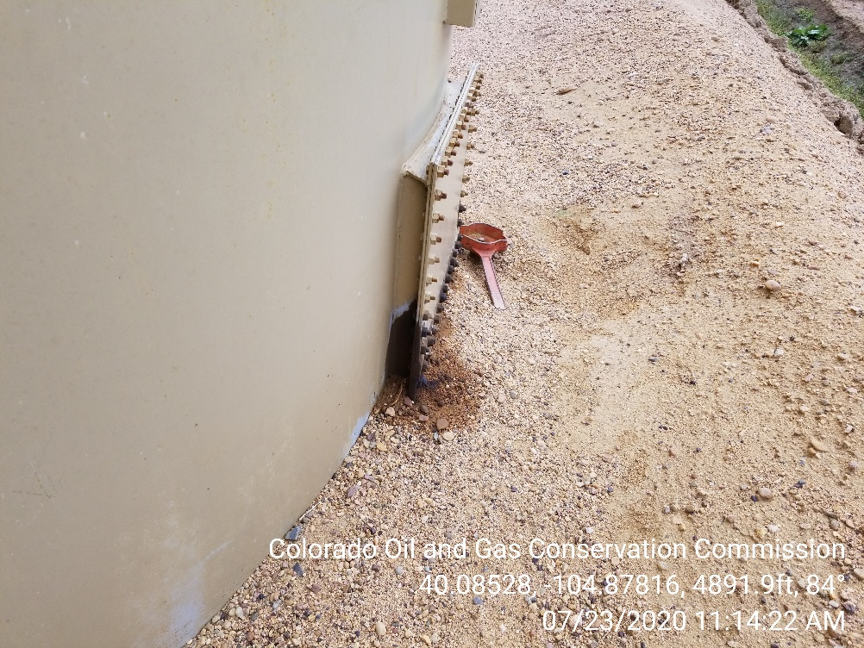
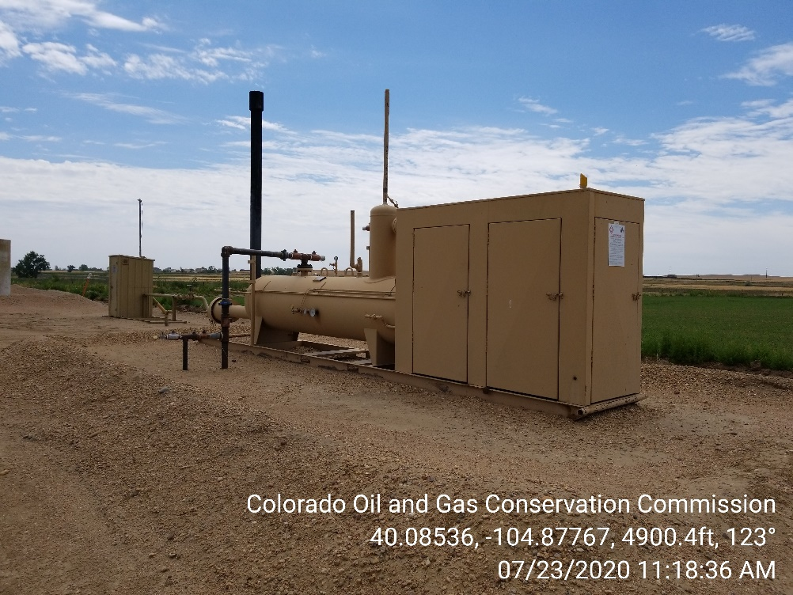
Inspection Photos
Location Name: AUGUST GITTLEIN 1 Pit
Location ID 317646; Pit ID 118161
Photo 5 – Stained soil
Photo 6 – Location photo

Slide 4
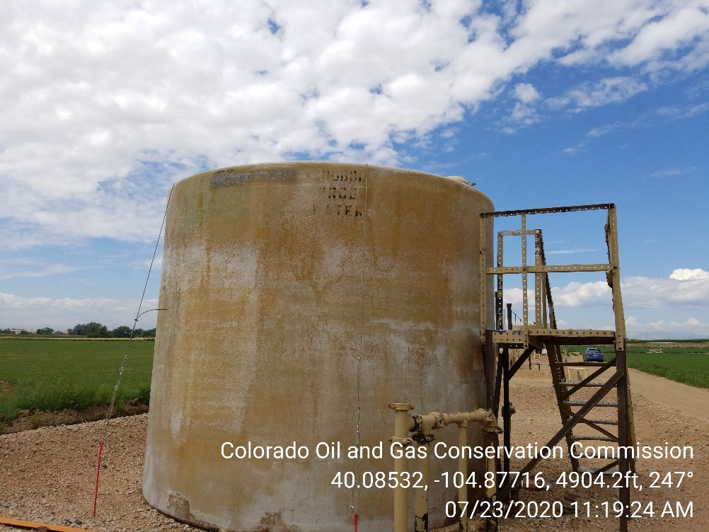
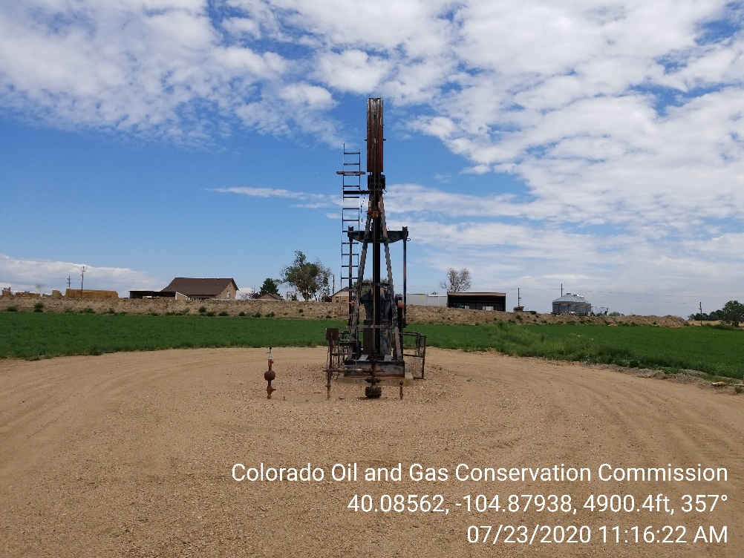
Inspection Photos
Location Name: AUGUST GITTLEIN 1 Pit
Location ID 317646; Pit ID 118161
Photo 7 – Fiberglass produced water tank
Photo 8 – Well photo

Slide 5
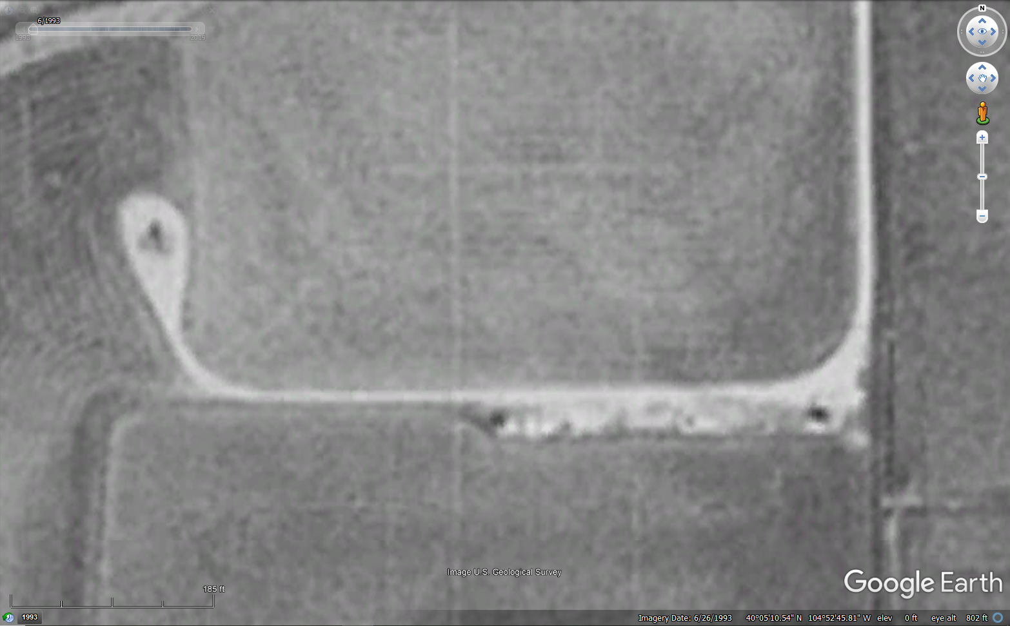
Aerial Imagery
Location Name: AUGUST GITTLEIN 1 Pit
Location ID 317646; Pit ID 118161
Photo 9 – 1993 aerial imagery

Slide 6
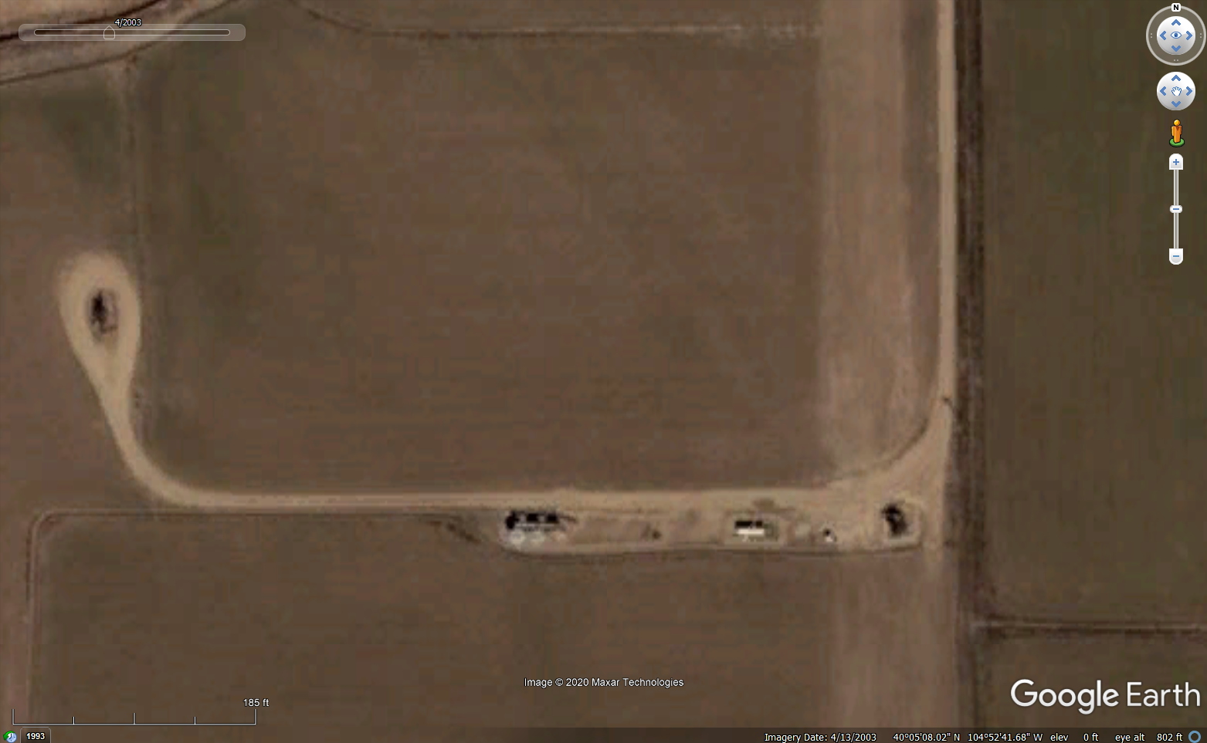
Aerial Imagery
Location Name: AUGUST GITTLEIN 1 Pit
Location ID 317646; Pit ID 118161
Photo 10 – 2003 aerial imagery

Slide 7
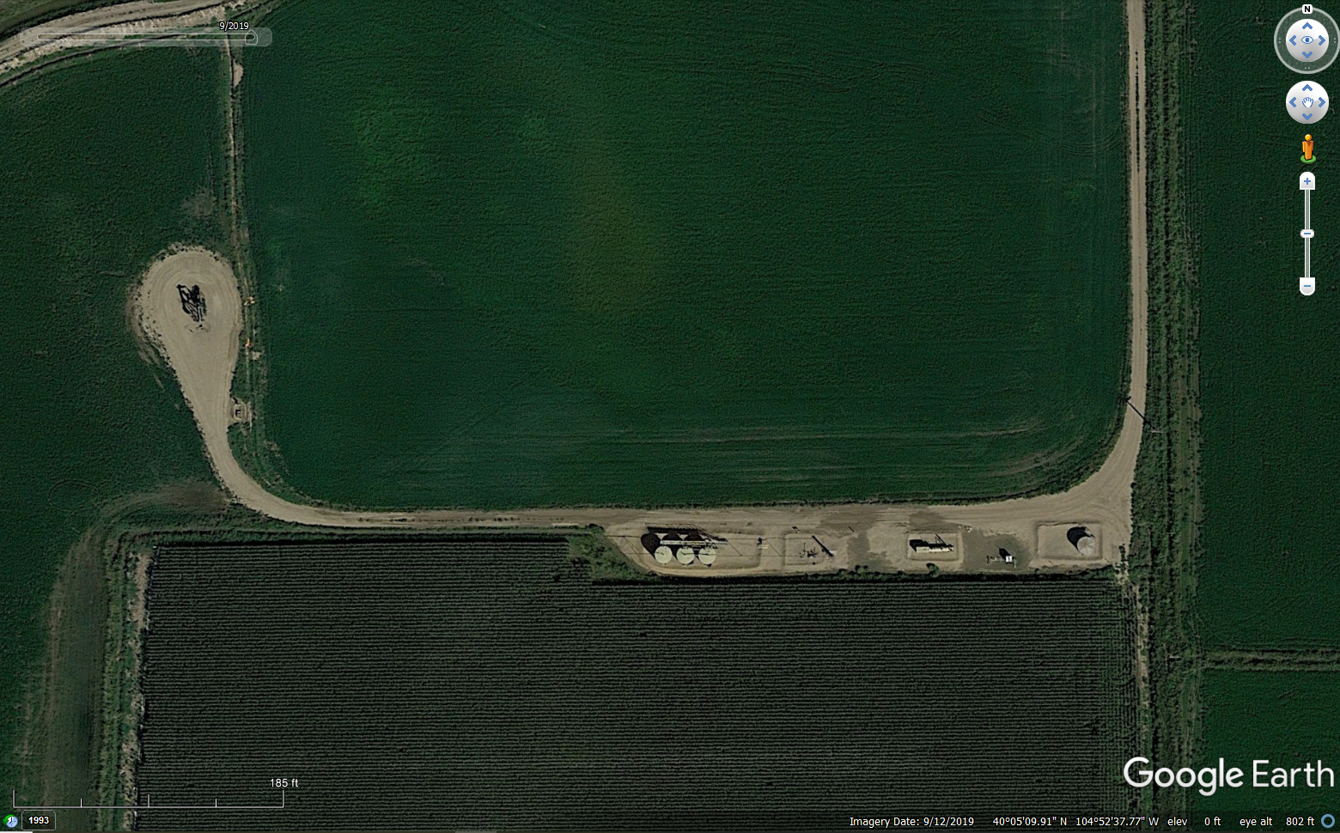
Aerial Imagery
Location Name: AUGUST GITTLEIN 1 Pit
Location ID 317646; Pit ID 118161
Photo11– 2019 aerial imagery

