Slide 1
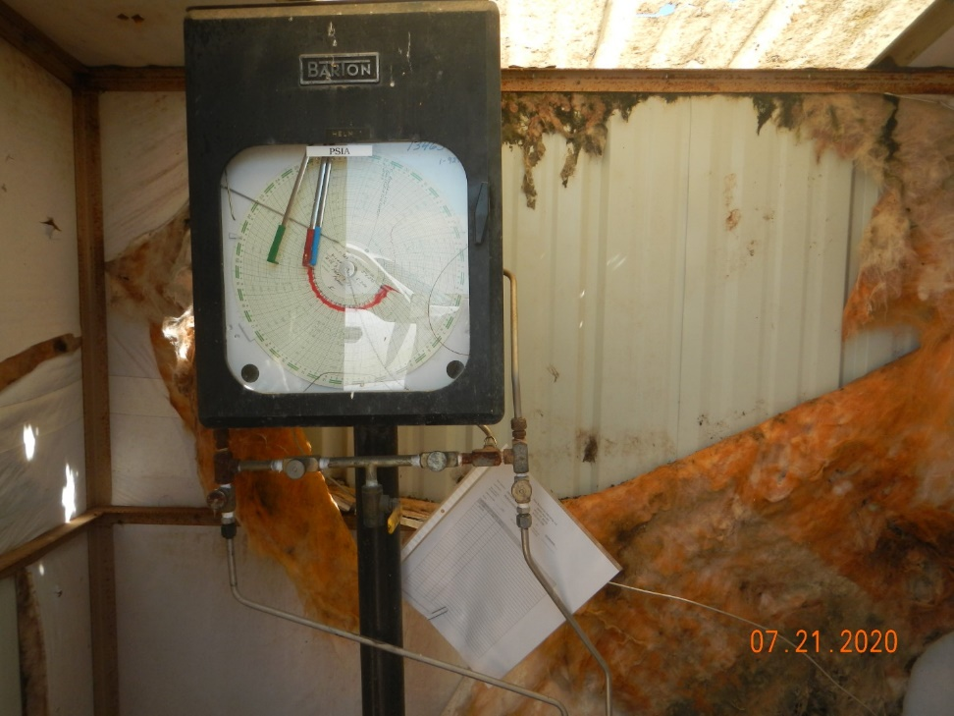
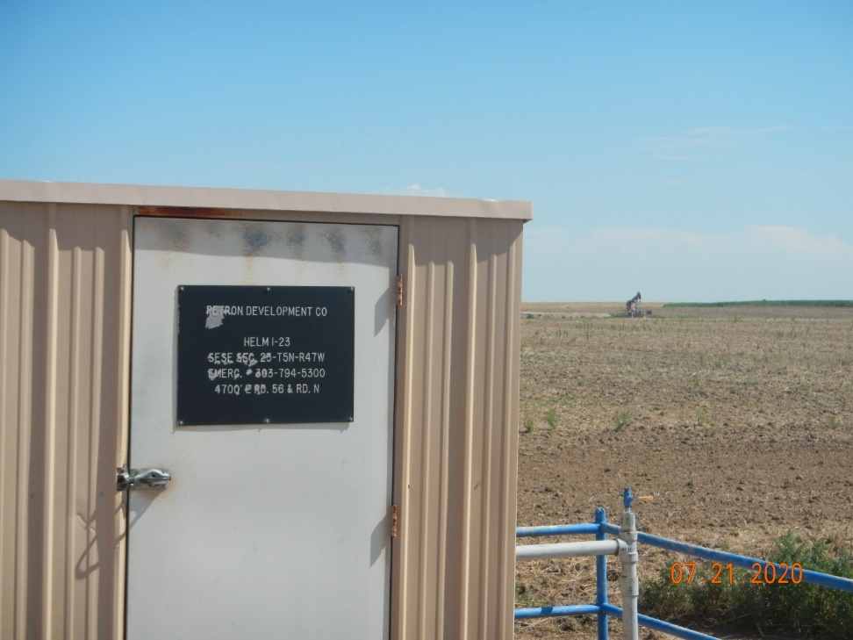
Operator Name: OWN Resources
Facility Name: Korf #3
Location ID# 125-07158
MR Calibration Cert.
MR

