Slide 1
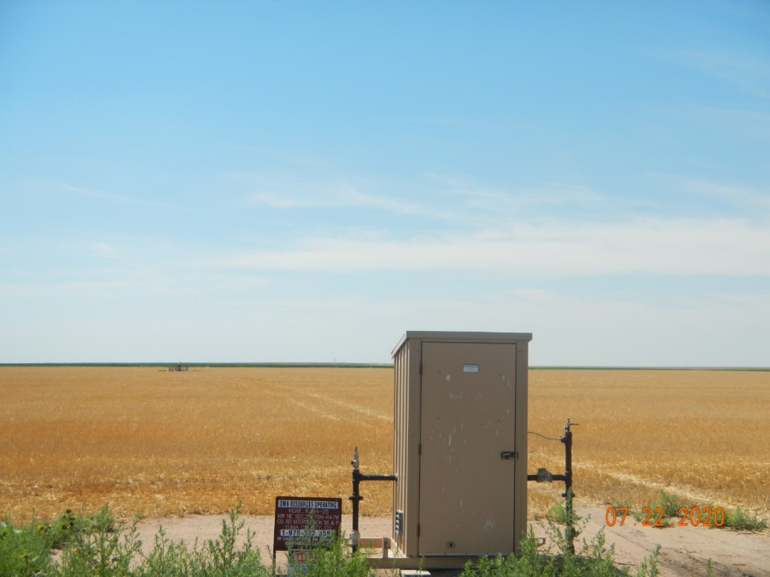
Operator Name: Petron Development
Facility Name: Korf 4-25
Location ID# 125-08813
PJ – Wellhead (background)
MR

