Slide 1
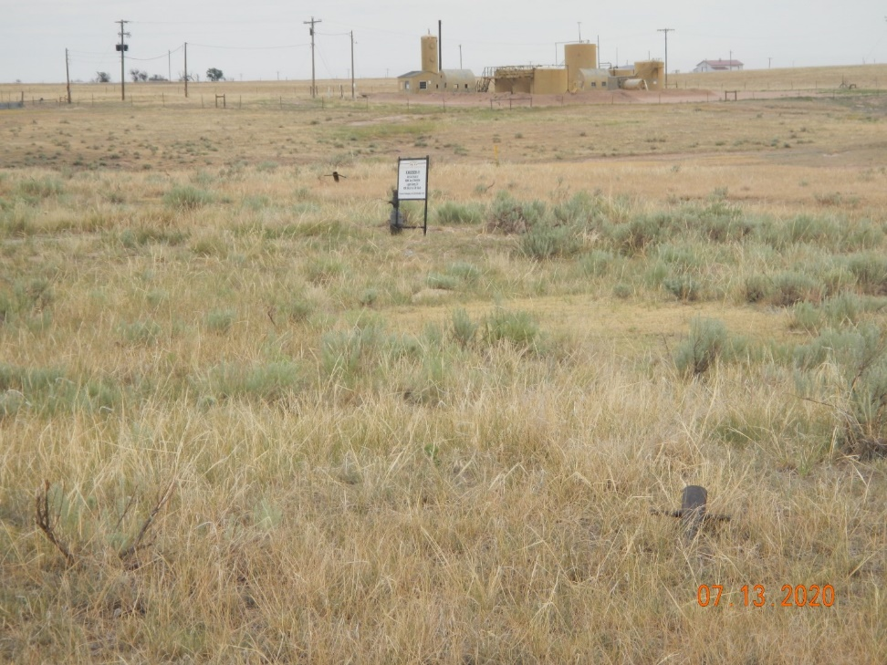
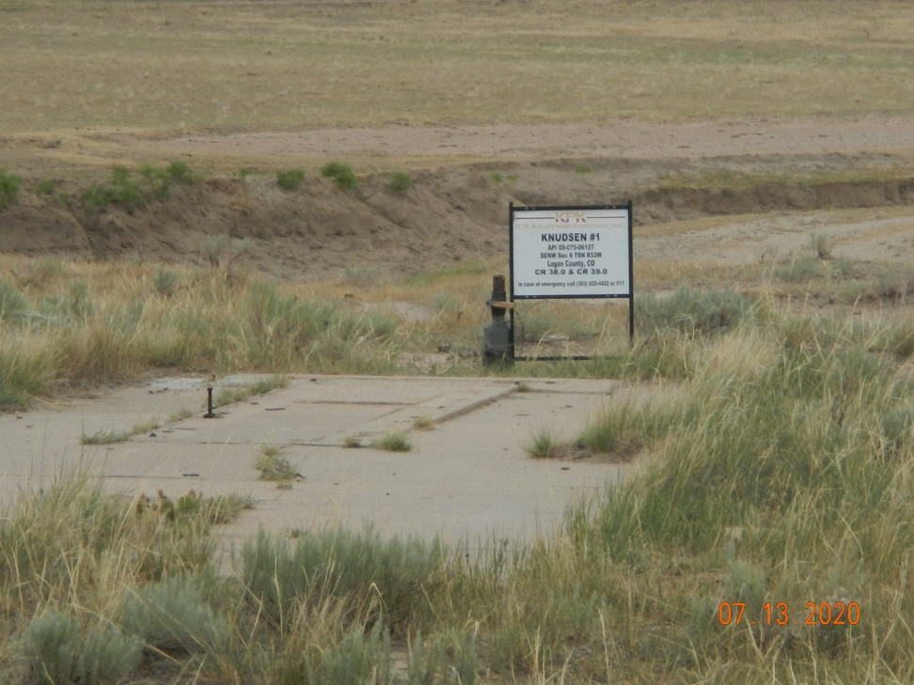
Operator Name: KP Kauffman Co.
Facility Name: Knudsen #1
Location ID# 075-06127
Unmarked deadman foreground and background
Wellhead-Signage-Concrete Pad

