Slide 1
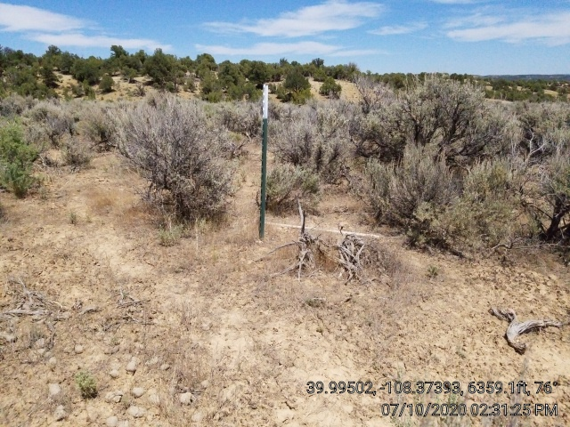
Yellow Creek 3-34-0364 API: 05-103-11856
Inspection: 700402342
Photo 1. Location.

