Slide 1
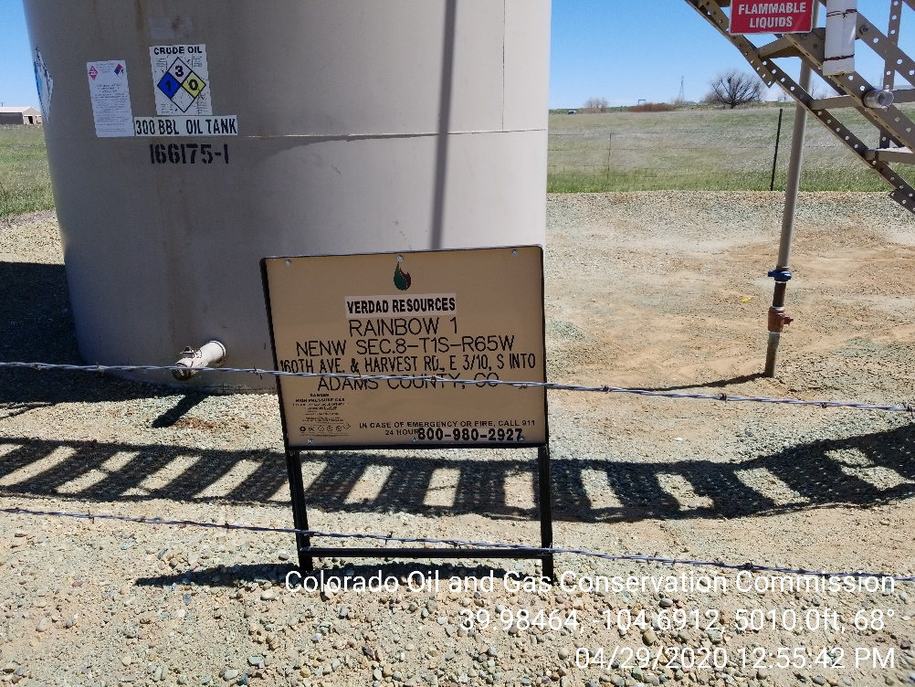
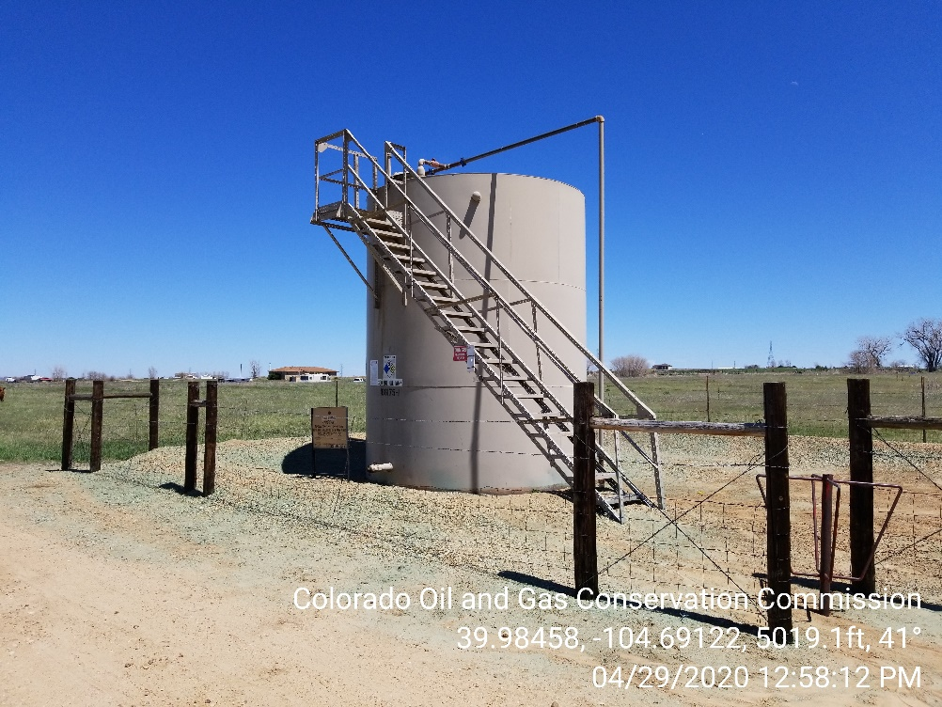

Inspection Photos
Location Name: KALLSEN #5
Location ID 322024
Photo 1 – Location photo
Photo 2 – Location photo

Slide 2
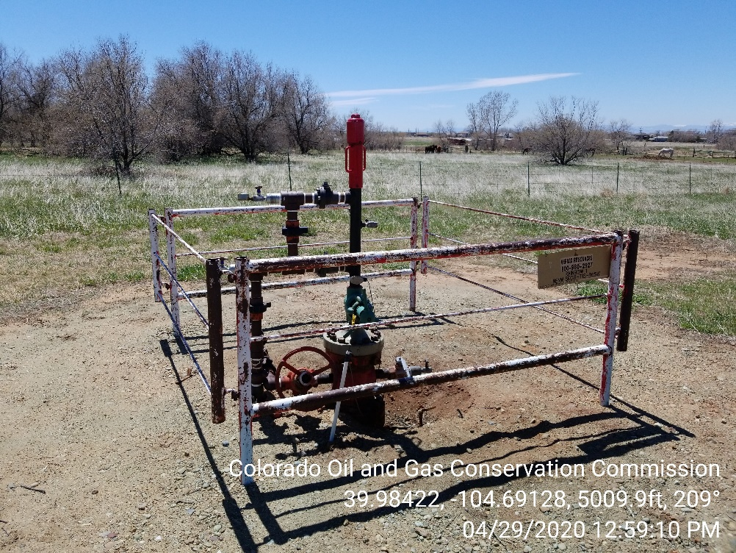
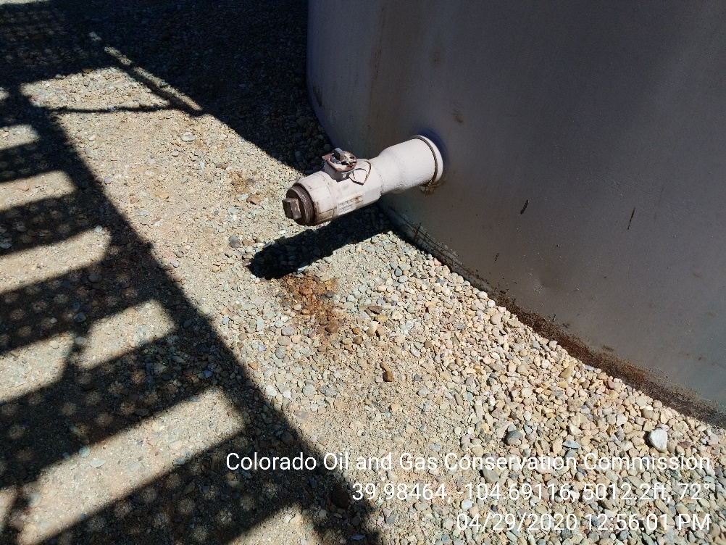
Inspection Photos
Location Name: KALLSEN #5
Location ID 322024
Photo 3 – Location photo
Photo 4 – Minor soil staining observed at base of tank

Slide 3
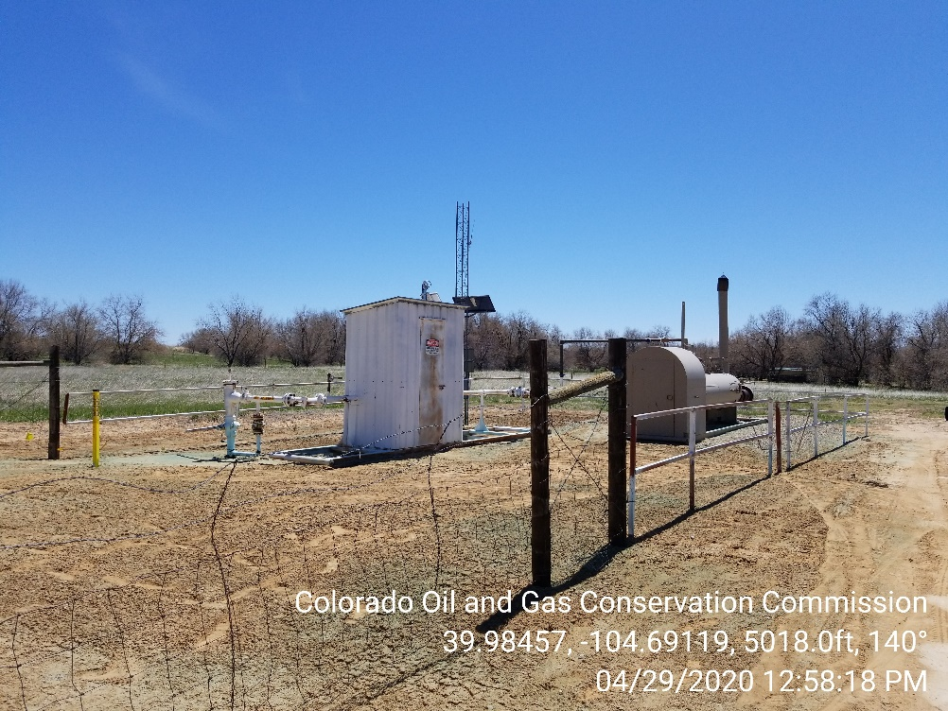
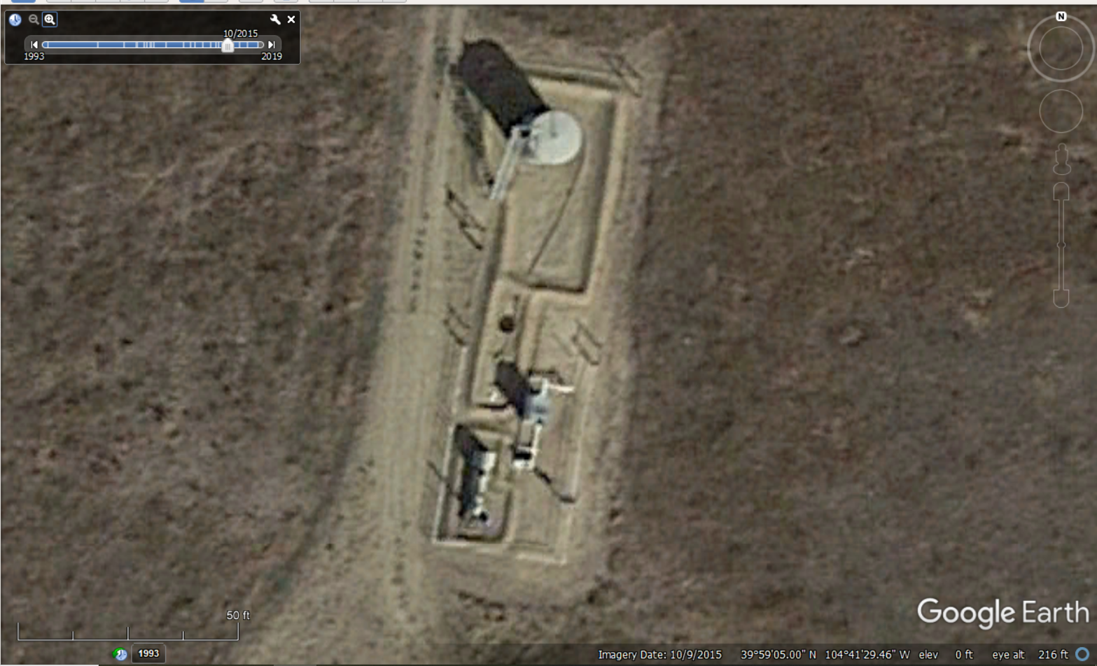
Inspection Photos
Location Name: RAINBOW #1
Location ID 320117; Spill ID 444861
Photo 5 – Spill ID 444861 (2/18/2016) is still open in the COGCC database at this location. Spill reports document historic impacts discovered area of a former concrete produced water vault.
Photo 6 – 2015 Google Earth Imagery showing location of former produced water vault

