Slide 1
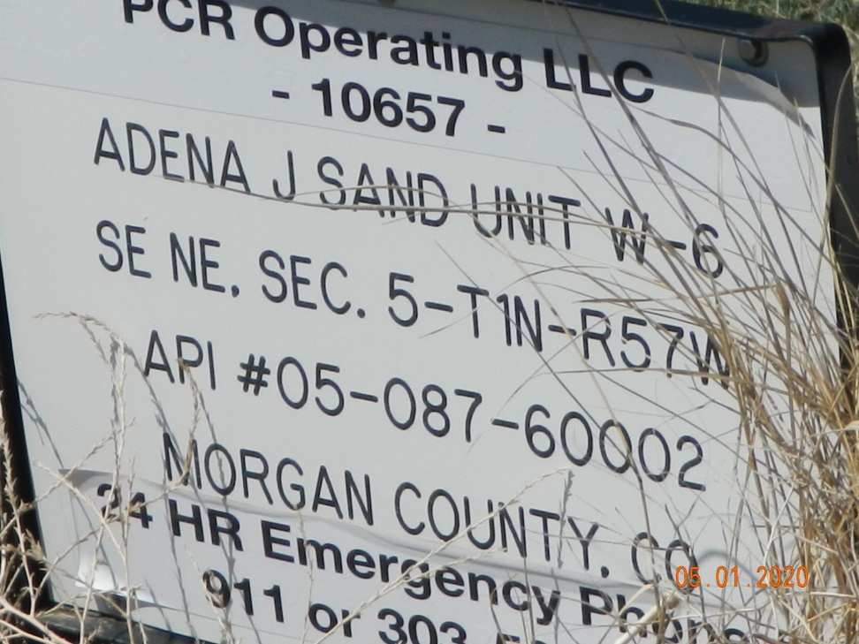
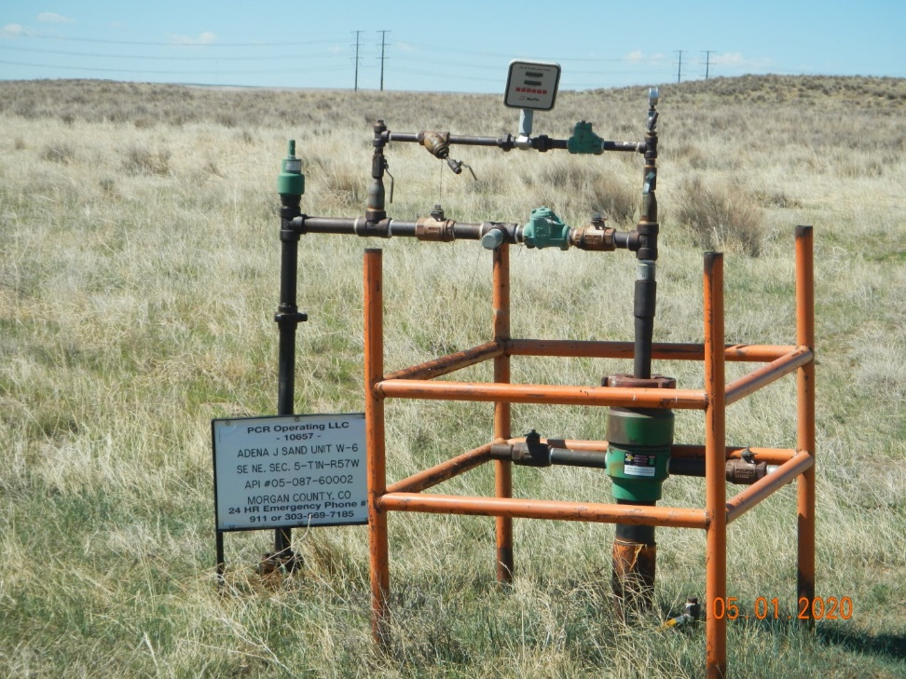
Operator Name: PCR
Facility Name: AJSU-W6
Location ID#087-60002
Signage @ wellhead
Wellhead & Cage

