Slide 1
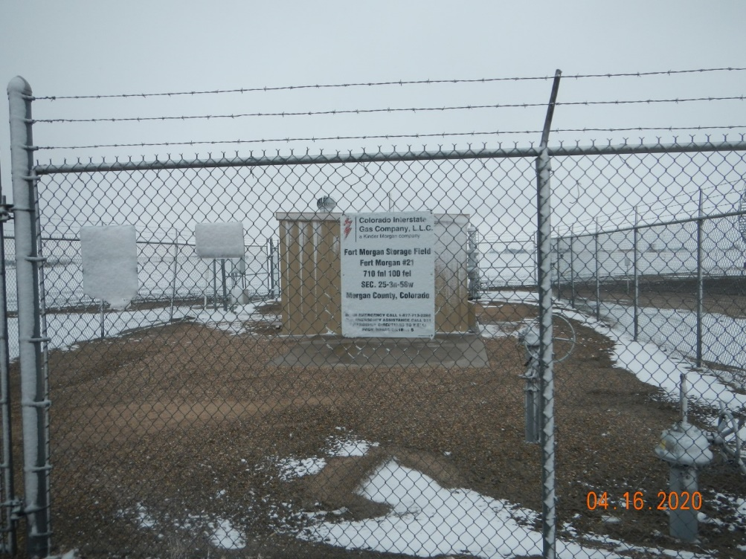
Operator Name: Kinder Morgan CIG
Facility Name: Fort Morgan Unit 21
Location ID# 087- 07167
Facility – Wellhead/Equipment

