Slide 1

Inspection Photos
API: 071-06565
Operator: EVERGREEN NATURAL RESOURCES
Inspection Date: 4/16/2020

Slide 2
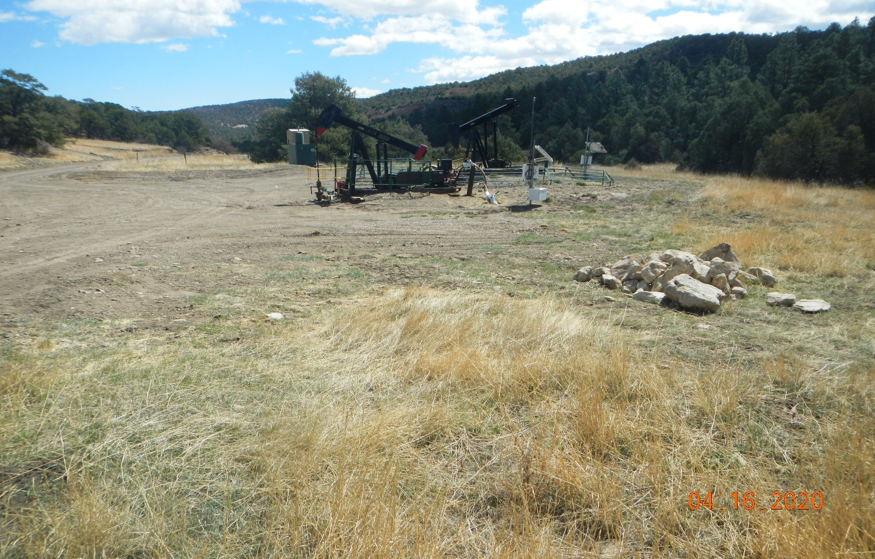
Inspection Photos
Photo 1. Facing southeast toward the location. A pile of rocks are stored on interim area and need to be removed.

Slide 3
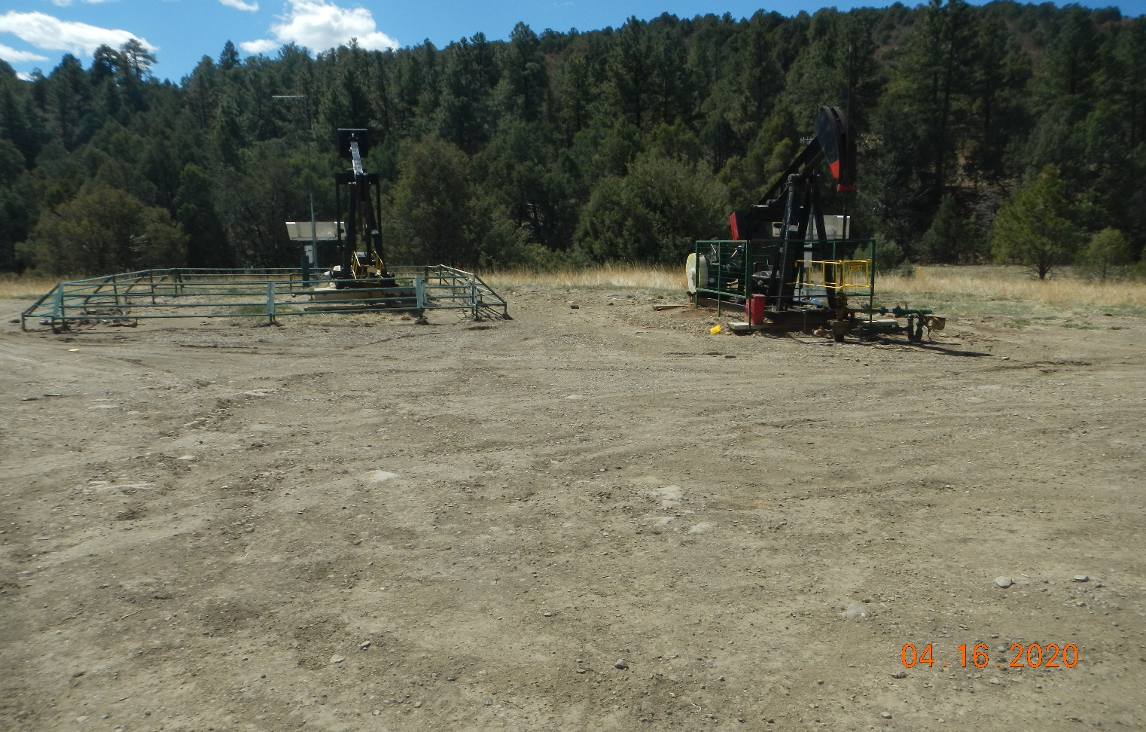
Inspection Photos
Photo 2. Facing toward the two wells at the location.

Slide 4
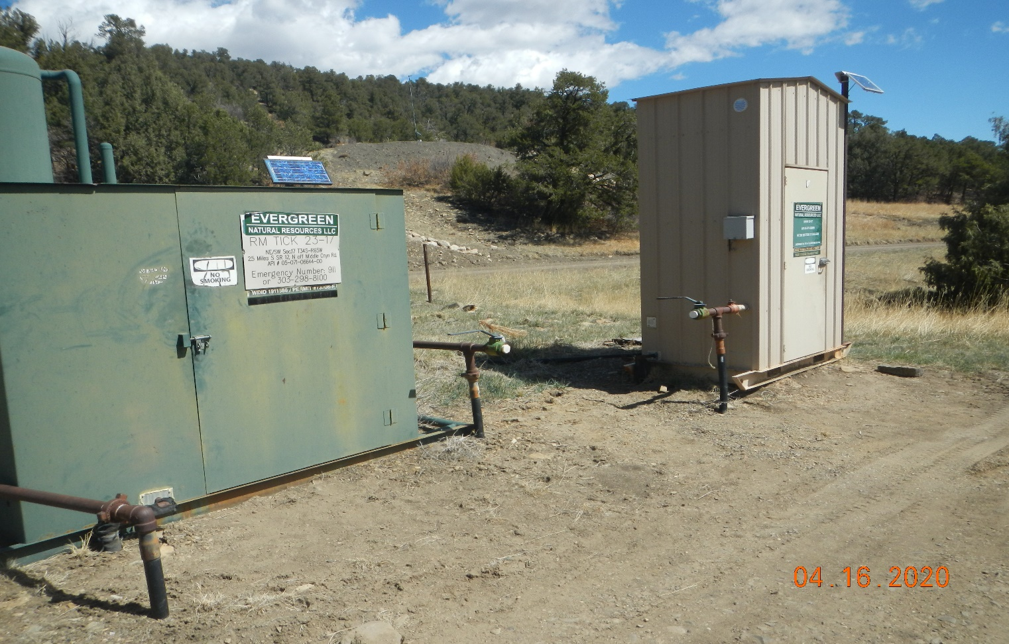
Inspection Photos
Photo 3. Well signs are posted at meter shed. Arrow points to pit shown in following photos.

Slide 5
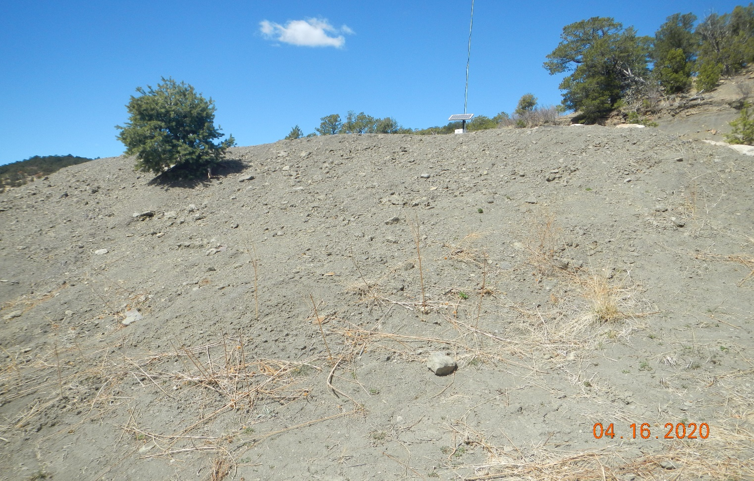
Inspection Photos
Photo 4. Facing toward the slope of the pit. The soils are not stabilized and need to be seeded.

Slide 6
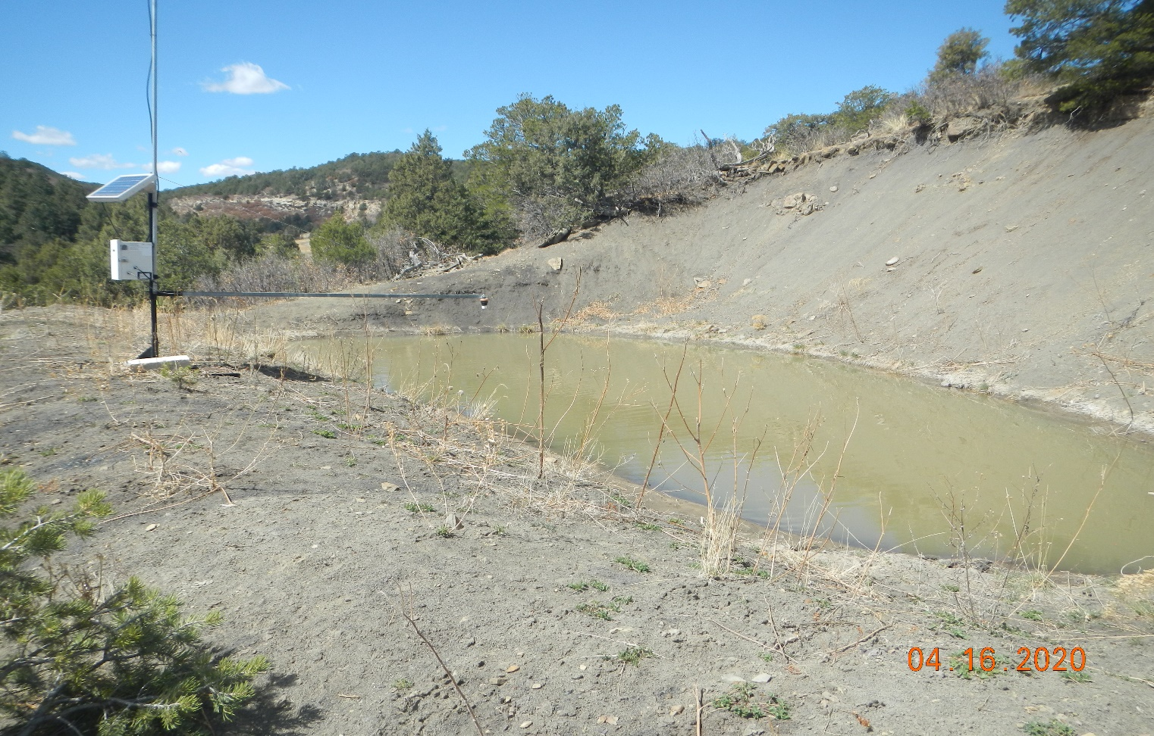
Inspection Photos
Photo 5. Facing toward the pit. There is no information found in database.

Slide 7
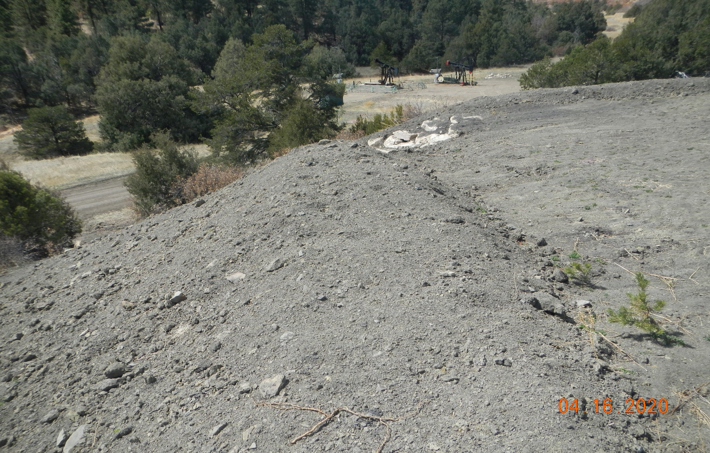
Inspection Photos
Photo 6. It appears recent work was performed at this pit area. The slope of the pit needs to be stabilized and reclaimed.

