Slide 1
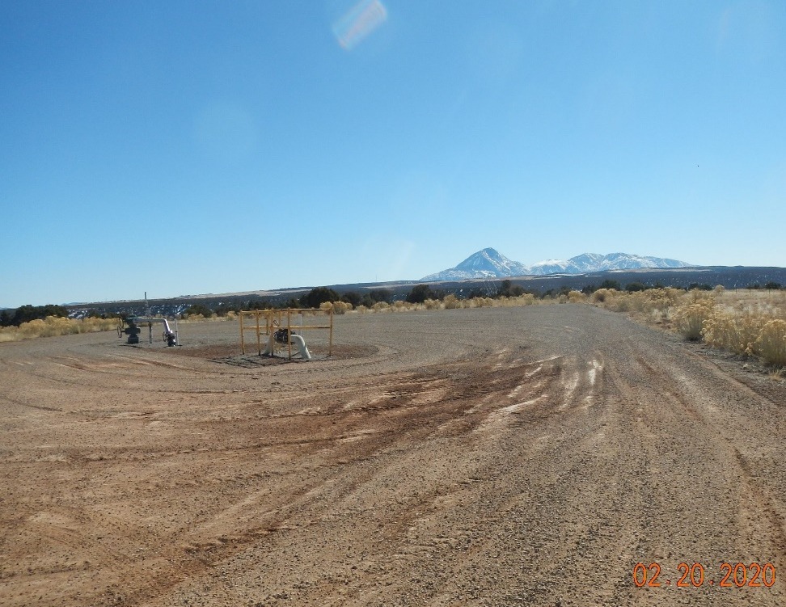
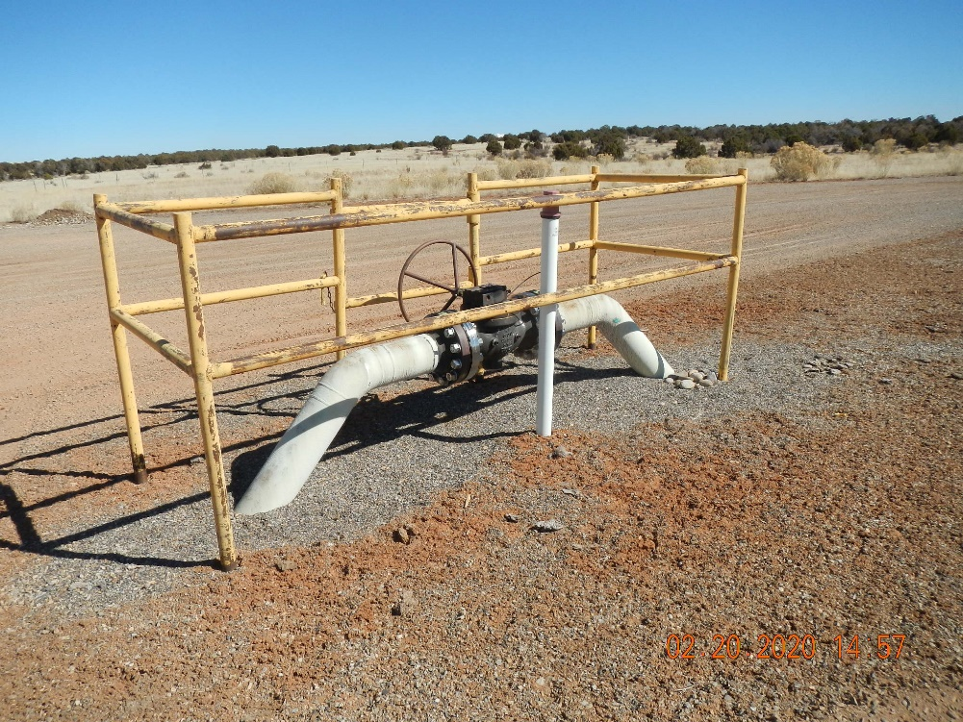
Inspection Photos
Location Name: YB-5
API: 05-083-06627
YB-5 location photo.
Valve set with barricade fencing.

Slide 2
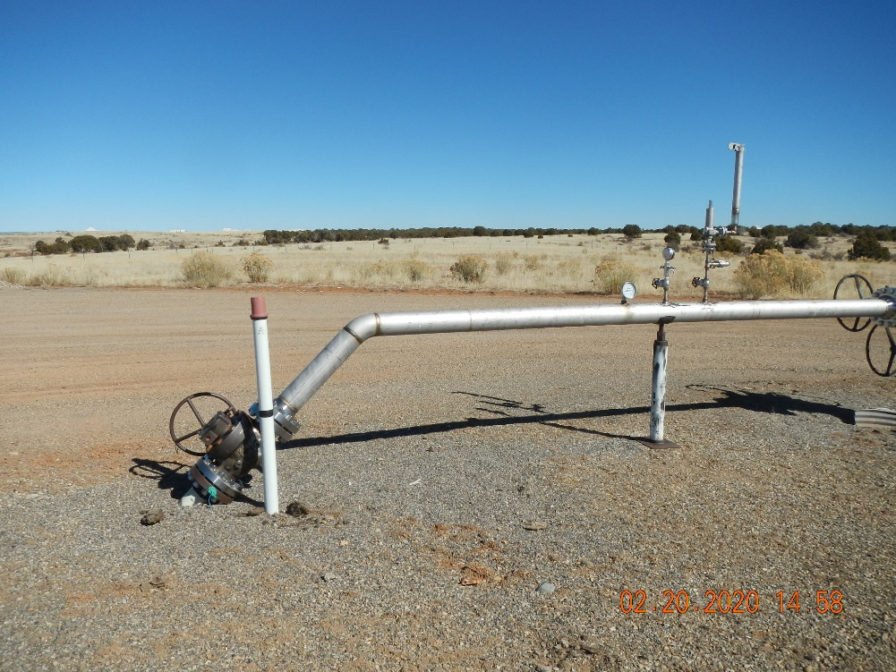
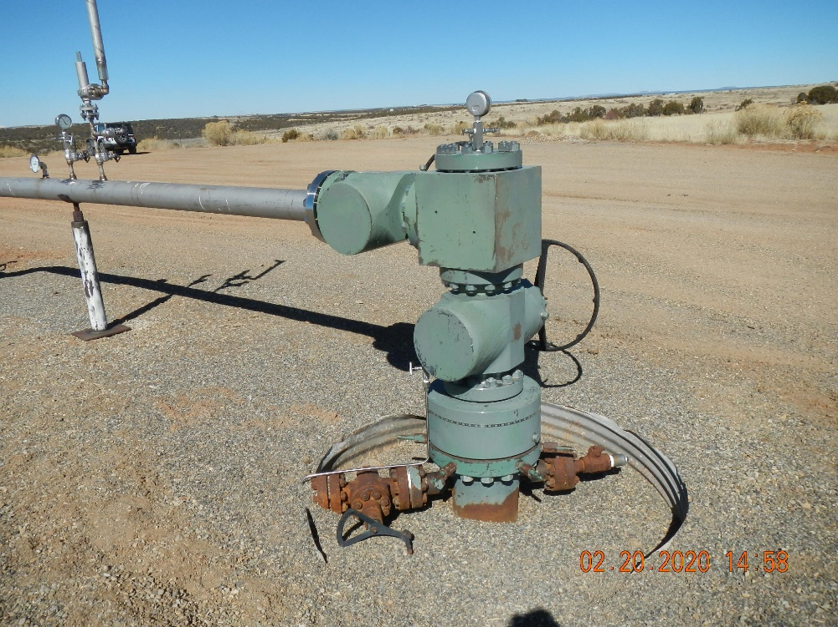
Inspection Photos
Location Name: YB-5
API: 05-083-06627
Flow line coming off of YB-5 well head.
YB-5 well head.

