Slide 1
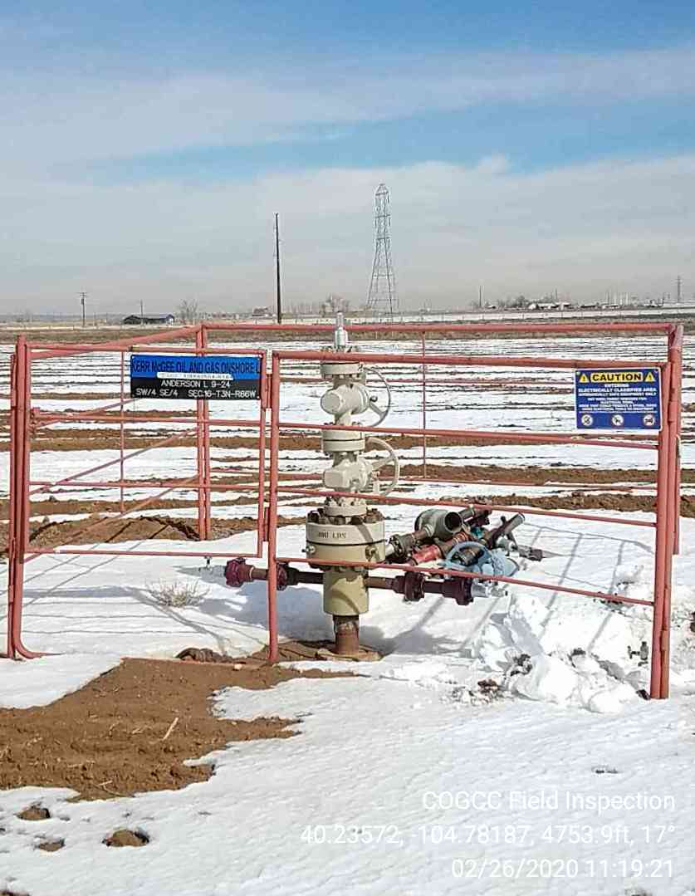
Inspection Photo
Location ID, Name: 302702, ANDERSON L-63N66W9SWSE
Photo 1 05-123-29660
ANDERSON L
09-24

