Slide 1
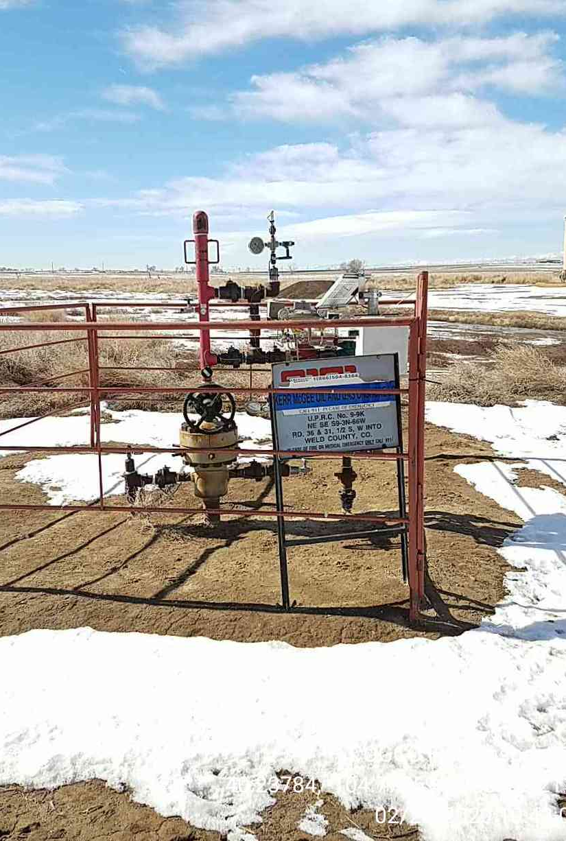
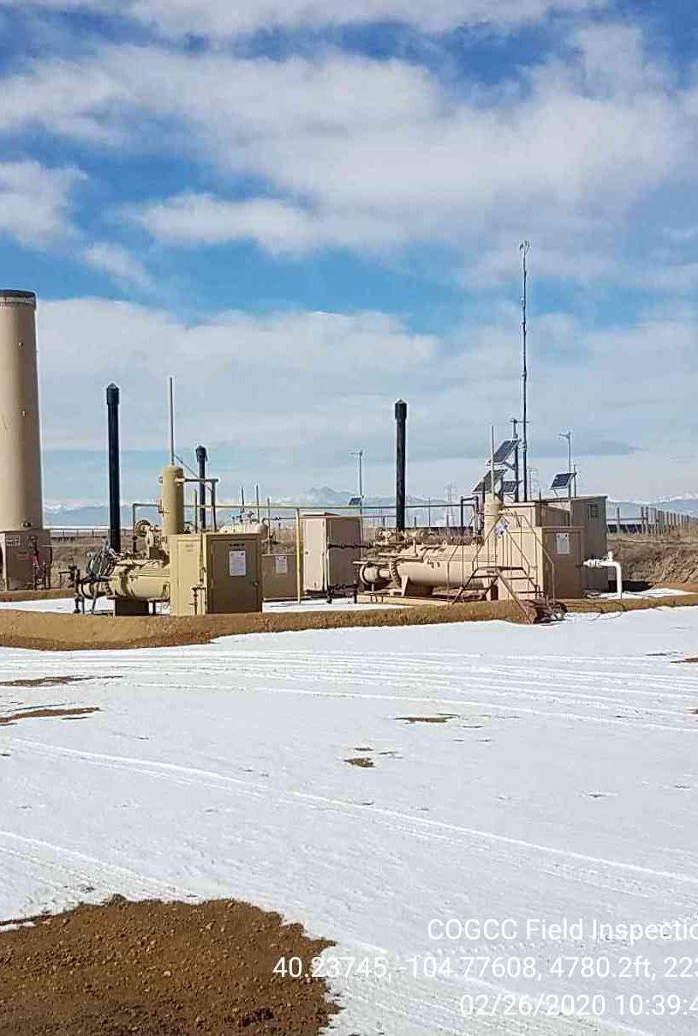
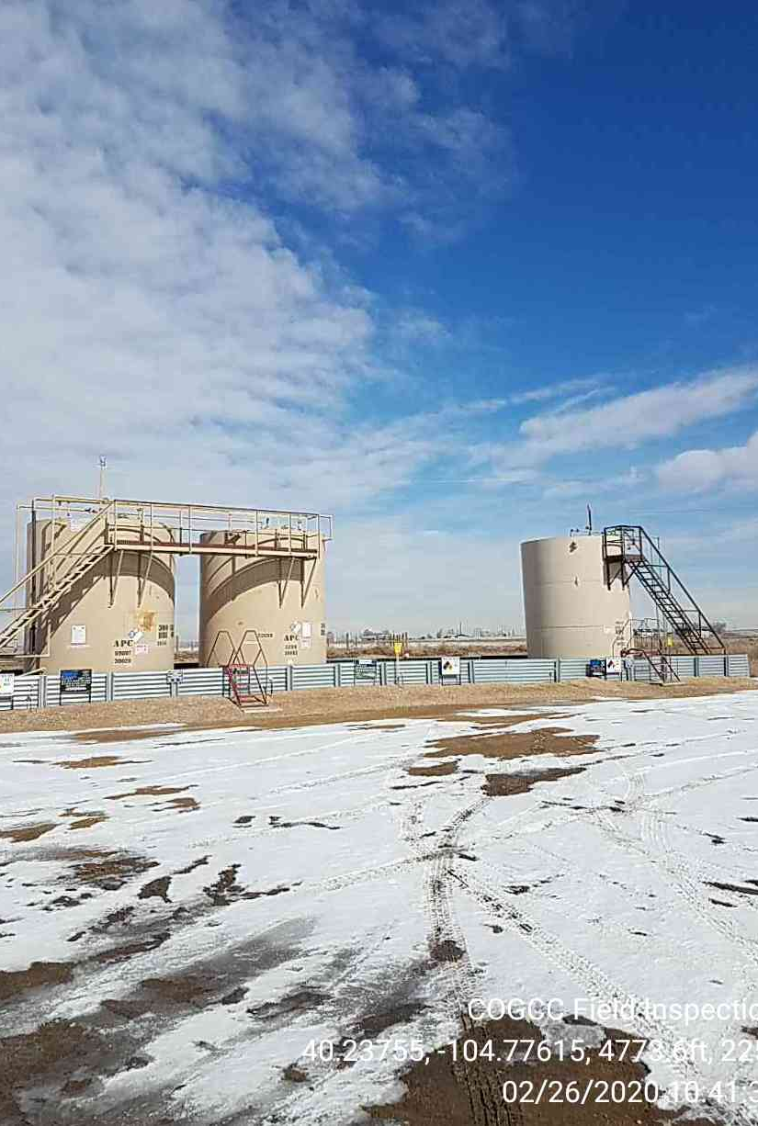
Inspection Photos
Location ID, Name: 336580
UPRC-63N66W 9NESE
Photo 105-123-16382
UPRC, 9-9K
Photo 2 Production Equipment
Photo 3 Battery

